Slide 1
Year 1 Maths
Week 1
20/4/20

Slide 2


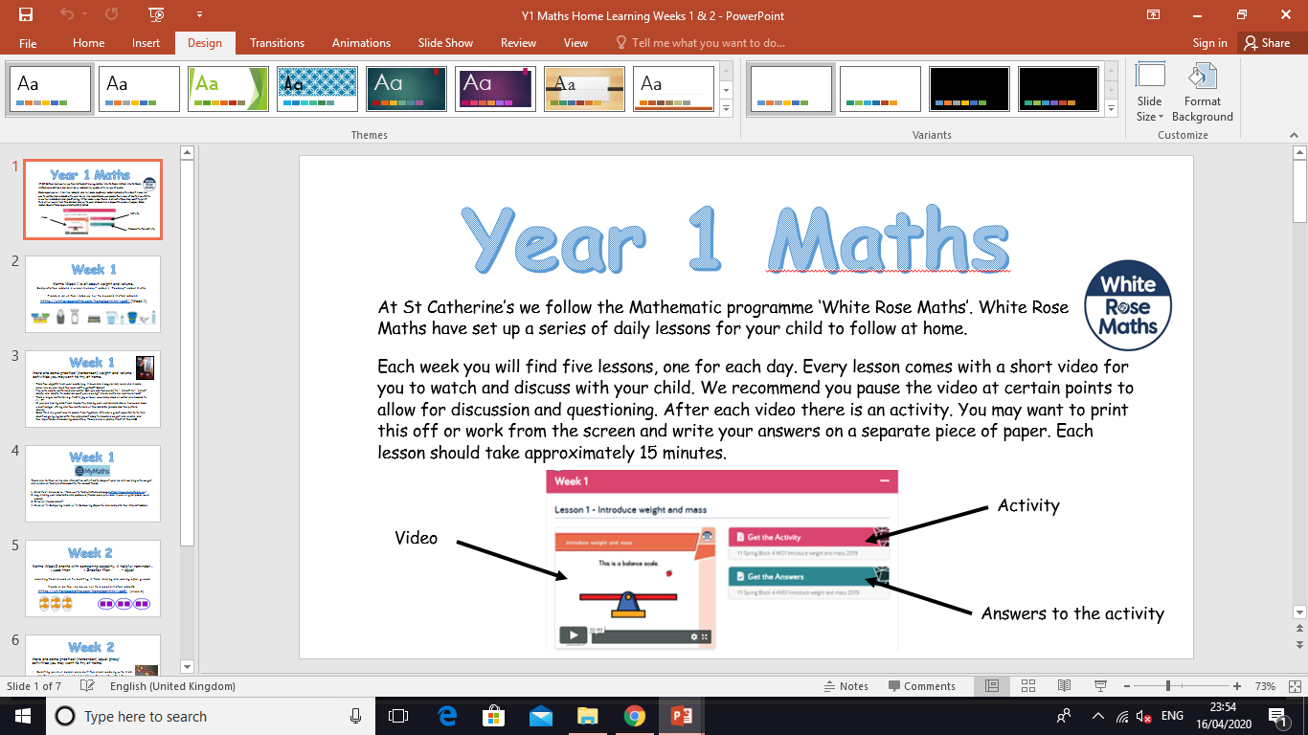
Information for Parents and Carers.
At St Catherine’s we follow the Mathematic programme ‘White Rose Maths’. White Rose Maths have set up a series of daily lessons for your child to follow at home.
Each week you will find five lessons, one for each day. Every lesson comes with a short video for you to watch and discuss with your child. We recommend you pause the video at certain points to allow for discussion and questioning. After each video there is an activity for your child to complete with your support. You may want to print this off or work from the screen and write your answers on a separate piece of paper. Each lesson should take approximately 20 minutes.
Look out for our ‘Helpful Tips’ on each slide. We have added a little more information about how you can support your child at home with each lesson. ☺

Slide 3
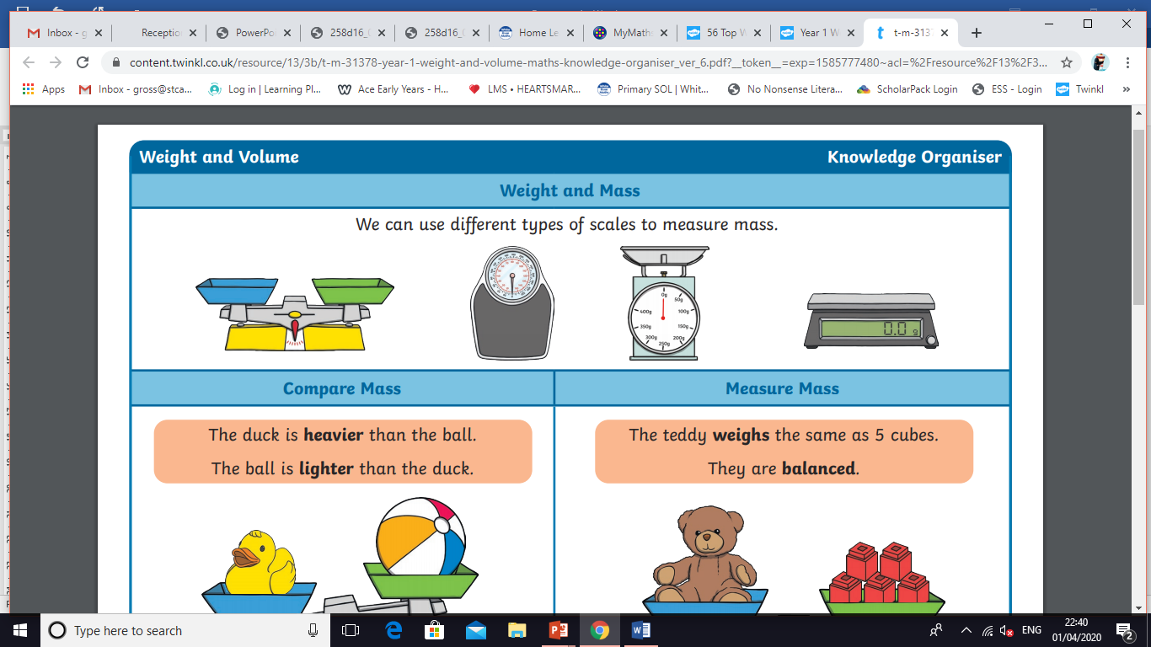
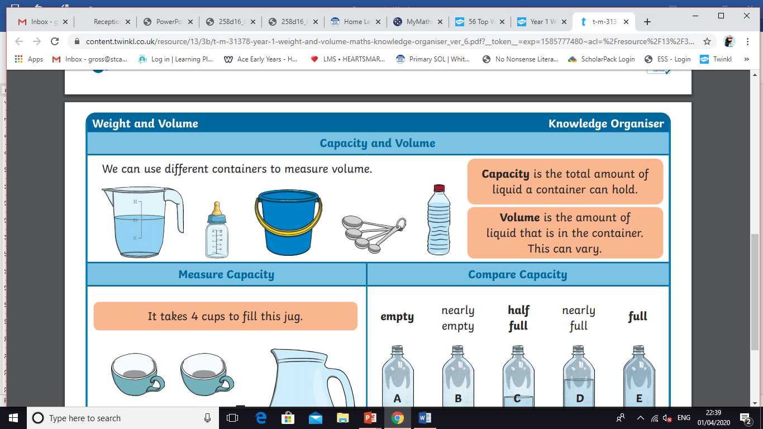

Week 1
Hello Year 1!
This week we are learning about weight and volume.
This PowerPoint includes five Maths sessions for you to complete this week.

Slide 4
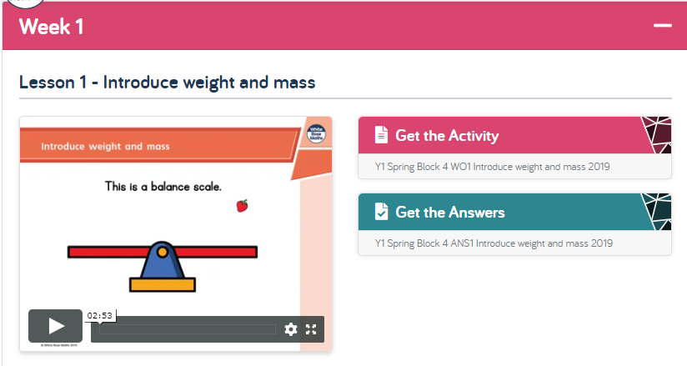
Lesson 1 – Introduce weight and mass.
1 . Watch the video clip with your adult.
Adults - Please pause the video to answer the questions and discuss the pictures ☺
2. Complete the activity with your adult.
Adults – Please read through the questions with your child. They are not expected to do this on their own ☺
3. Check your answers by clicking on ‘Get the Answers’.
Click this link to get started:
https://whiterosemaths.com/homelearning/year-1/

Slide 5
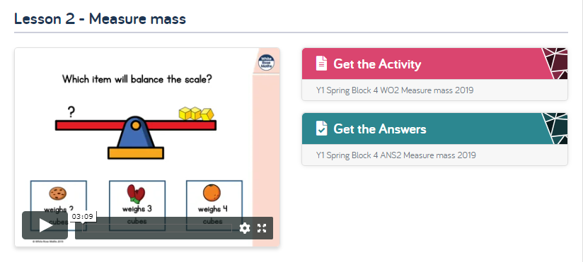
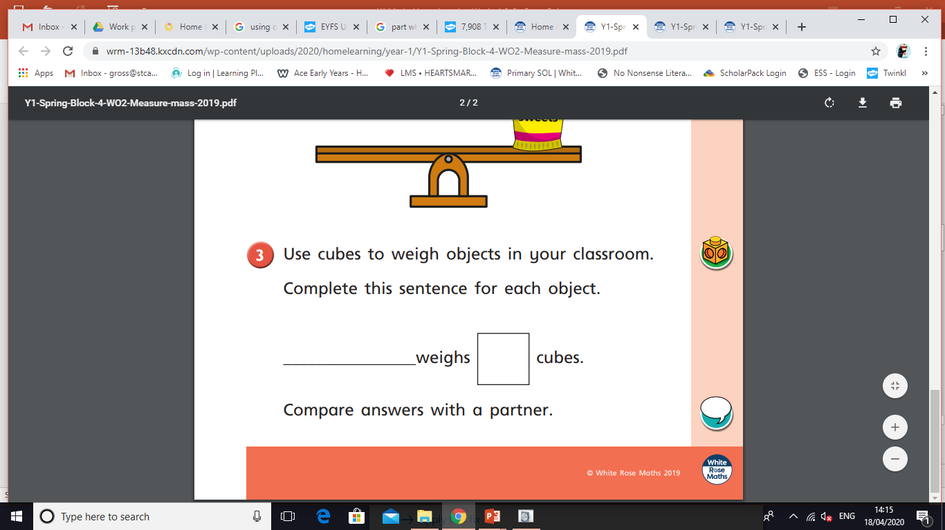
Lesson 2 - Measure mass.
Follow the same instructions as yesterday, but with lesson 2.
Click this link to get started:
https://whiterosemaths.com/homelearning/year-1/
This part of the activity will not be possible to complete at home.
Instead find two objects in your house that may weigh the same. Hold them in each hand. Do they feel equal in weight?

Slide 6
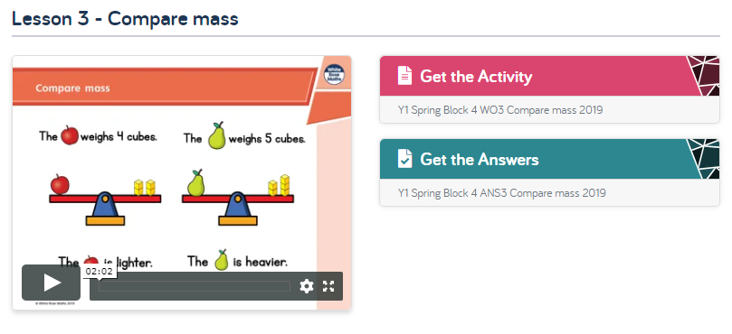
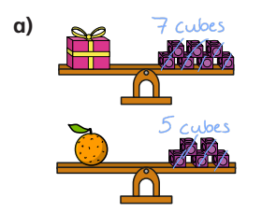
Lesson 3 – Compare mass.
Follow the same instructions, but with lesson 3.
Click this link to get started:
https://whiterosemaths.com/homelearning/year-1/
When deciding if an object is heavier or lighter. Ask your child to count the cubes and record the number above, like this

Slide 7
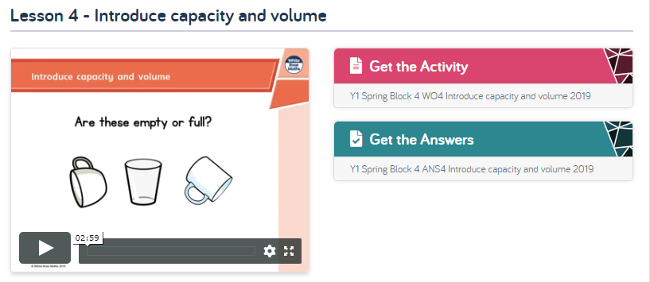
Lesson 4 – Introduce capacity and volume.
Follow the same instructions, but with lesson 4.
Click this link to get started:
https://whiterosemaths.com/homelearning/year-1/
There is a lot of new vocabulary in this lesson such as:
almost liquid
Model using these words during your day to day activities
e.g. My cup is almost empty.
e.g. When pouring your milk onto your cereal point out that
milk is a liquid.

Slide 8
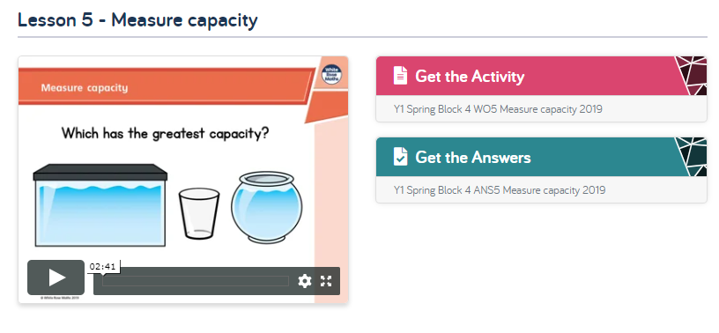
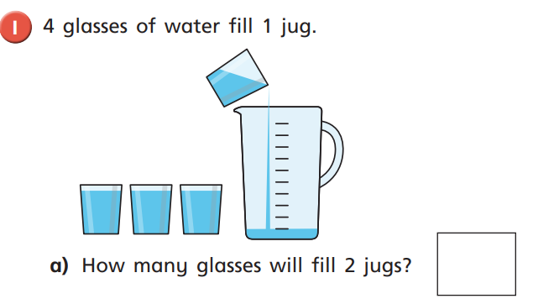
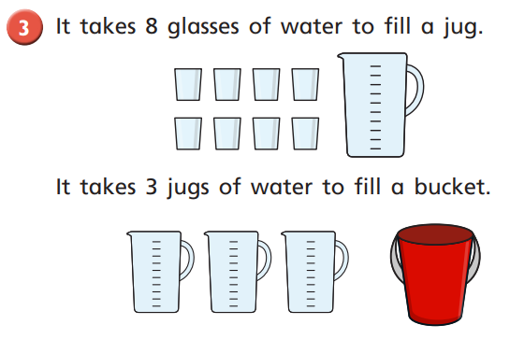
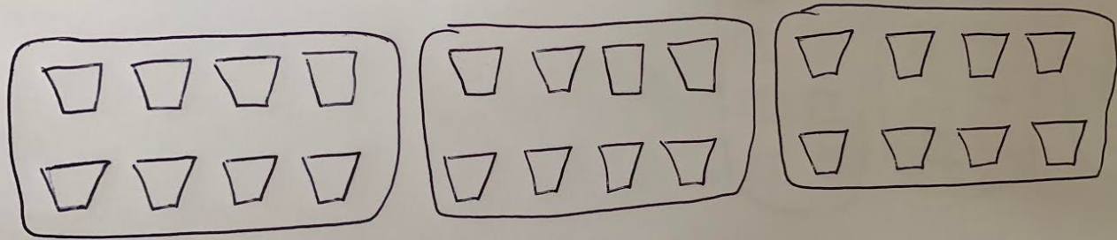
Lesson 5 – Measure capacity.
Follow the same instructions, but with lesson 5.
Click this link to get started:
https://whiterosemaths.com/homelearning/year-1/
When solving the addition problems, encourage your child to record the number sentence next to the picture like this.
4 + 4 =
This last question is a challenge! Guide your child through the problem and record the number sentence 8 + 8 + 8 =
To solve the problem ask your child to draw a picture to represent what it is asking.
Or you could use objects (e.g Lego bricks) to represent the problem.

Slide 9
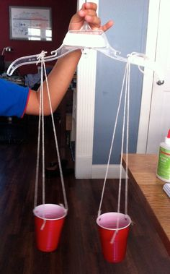
Week 1
Here are some practical (non-screen) weight and volume activities you may want to try at home.
Play with water and empty containers. Can you use the words ‘full’, ‘almost full’, ‘almost empty’ and ‘empty’ to describe what you’re doing? Which container has more/less?
Try making your own balance scale. You would need a coat hanger, string and two containers of the same size (please see picture).
Bake! This is a great way to spend time together. It’s also a great opportunity to talk about weighing ingredients, the equipment used to measure weight and volume, and the importance of measuring accurately. There’s also a yummy treat at the end ☺
Take two objects from your house (e.g. A book and a Lego brick). Hold one in each hand. Which one feels the heaviest? Lightest?
Take a larger container e.g. plastic jug or bowl. How many cups of water are needed to fill it?

Slide 10
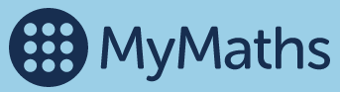
Week 1
There are further online and interactive activities to support your child’s learning with weight and volume on the MyMaths website. To access these:
Click this link which will take you to the MyMaths homepage https://www.mymaths.co.uk/
Log in using your username and password (these were provided in your original paper work packs).
Click on ‘Measurement’
Click on ‘Y1 Comparing Mass’ or ‘Y1 Comparing Capacity’ and complete the interactive lesson.

Slide 11
If you have had a go at some or all of the tasks…
Well done!
We are really proud of you.
Have a lovely weekend.

