Slide 1
Year 1 Maths
Week 2
27/4/20

Slide 2


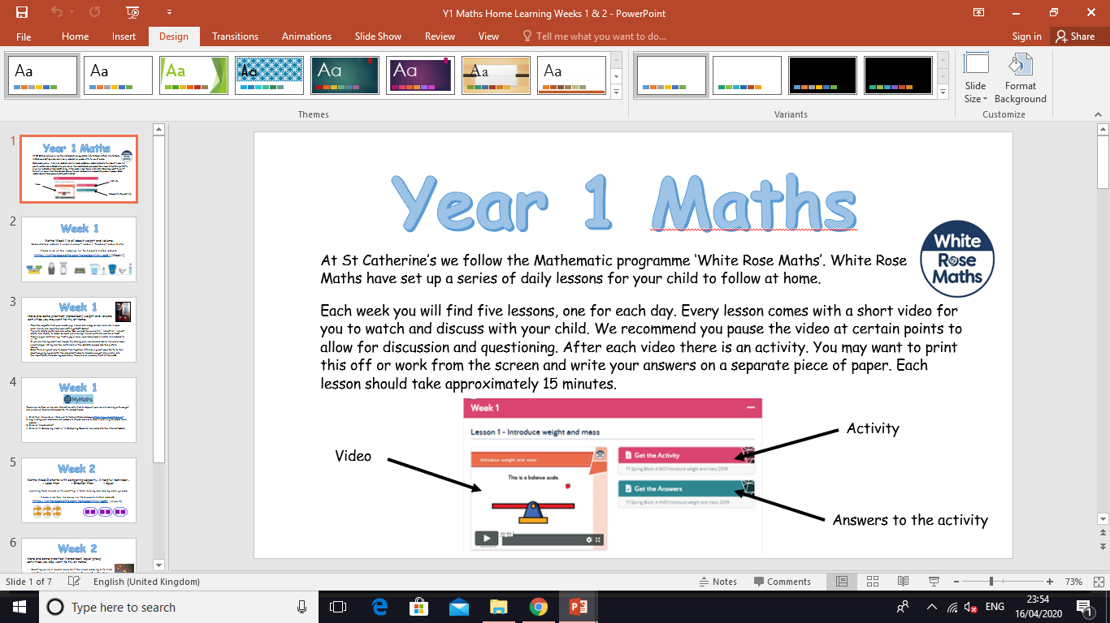
Information for Parents and Carers.
At St Catherine’s we follow the Mathematic programme ‘White Rose Maths’. White Rose Maths have set up a series of daily lessons for your child to follow at home.
Each week you will find five lessons, one for each day. Every lesson comes with a short video for you to watch and discuss with your child. We recommend you pause the video at certain points to allow for discussion and questioning. After each video there is an activity for your child to complete with your support. You may want to print this off or work from the screen and write your answers on a separate piece of paper. Each lesson should take approximately 20 minutes.
Look out for our ‘Helpful Tips’ on each slide. We have added a little more information about how you can support your child at home with each lesson. ☺

Slide 3
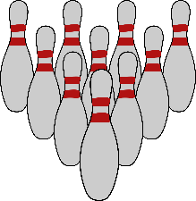
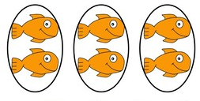

Week 2
Hello Year 1!
This week we will be:
Completing our work on capacity 2. Counting in tens
3. Making and adding equal groups
This PowerPoint includes five Maths sessions for you to complete this week.

Slide 4
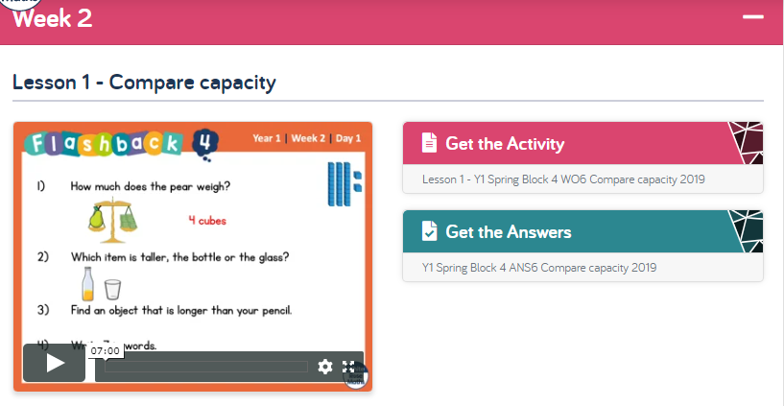
Lesson 1 – Compare capacity.
1 . Watch the video clip with your adult.
Adults - Please pause the video to answer the questions and discuss the pictures ☺
Each video clip now starts with four ‘Flash back’ questions.
These are designed to recap on previous learning.
2. Complete the activity with your adult.
Adults – Please read through the questions with your child. They are not expected to do this on their own ☺
3. Check your answers by clicking on ‘Get the Answers’.
Click this link to get started:
https://whiterosemaths.com/homelearning/year-1/

Slide 5
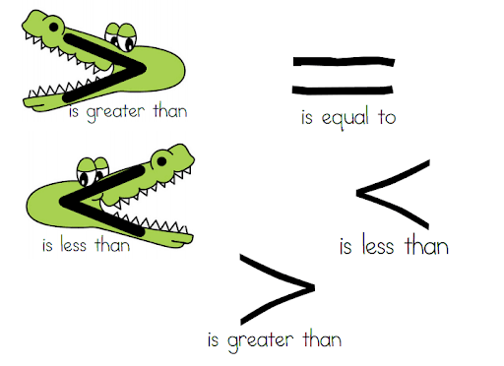
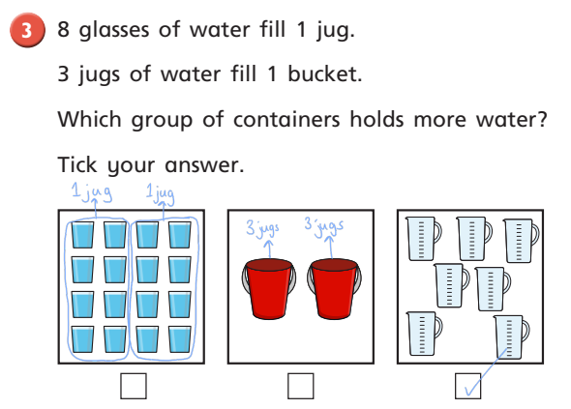
Lesson 1 – Compare capacity
One of the questions on the activity asks you to use these symbols. We have learnt about these in school. Here is a reminder of what they mean:
The last question on the activity is a real challenge!! We advise you only have a go at this if you feel your child is ready.
The idea here is to convert each image into jugs of water and then compare them to see which holds the most. This will need a lot of guidance. It would not be expected for your child to do this on their own ☺

Slide 6
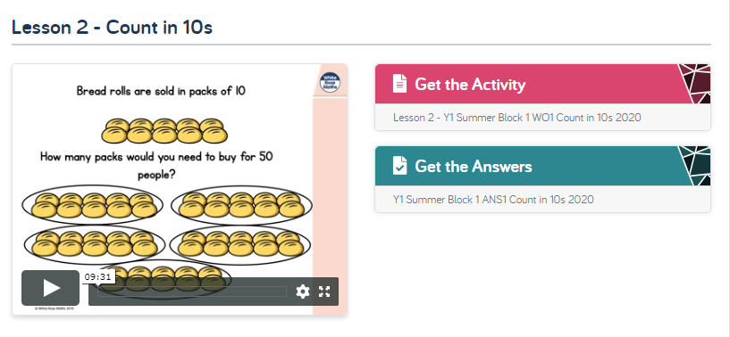
Lesson 2 – Count in 10s.
Follow the same instructions as yesterday, but with lesson 2.
Click this link to get started:
https://whiterosemaths.com/homelearning/year-1/
Number squares are a great resource for supporting counting in 10s. On the next slide you’ll find a large number square for you to practice counting forwards and backwards in 10s.

Slide 7
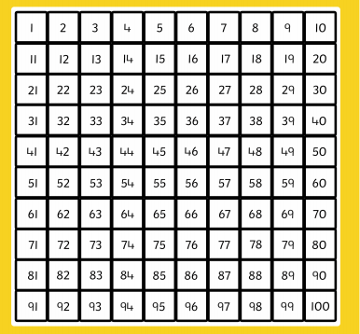

Slide 8
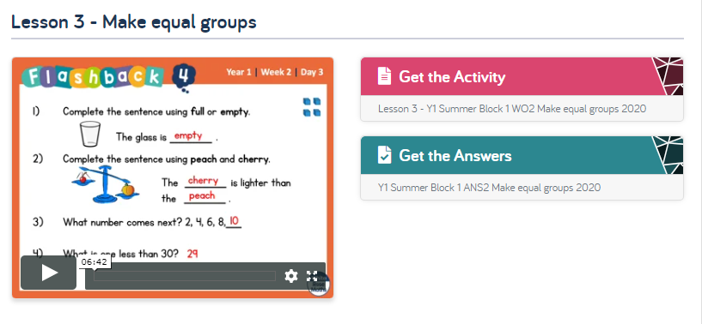
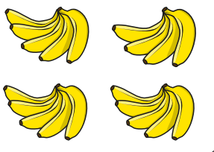
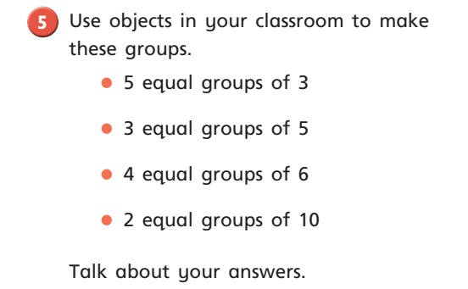
Lesson 3 – Make equal groups.
Follow the same instructions, but with lesson 3.
Click this link to get started:
https://whiterosemaths.com/homelearning/year-1/
When comparing groups encourage your child to record the number in each group, like this
5
4
5
5
The last question asks you to find objects to make equal groups. For this try and find something safe in your house to use. You could use raisins, Lego bricks or penny coins.

Slide 9
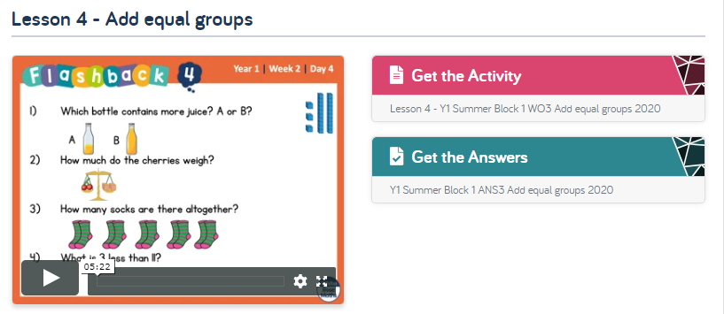
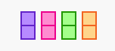
Lesson 4 – Add equal groups.
Follow the same instructions, but with lesson 4.
Click this link to get started:
https://whiterosemaths.com/homelearning/year-1/
This lesson looks at adding equal groups and builds towards repeated addition
e.g. 2+2+2+2 =
Most of the questions have a visual image to support your child’s thinking. Where an image is not provided, encourage you child to either draw their own pictures or use objects from around the house e.g. Lego blocks.
2 + 2 + 2 + 2 = 8

Slide 10
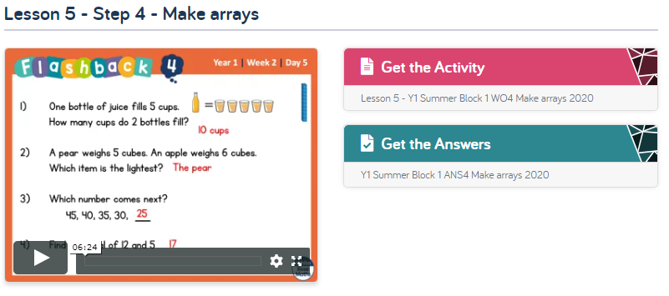
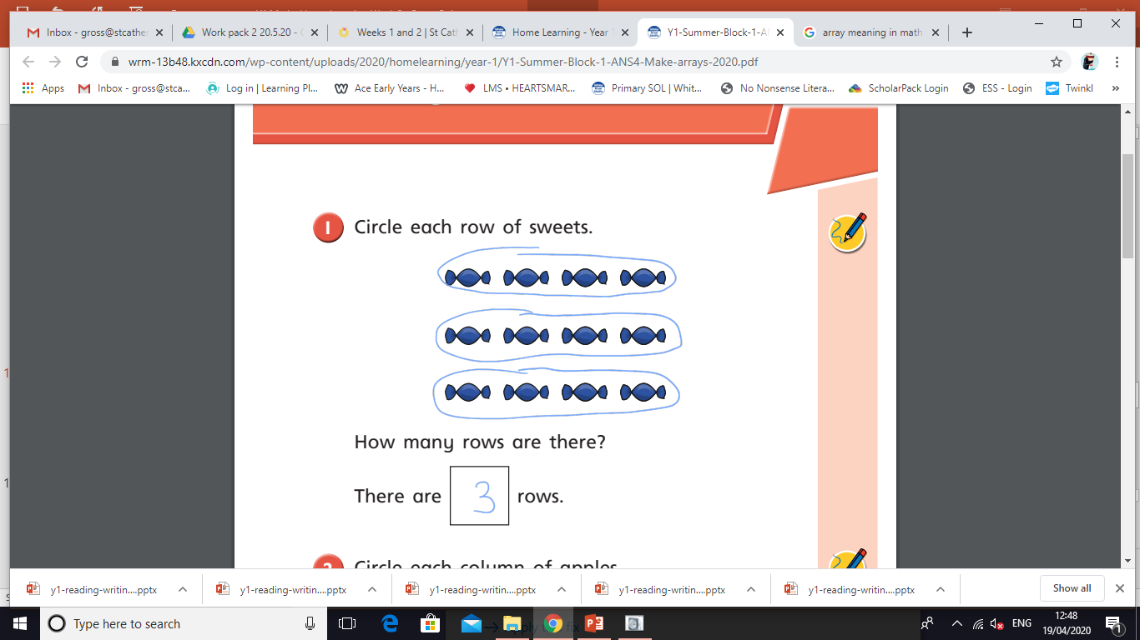
Lesson 5 – Make arrays.
Follow the same instructions, but with lesson 5.
Click this link to get started:
https://whiterosemaths.com/homelearning/year-1/
An array is an arrangement of objects, pictures or numbers in rows or columns. It is a useful way of displaying equal groups.
During the activity encourage your child to circle the rows and columns. This makes it more visual and easier to understand.

Slide 11
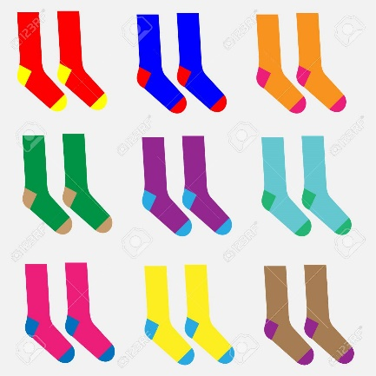
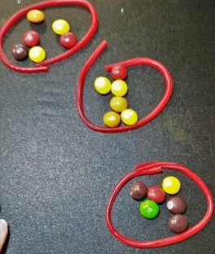
Week 2
Here are some practical (non-screen) ‘equal group’ activities you may want to try at home.
Counting pairs of socks. Help sort the clean washing with Mum and Dad. How many pairs of socks are there altogether? How many individual socks?
Use objects around your house (e.g. Lego) to make 2 equal groups of 10, 5 equal groups of 2, 3 equal groups of 5 etc…
Share out chocolates/sweets with family members. Can you make it fair by making sure everyone has an equal amount?

Slide 12
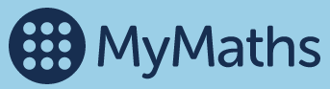
Week 2
There are further online and interactive activities to support your child’s learning with equal groups on the MyMaths website. To access these:
Click this link which will take you to the MyMaths homepage https://www.mymaths.co.uk/
Log in using your username and password (these were provided in your original paper work packs).
Click on ‘Number’
Click on ‘Multiplication and division’
Click on ‘Y1 Multiplication introduction’ and complete the interactive lesson.

Slide 13
If you have had a go at some or all of the tasks…
Well done!
We are really proud of you.
Have a lovely weekend.

