Slide 1

Year 1 Maths
Week 6 & 7
1/6/20 and 8/6/20

Slide 2
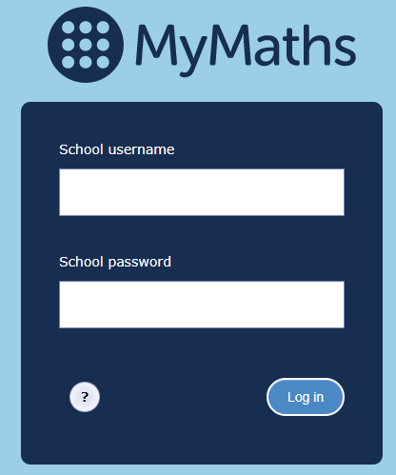
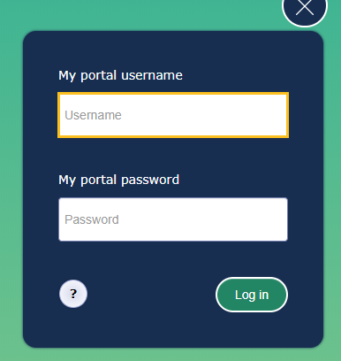
For the next 2 weeks we are going to be learning about position, direction and movement.
Each day go to the MyMaths website https://login.mymaths.co.uk/login and log in with the school’s username and password.
You then need to login with your own personal details which were sent to you in the first home learning pack. If you have lost yours, please contact the school office.

Slide 3
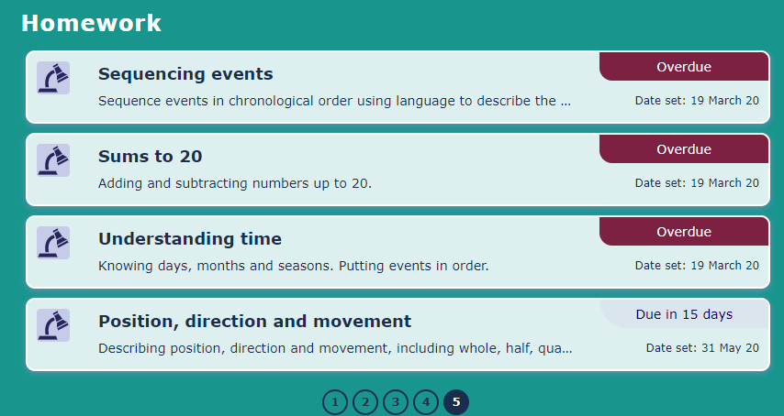
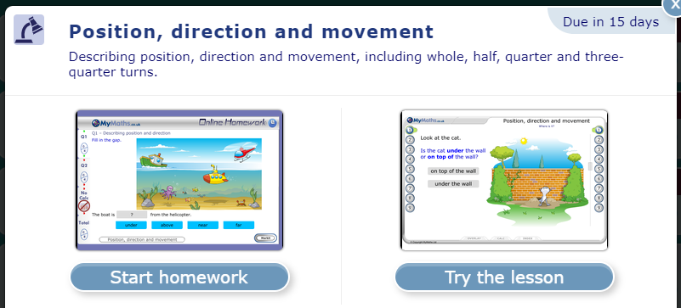
Once you have logged in click on ‘Position, direction and movement’.
Please note you will find this lesson on page 5.
Page 5
Then click on ‘Try the lesson’.
Please follow the instructions on this Powerpoint presentation to see which parts of the lesson you need to complete each day ☺
There are some practical (non-screen) activities suggested at the end of the PowerPoint too. ☺

Slide 4
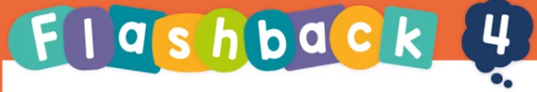
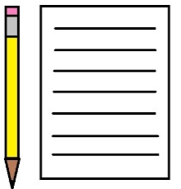
Each day we have set four flashback questions for you to complete. These four questions are based on what we have already learnt.
Complete the flashback questions before starting your MyMaths lesson.
You will need a piece of paper to jot down your answers.
The answers to each set of questions are on the following slide.

Slide 5
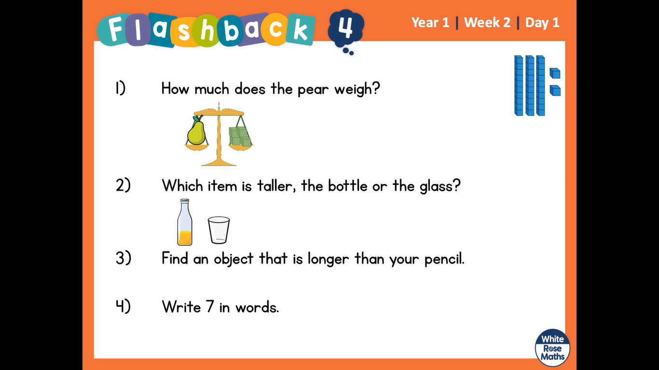
Monday
Here are 4 questions based on what we have already learnt.
Write numbers 1 – 4 on a piece of paper and have a go at working out the answers.
1. What is 5 + 4?
2. How much does the pear weigh?
3. Which item is taller, the bottle or the glass?
4. Write the number 1 as a word.

Slide 6
Monday
Answers. Mark your own work ☺
1. What is 5 + 4? 9
2. How much does the pear weigh?
4 cubes
3. Which item is taller, the bottle or the glass?
The bottle is taller
4. Write the number 1 as a word. one

Slide 7
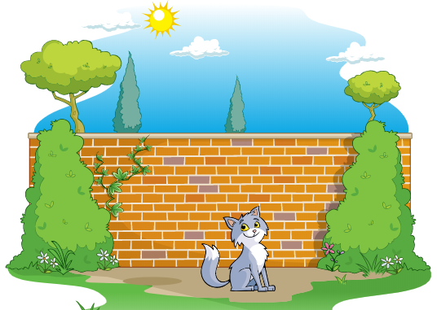
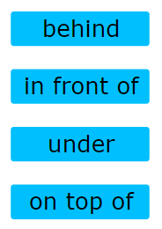
Monday
Today we are going to complete section 1: Where is it?
We are going to be learning some new vocabulary to describe the position of objects.

Slide 8
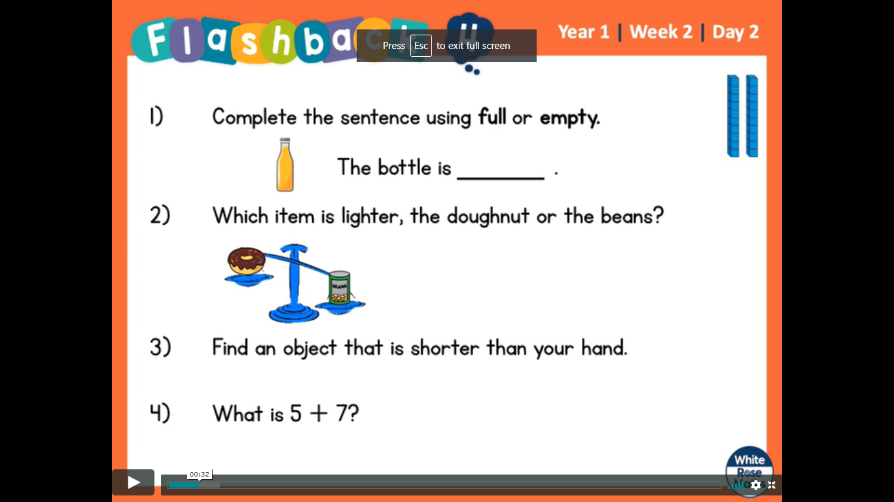
Tuesday
Here are 4 questions based on what we have already learnt.
Write numbers 1 – 4 on a piece of paper and have a go at working out the answers.
1. What number is being represented by the dienes?
2. Which item is lighter, the doughnut or the
beans?
3. What is double 3?
4. Write the number 2 as a word.

Slide 9
Tuesday
Answers. Mark your own work ☺
What number is being represented by the dienes?
20
2. Which item is lighter, the doughnut or the beans?
The doughnut.
3. What is double 3? 6 (3 + 3)
4. Write the number 2 as a word. two

Slide 10
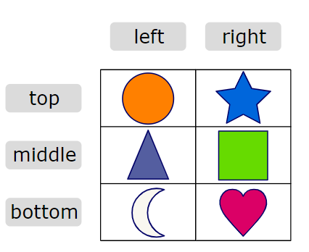

Tuesday
Today we are going to complete section 2: Where is the shape?
We are going to be learning some more new vocabulary to describe the position of objects.
Playing board games are also a great way of practising left and right!

Slide 11
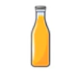
Wednesday
Here are 4 questions based on what we have already learnt.
Write numbers 1 – 4 on a piece of paper and have a go at working out the answers.
1. What is one less than 20?
2. Complete the sentence.
The bottle is _____.
3. What number comes next?
0, 2, 4, 6, 8, ____
4. Write the number 3 as a word.

Slide 12
Wednesday
Answers. Mark your own work ☺
1. What is one less than 20? 19
2. Complete the sentence.
The bottle is full .
3. What number comes next?
0, 2, 4, 6, 8, __10__
4. Write the number 3 as a word. three

Slide 13
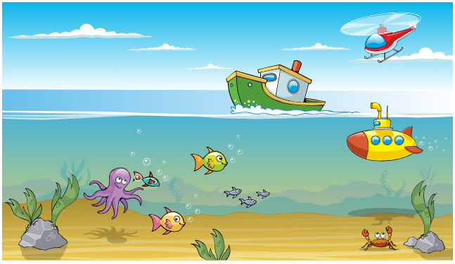
Wednesday
Today we are going to complete section 3: Describing position
We are going to be learning some more new vocabulary to describe the position of objects.
above
below
near
far

Slide 14
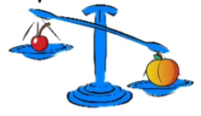
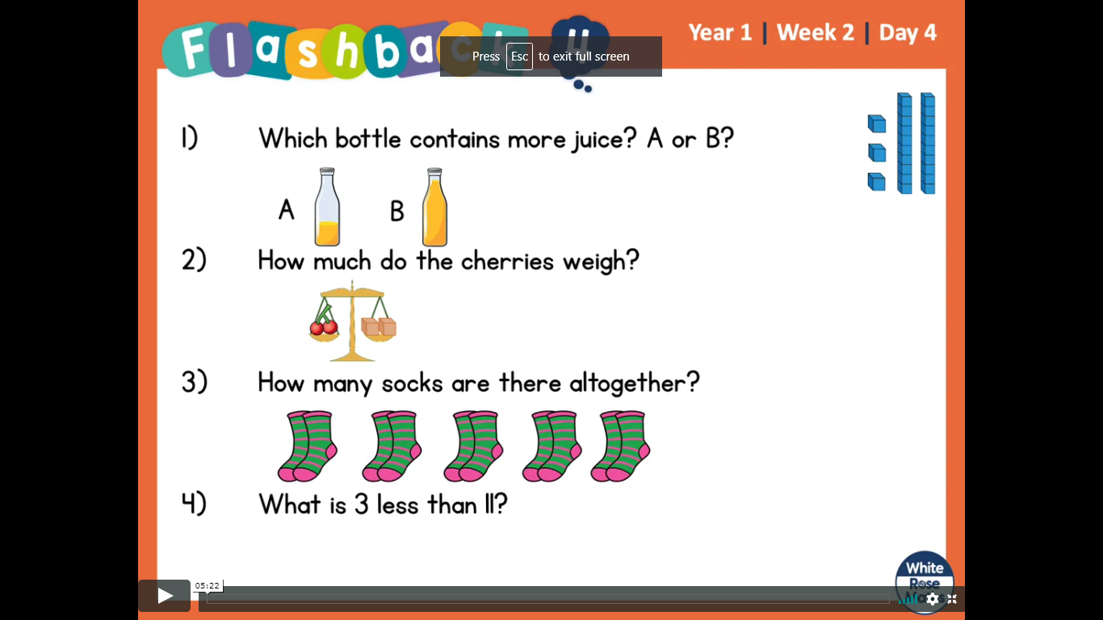
Thursday
Here are 4 questions based on what we have already learnt.
Write numbers 1 – 4 on a piece of paper and have a go at working out the answers.
Complete the sentence.
The _______ is lighter than the _______.
2. How many socks are there altogether?
3. What is 3 less than 12?
4. Write the number 4 as a word.

Slide 15
Thursday
Answers. Mark your own work ☺
Complete the sentence.
The cherry is lighter than the peach .
2. How many socks are there altogether?
8
3. What is 3 less than 12? 9
4. Write the number 4 as a word. four

Slide 16
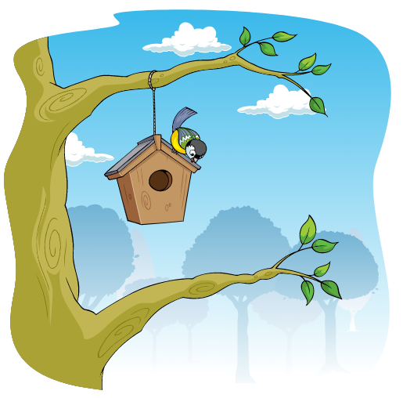
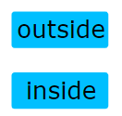
Thursday
Today we are going to complete section 4: Inside and outside
We are going to be learning some more new vocabulary to describe the position of objects.

Slide 17

Friday
Here are 4 questions based on what we have already learnt.
Write numbers 1 – 4 on a piece of paper and have a go at working out the answers.
Which bottle contains less juice? A or B?
2. Which number is being represented?
3. What is 7 plus 3?
4. Write the number 5 as a word.

Slide 18
Friday
Answers. Mark your own work ☺
Which bottle contains less juice? A or B?
2. Which number is being represented? 23
3. What is 7 plus 3? 10
4. Write the number 5 as a word. five

Slide 19
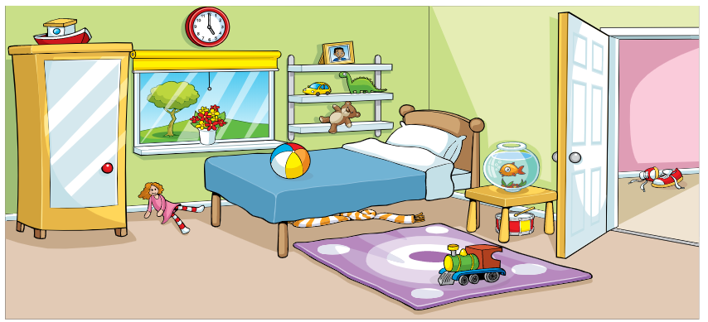
Friday
Today we are going to complete section 5: Position of objects (game)
Today’s session is a game for you to play which will help you to practise and recap all of the new words we have learnt about this week!
If you prefer an off-screen activity, you could play this game in one of the rooms in your house. Ask your child questions using the vocabulary covered this week. E.g. What is under the bed? Is the teddy to the left or the right of the cushion? They could ask you questions too!

Slide 20
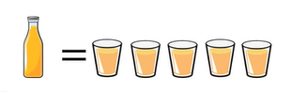
Monday
Here are 4 questions based on what we have already learnt.
Write numbers 1 – 4 on a piece of paper and have a go at working out the answers.
If one bottle of juice fills 5 cups.
How many cups do 2 bottles fill?
2. Which number comes next?
20, 30, 40, ____
3. What is the total of 12 and 5?
4. Write the number 6 as a word.

Slide 21
Monday
Answers. Mark your own work ☺
If one bottle of juice fills 5 cups.
How many cups do 2 bottles fill? 10 cups.
2. Which number comes next?
20, 30, 40, 50
3. What is the total of 12 and 5? 17 (12 + 5)
4. Write the number 6 as a word. six

Slide 22
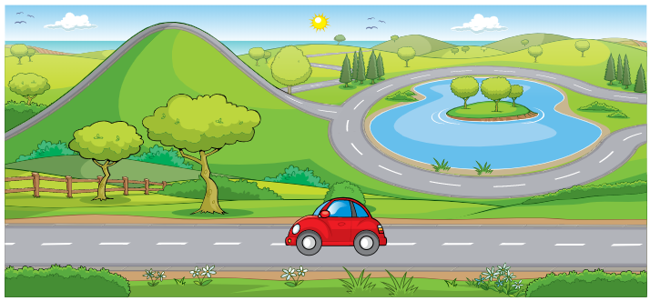
Monday
Today we are going to complete section 6: Where am I going?
We are going to be learning some new vocabulary to describe the direction that objects are moving.
forwards
backwards
up
down
around

Slide 23
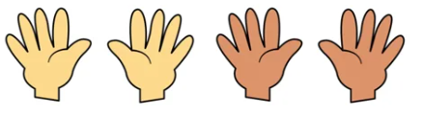
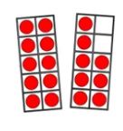
Tuesday
Here are 4 questions based on what we have already learnt.
Write numbers 1 – 4 on a piece of paper and have a go at working out the answers.
How many fingers?
2. What is ten take away four?
3. Which number is being represented?
4. Write the number 7 as a word.

Slide 24
Tuesday
Answers. Mark your own work ☺
How many fingers? 20
2. What is ten take away four? 6
3. Which number is being represented? 18
4. Write the number 7 as a word. seven

Slide 25
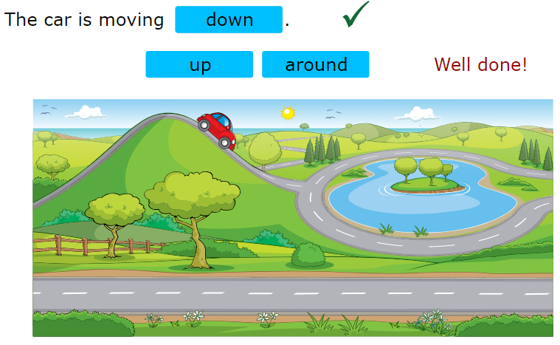

Tuesday
Today we are going to complete section 7: Describing directions (game)
Today’s session is a game for you to play which will help you to practise and recap the new direction words we learnt about yesterday!
You could use toy cars to play this game practically instead!

Slide 26
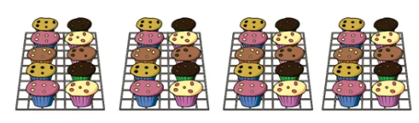
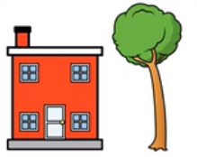
Wednesday
Here are 4 questions based on what we have already learnt.
Write numbers 1 – 4 on a piece of paper and have a go at working out the answers.
How many cupcakes?
2. The tree is __________ than the house.
(taller or shorter)
3. What is the total of 4 and 8?
4. Write the number 8 as a word.

Slide 27
Wednesday
Answers. Mark your own work ☺
How many cupcakes? 40
2. The tree is taller than the house.
(taller or shorter)
3. What is the total of 4 and 8? 12 (4 + 8)
4. Write the number 8 as a word. eight

Slide 28
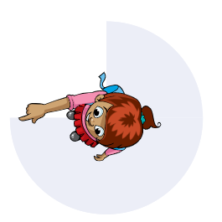



Wednesday
Today we are going to complete section 8: Clockwise and anticlockwise
We are going to be learning some more new vocabulary to describe turns.
clockwise
anticlockwise

Slide 29
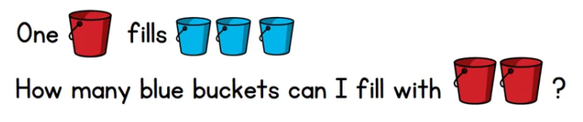
Thursday
Here are 4 questions based on what we have already learnt.
Write numbers 1 – 4 on a piece of paper and have a go at working out the answers.
2. What is 20 – 2 ?
3. Which number comes next?
20, 25, 30, 35, 40, _____
4. Write the number 9 as a word.

Slide 30
Thursday
Answers. Mark your own work ☺
6
2. What is 20 – 2 ? 18
3. Which number comes next?
20, 25, 30, 35, 40, 45
4. Write the number 9 as a word. nine

Slide 31
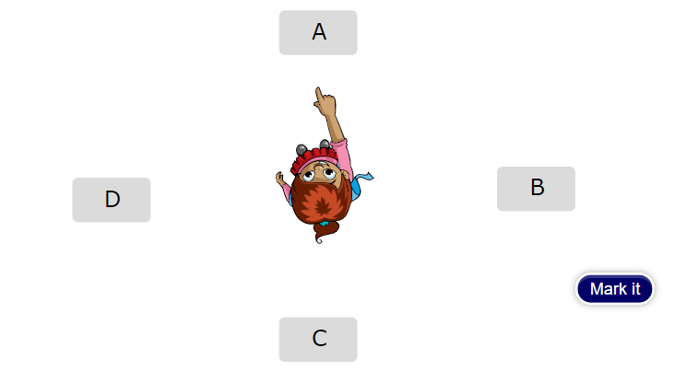

Thursday
Today we are going to complete section 9: What’s the point? (game)
Today’s session is a game for you to play which will help you to practise and recap the new direction words we learnt about yesterday!
Play this game practically too, taking it in turns to give each other instructions!

Slide 32

Friday
Here are 4 questions based on what we have already learnt.
Write numbers 1 – 4 on a piece of paper and have a go at working out the answers.
1. The train is _____ cubes long.
2. What is 2 more than 6 ?
3. There are _____ groups of _____ cookies.
4. Write the number 10 as a word.

Slide 33
Friday
Answers. Mark your own work ☺
1. The train is 4 cubes long.
2. What is 2 more than 6 ? 8
3. There are 2 groups of 4 cookies.
4. Write the number 10 as a word. ten

Slide 34
Friday
Today we are going to complete the homework, which will recap all of the learning from the past two weeks on position, direction and movement.
Once you’ve logged in click on ‘Start homework’.

Slide 35
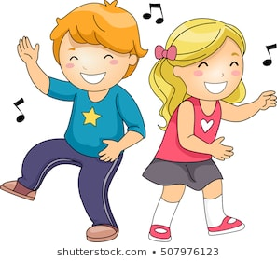
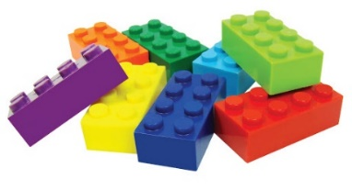
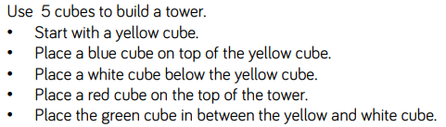
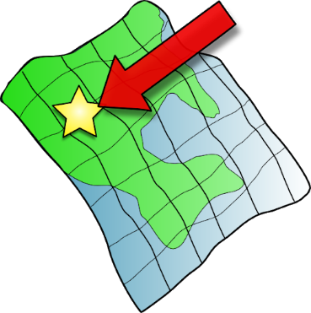
Week 6 & 7
Turn a set of instructions into a dance routine!
Here are some practical (non-screen) position
& direction activities you could try at home.
Use Lego bricks to make a tower following a grown up’s instructions. E.g.
Play a game of Simon Says giving each other instructions using the vocabulary we have learnt. E.g. ‘Simon Says, make a quarter turn.’ ‘Simon says turn left and take 2 steps forwards.’
Give each other a
route/ obstacle course to follow in the garden. E.g. ‘Turn left, walk forwards until you are behind the plant pot. Make a quarter turn and look under the chair.’ There could even be a prize at the end!

Slide 36
If you have had a go at some or all of the tasks…
Well done!
We are really proud of you.

