Slide 1
Year 1 Maths
Week 5
18/5/20

Slide 2


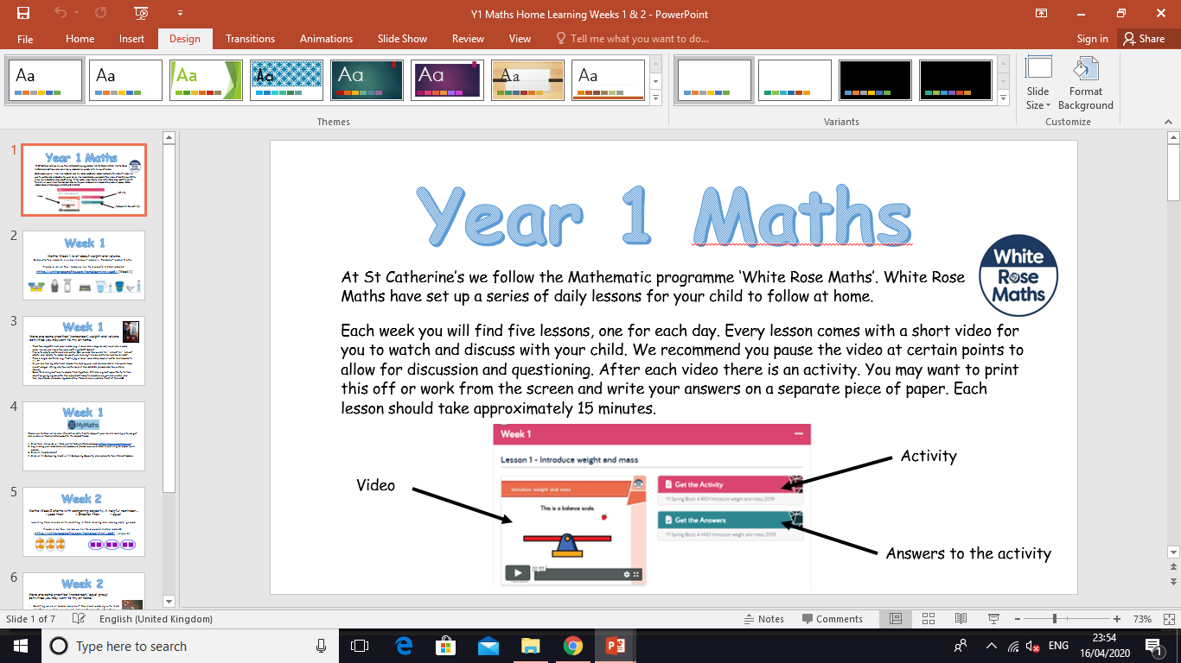
Information for Parents and Carers.
At St Catherine’s we follow the Mathematic programme ‘White Rose Maths’. White Rose Maths have set up a series of daily lessons for your child to follow at home.
Each week you will find five lessons, one for each day. Every lesson comes with a short video for you to watch and discuss with your child. We recommend you pause the video at certain points to allow for discussion and questioning. After each video there is an activity for your child to complete with your support. You may want to print this off or work from the screen and write your answers on a separate piece of paper. Each lesson should take approximately 20 minutes.
Look out for our ‘Helpful Tips’ on each slide. We have added a little more information about how you can support your child at home with each lesson. ☺

Slide 3
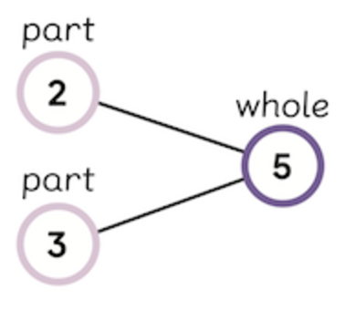

Week 5
Adults please note, this week we are completing Summer Term – Week 3 (w/c 4th May) on the White Rose website. We are following the sequence of learning from the point we are at. Thank you ☺
Hello Year 1! This week we will be:
1. Revising our number bonds to 10 and 20.
2. Linking addition and subtraction (fact families).
3. Adding together to find ‘a part’.
4. Counting on.
This PowerPoint includes five Maths sessions for you to complete this week.

Slide 4
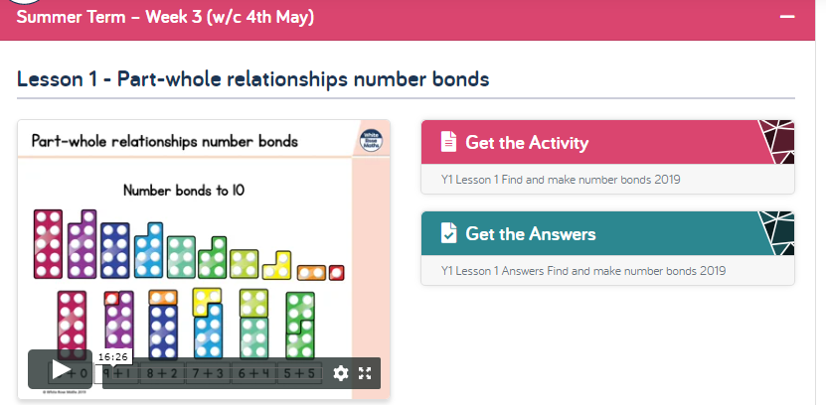
Lesson 1
Part-whole relationships number bonds
1 . Watch the video clip with your adult.
Adults - Please pause the video to answer the questions and discuss the pictures ☺
2. Complete the activity with your adult. You can print this if you prefer or work off the screen.
Adults – Please read through the questions with your child. They are not expected to do this on their own ☺
3. Check your answers by clicking on ‘Get the Answers’.
Click this link to get started:
https://whiterosemaths.com/homelearning/year-1/

Slide 5
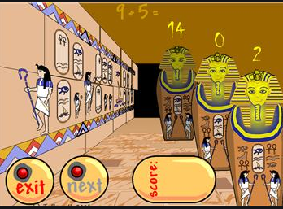
Lesson 1 – Part-whole relationships number bonds.
Practicing and remembering number bonds to 10 and 20 is important. They will help you with future learning.
Do you remember the rhyme we made at school?
Our Number Bond to 10 rhyme.
0 + 10 are big strong men.
1 + 9 get along just fine.
2 + 8 are always late.
3 + 7 come from Devon.
4 + 6 like playing tricks.
5 + 5 go for a drive.
6 + 4 knock on the door.
7 + 3 climb up the tree.
8 + 2 go to the zoo.
9 + 1 nearly done
10 + 0 are superheroes.
The children also loved this number bond game ‘Funky Mummy’
http://www.ictgames.com/mobilePage/funkyMummy/index.html

Slide 6
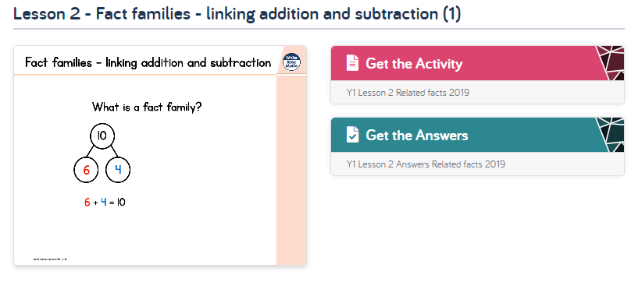
Lesson 2
Fact families – linking addition and subtraction.
Follow the same instructions as yesterday, but with lesson 2.
Click this link to get started:
https://whiterosemaths.com/homelearning/year-1/
The children are familiar with part whole models. We have used them in school ☺
Remember!
Addition always adds both parts.
Subtraction always starts with the whole.

Slide 7
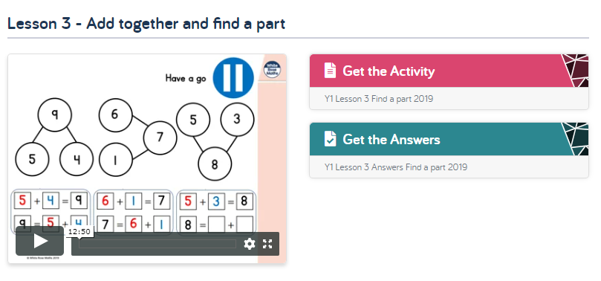
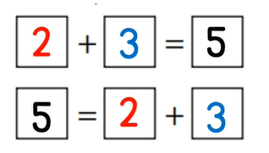
Lesson 3 – Add together and find a part.
Follow the same instructions, but with lesson 3.
Click this link to get started:
https://whiterosemaths.com/homelearning/year-1/
= means ‘equal to’
Look carefully at where it is used in each number sentence.

Slide 8
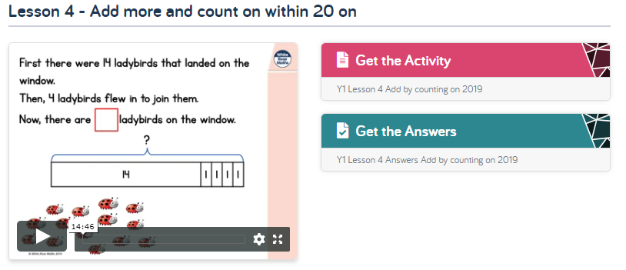
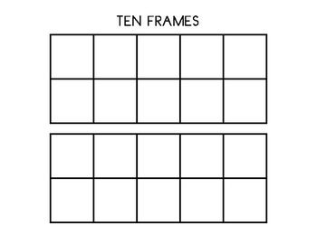
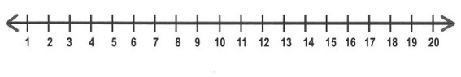
Lesson 4 – Add more and count on within 20
Follow the same instructions, but with lesson 4.
Click this link to get started:
https://whiterosemaths.com/homelearning/year-1/
Ten frames and number lines are great to use for counting on. You can draw your own on a piece of paper to help you with your thinking.

Slide 9
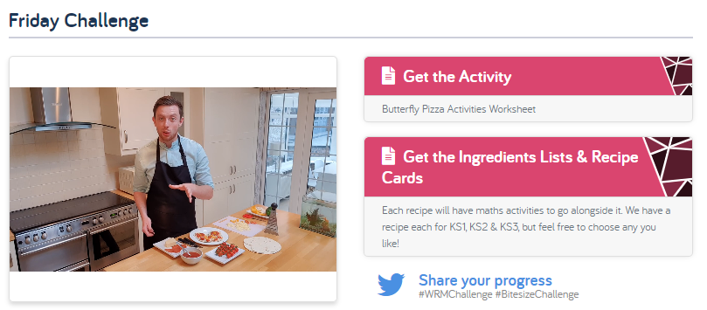

Lesson 5 – Friday challenge!
https://whiterosemaths.com/homelearning/year-1/
Today you are being challenged to make a butterfly! Butterflies are symmetrical which means the patterns and colours on their wings are the same on both sides. Look carefully at these butterflies…
Ideas for making a butterfly are on the next slide ☺

Slide 10
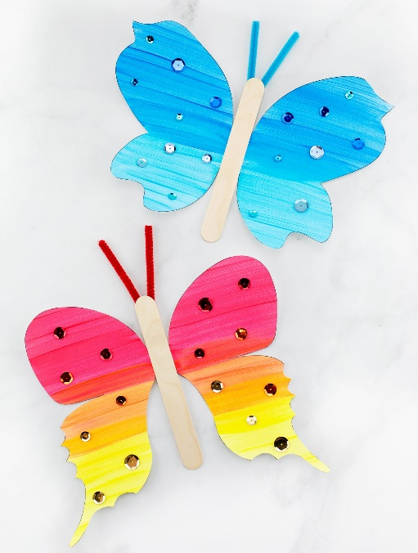
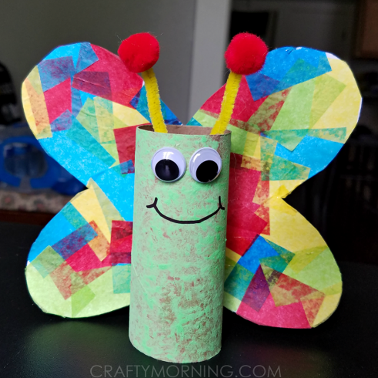
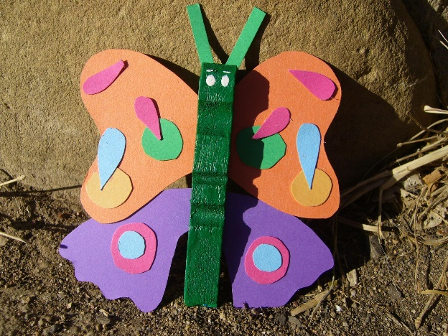
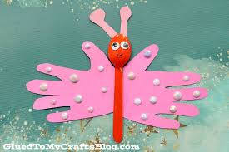
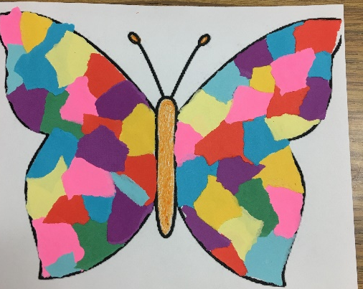
Lesson 5 – Friday challenge!
The video on the website suggests making a butterfly pizza with an adult. If you are unable to do this at home, you could try one of the activities below instead ☺
If you are able to print, there is a printable activity on the website called ‘Butterfly Pizza Activities Worksheet’.

Slide 11
If you have had a go at some or all of the tasks…
Well done!
We are really proud of you.
Have a lovely half term with your families.

