Slide 1
Year 1 Maths
Week 3
4/5/20

Slide 2


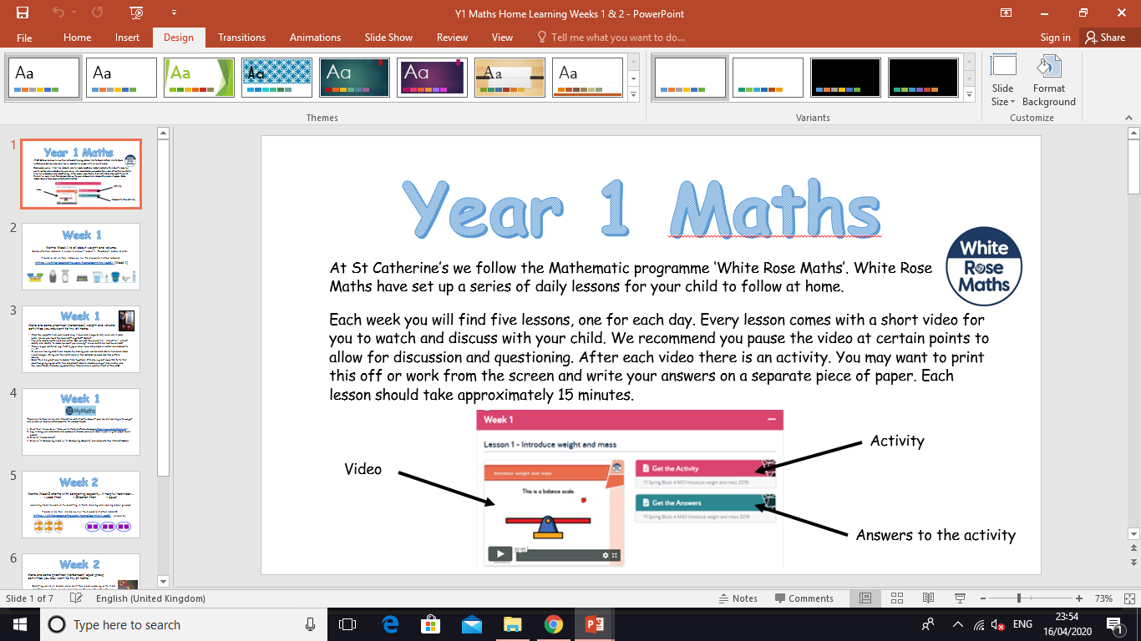
Information for Parents and Carers.
At St Catherine’s we follow the Mathematic programme ‘White Rose Maths’. White Rose Maths have set up a series of daily lessons for your child to follow at home.
Each week you will find five lessons, one for each day. Every lesson comes with a short video for you to watch and discuss with your child. We recommend you pause the video at certain points to allow for discussion and questioning. After each video there is an activity for your child to complete with your support. You may want to print this off or work from the screen and write your answers on a separate piece of paper. Each lesson should take approximately 20 minutes.
Look out for our ‘Helpful Tips’ on each slide. We have added a little more information about how you can support your child at home with each lesson. ☺

Slide 3
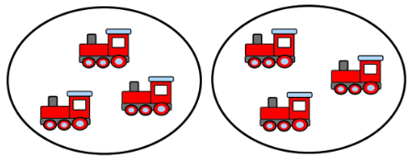




Week 3
Hello Year 1!
This week we will be:
1. Doubling 2. Grouping & sharing 3. Halving
This PowerPoint includes four Maths sessions for you to complete this week.

Slide 4
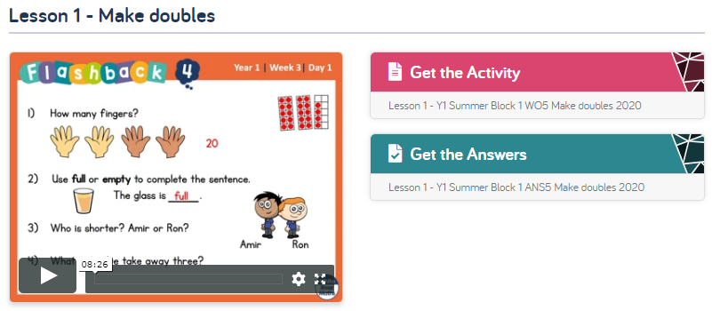
Lesson 1 – Make doubles.
Adults please note, this week we are completing Summer Term – Week 1 (w/c 20.4.20) on the website. Please ignore the date. We are following the sequence of learning from the point we are at. Thank you ☺
1 . Watch the video clip with your adult.
Adults - Please pause the video to answer the questions and discuss the pictures ☺
Each video clip now starts with four ‘Flash back’ questions.
These are designed to recap on previous learning.
2. Complete the activity with your adult. You can print this if you prefer or work off the screen.
Adults – Please read through the questions with your child. They are not expected to do this on their own ☺
3. Check your answers by clicking on ‘Get the Answers’.
Click this link to get started:
https://whiterosemaths.com/homelearning/year-1/

Slide 5
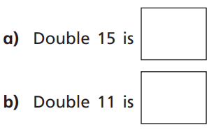

Lesson 1 – Make doubles.
When working out doubles, encourage your child to record the number sentence.
Use objects to work out the doubles. You could use raisins, marbles or Lego bricks. Make two groups and then count how many there are altogether.
18
9 + 9 = 18
e.g. Double 9 is

Slide 6
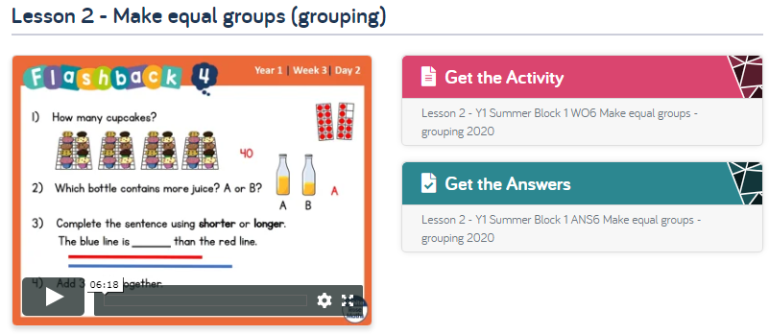
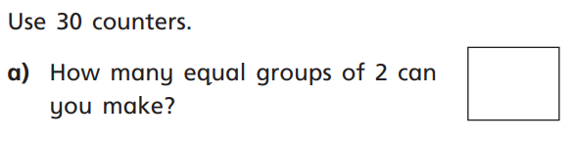
Lesson 2 – Make equal groups (grouping).
Follow the same instructions as yesterday, but with lesson 2.
Click this link to get started:
https://whiterosemaths.com/homelearning/year-1/
Discuss the term equal together. Equal means the same.
You can use any object to complete this task!

Slide 7
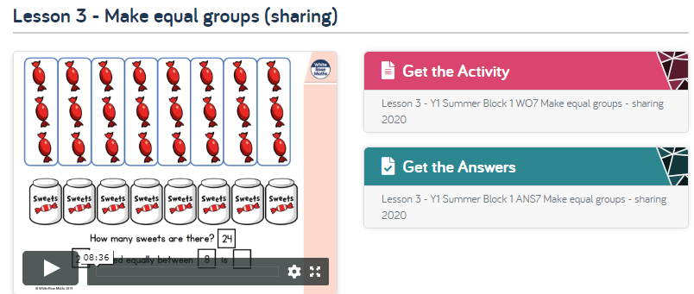
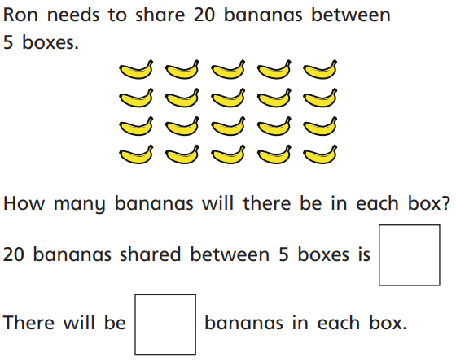
Lesson 3 – Make equal groups (sharing).
Follow the same instructions, but with lesson 3.
Click this link to get started:
https://whiterosemaths.com/homelearning/year-1/
You could circle the rows/ columns as shown in the video for these questions or you could work it out practically. You could use an object to represent the bananas and sort them into 5 boxes, one at a time.

Slide 8
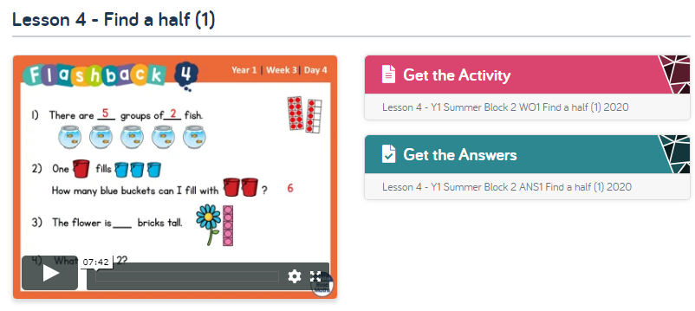
Lesson 4 – Find a half (1).
Follow the same instructions, but with lesson 4.
Click this link to get started:
https://whiterosemaths.com/homelearning/year-1/
Focus on the term equal parts in this lesson.
It is important that your child understands that two halves make a whole and that the halves are equal (the same).
Model using the word half during your day to day activities
e.g. I have eaten half of my biscuit.

Slide 9
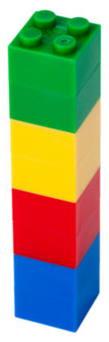

Week 3
Here are some practical (non-screen) doubling and halving activities you may want to try at home.
Use Lego bricks to
make a tower. Now
can you double it?
Draw half of a shape, swap with a partner and see if you can complete each other’s drawings!
Find an object in your house to share in half with a family member. E.g. a chocolate bar, an orange, some sweets.
Tell your partner a doubling or halving story. E.g. 4 children are at a party. 4 more children arrive. Now there are 8!

Slide 10
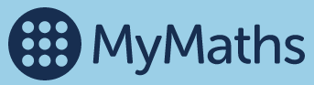
Week 3
We advise you follow the White Rose Mathematics learning sequences in Year 1, as outlined in this PowerPoint.
If you are looking for more Maths work you can find a mixture of interactive activities on the MyMaths website. We do not expect you to do this as well as the White Rose Math lessons. This is purely ‘extra’ should you want it ☺
https://www.mymaths.co.uk/

Slide 11
If you have had a go at some or all of the tasks…
Well done!
We are really proud of you.
Have a lovely bank holiday weekend.

