Slide 1
Year 1 Maths
Week 4
11/5/20

Slide 2


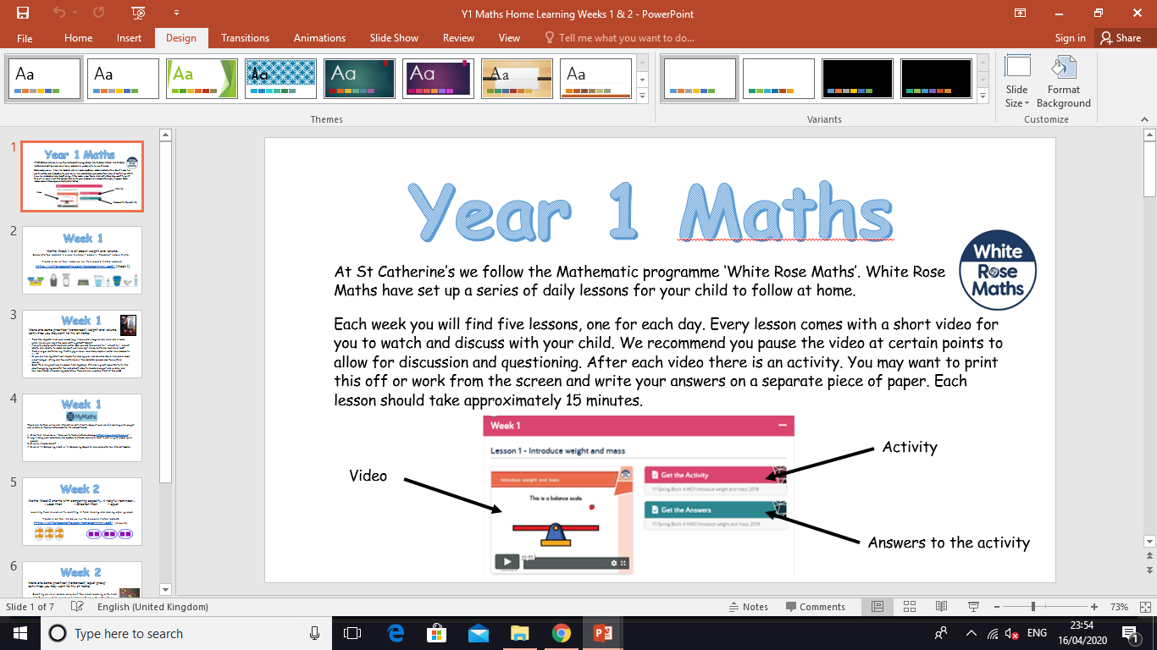
Information for Parents and Carers.
At St Catherine’s we follow the Mathematic programme ‘White Rose Maths’. White Rose Maths have set up a series of daily lessons for your child to follow at home.
Each week you will find five lessons, one for each day. Every lesson comes with a short video for you to watch and discuss with your child. We recommend you pause the video at certain points to allow for discussion and questioning. After each video there is an activity for your child to complete with your support. You may want to print this off or work from the screen and write your answers on a separate piece of paper. Each lesson should take approximately 20 minutes.
Look out for our ‘Helpful Tips’ on each slide. We have added a little more information about how you can support your child at home with each lesson. ☺

Slide 3


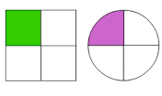


Week 4
Hello Year 1!
This week we will be:
1. Halving 2. Finding a quarter 3. Problem solving
This PowerPoint includes five Maths sessions for you to complete this week.

Slide 4
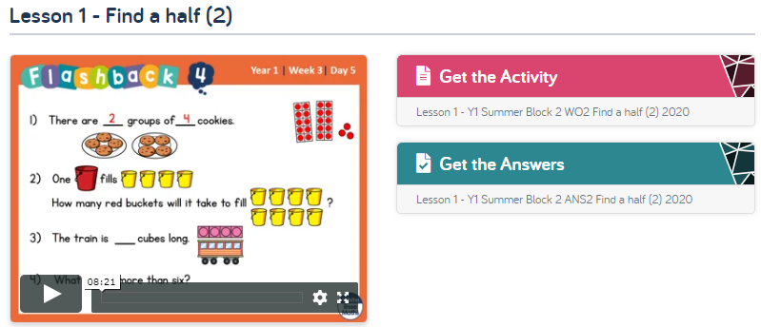
Lesson 1 – Find a half (2).
Adults please note, this week we are completing Summer Term – Week 2 (w/c 27.4.20) on the website. Please ignore the date. We are following the sequence of learning from the point we are at. Thank you ☺
1 . Watch the video clip with your adult.
Adults - Please pause the video to answer the questions and discuss the pictures ☺
Each video clip now starts with four ‘Flash back’ questions.
These are designed to recap on previous learning.
2. Complete the activity with your adult.
Adults – Please read through the questions with your child. They are not expected to do this on their own ☺
3. Check your answers by clicking on ‘Get the Answers’.
Click this link to get started:
https://whiterosemaths.com/homelearning/year-1/

Slide 5
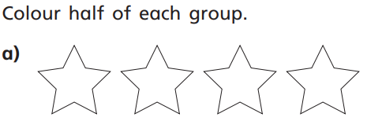
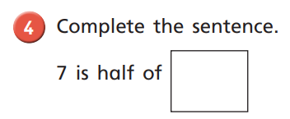

Lesson 1 – Find a half (2).
For an extra challenge, you could draw the stars again and show a different way of colouring half.
12 6
e.g. Half of is
Don’t forget to use objects to help you! Discuss what halves are again. If 7 is one half, we need to make another group of 7 to work out the whole.
Encourage your child to circle the objects to help them.

Slide 6
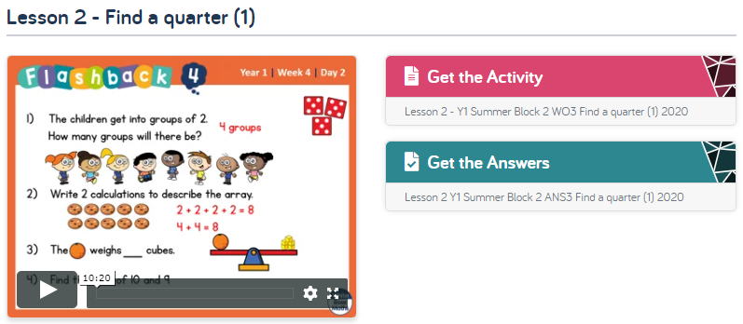
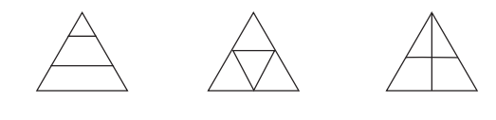
Lesson 2 – Find a quarter (1).
Follow the same instructions as yesterday, but with lesson 2.
Click this link to get started:
https://whiterosemaths.com/homelearning/year-1/
Discuss the term equal together. Equal means the same. Remember that to have quarters, we need 4 equal pieces.
For this question you could draw the shapes, cut the pieces out and lay them on top of each other to show which are the same (equal) and which are not.

Slide 7
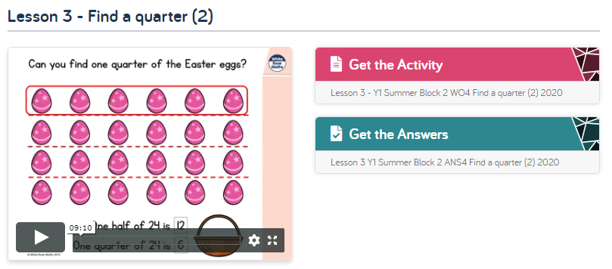
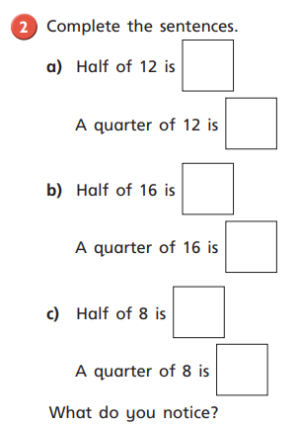
Lesson 3 – Find a quarter (2) .
Follow the same instructions, but with lesson 3.
Click this link to get started:
https://whiterosemaths.com/homelearning/year-1/
Use objects to help you with this question. Remember you need two equal groups when finding one half and four equal groups when finding one quarter.

Slide 8
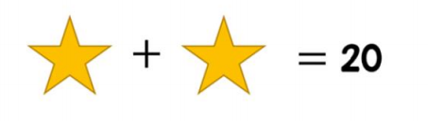
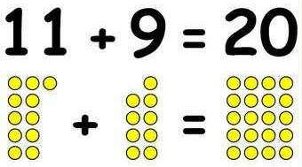
Lesson 4 – Problem Solving.
Today, instead of watching the video, we would like you to have a go at the activity below.
What number could be behind each star?
This problem has lots of possible answers. How many can you think of? Use objects to help you if you are unsure.
Would a system help?
Example:

Slide 9
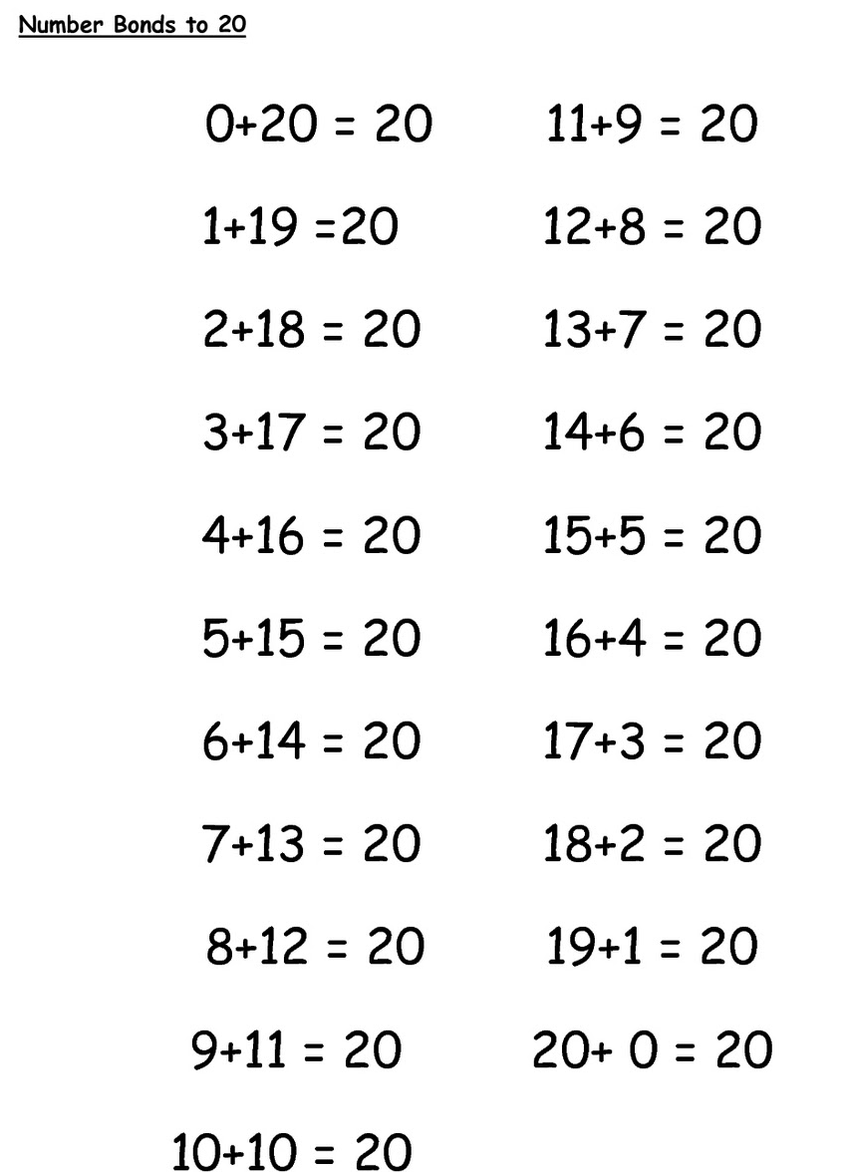
Here are all the possible answers to the problem:
Do you notice a pattern?
Using a system can help ☺

Slide 10
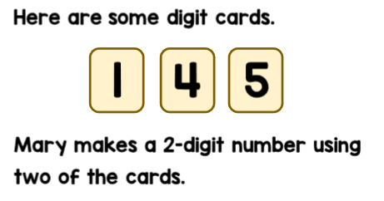
Lesson 5 – Problem Solving.
Today, instead of watching the video, we would like you to have a go at the activity below.
This problem has lots of possible answers. How many can you find? Would a system help?
How many different numbers can she make?

Slide 11
Answers:
Mary can make 6 different numbers.
14 15 41 45 51 54

Slide 12
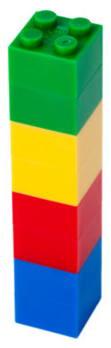
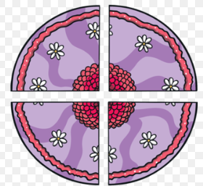
Week 3
Here are some practical (non-screen) ‘quarters’ activities you may want to try at home.
Use Lego bricks to
make a tower. Can you halve it? Split it into quarters?
Watch your adult cut a sandwich or cake in half and then into quarters. How many equal parts are there?
Find an object in your house to share in half and quarters with a family member. E.g. a chocolate bar, an orange, some sweets.

Slide 13
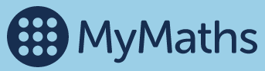
Week 3
We advise you follow the White Rose Mathematics learning sequences in Year 1, as outlined in this PowerPoint.
If you are looking for more Maths work you can find a mixture of interactive activities on the MyMaths website. We do not expect you to do this as well as the White Rose Math lessons. This is purely ‘extra’ should you want it ☺
https://www.mymaths.co.uk/

Slide 14
If you have had a go at some or all of the tasks…
Well done!
We are really proud of you.
Have a lovely weekend.

