Slide 1

Year 1 Maths
Week 8 & 9
15/6/20 and 22/6/20

Slide 2
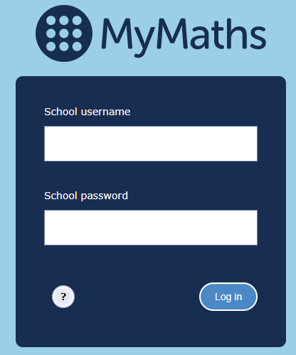
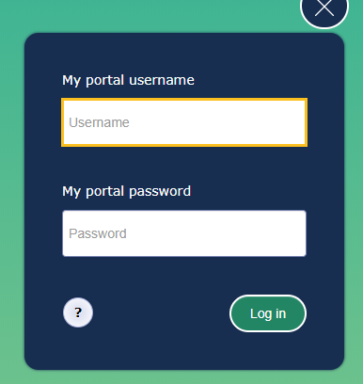
For the next 2 weeks we are going to be learning about time.
Each day go to the MyMaths website https://login.mymaths.co.uk/login and log in with the school’s username and password.
You then need to login with your own personal details which were sent to you in the first home learning pack. If you have lost yours, please contact the school office.

Slide 3
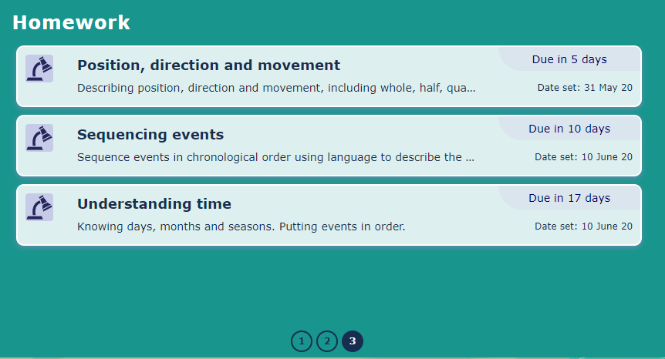
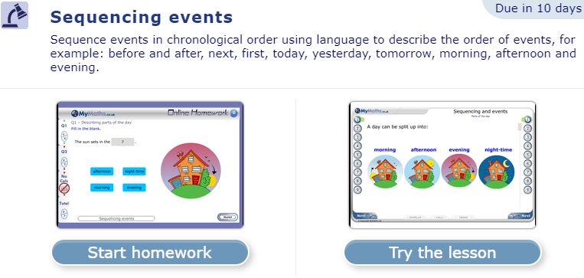
Week 1
Once you have logged in click on ‘Sequencing events’.
Please note you will find this lesson on the last page.
Last page
Then click on ‘Try the lesson’.
Please follow the instructions on this Powerpoint presentation to see which parts of the lesson you need to complete each day ☺

Slide 4
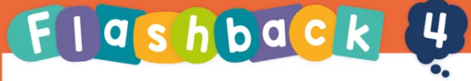

Each day we have set four flashback questions for you to complete. These four questions are based on what we have already learnt.
Complete the flashback questions before starting your MyMaths lesson.
You will need a piece of paper to jot down your answers.
The answers to each set of questions are on the following slide.

Slide 5
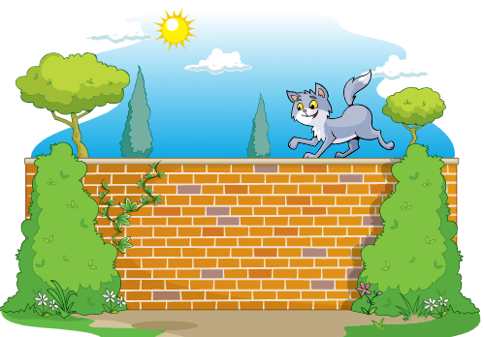
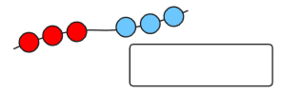
Monday
Here are 4 questions based on what we have already learnt.
Write numbers 1 – 4 on a piece of paper and have a go at working out the answers.
1. What is 6 + 5 ?
2. Where is the cat, on top of the wall
or under the wall?
3. What is 10 - 6?
4. Write a number sentence to show how many
beads there are altogether.

Slide 6
Monday
Answers. Mark your own work ☺
1. What is 6 + 5 ? 11
2. Where is the cat, on top of the wall
or under the wall?
On top of the wall.
3. What is 10 - 6? 4
4. Write a number sentence to show how many
beads there are altogether.
3 + 3 = 6

Slide 7
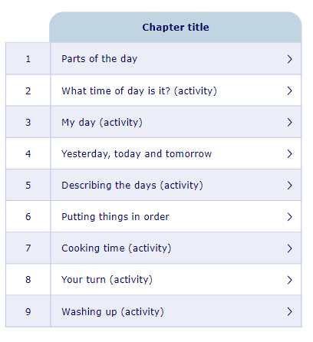
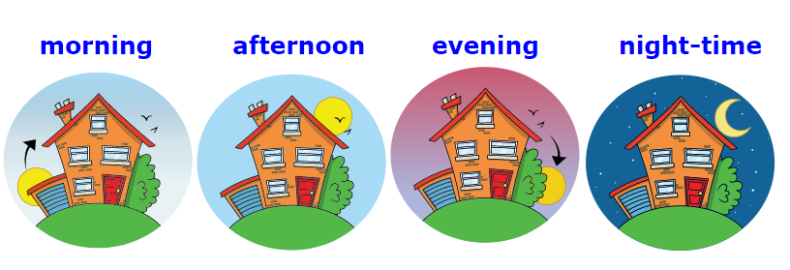

Monday
Today we are going to complete section 1:
Parts of the day.
We are going to be using the correct vocabulary to describe the different parts of the day.
Look on the next slide for an extra activity.

Slide 8
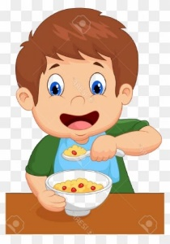
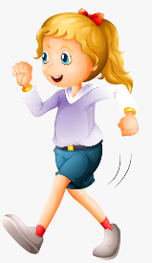

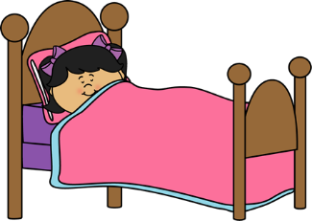
Monday
Parts of the day.
What do you do during the morning, afternoon, evening and at night-time?
Write and draw your ideas on a piece of paper.
I eat my breakfast.
I go for a walk.
I read a book.
I go to sleep.

Slide 9
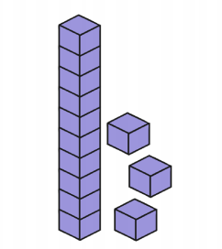
Tuesday
Here are 4 questions based on what we have already learnt.
Write numbers 1 – 4 on a piece of paper and have a go at working out the answers.
1. What number is being represented by the dienes?
2. If today is Tuesday, what day is it tomorrow?
3. What is double 4?
4. Write the number 7 as a word.

Slide 10
Tuesday
Answers. Mark your own work ☺
What number is being represented by the dienes?
13
2. If today is Tuesday, what day is it tomorrow?
Wednesday
3. What is double 4? 8 (4 + 4)
4. Write the number 7 as a word. seven

Slide 11
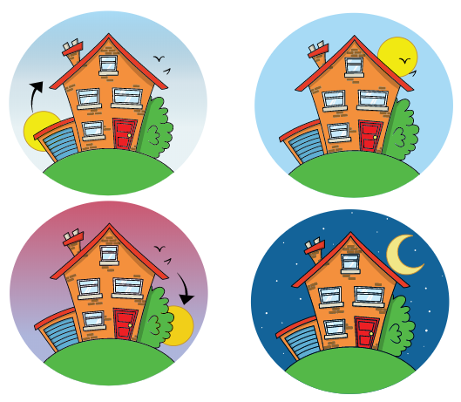
Tuesday
Today we are going to complete sections 2 and 3:
What time of day is it?
My day.
We are going to be using the correct vocabulary to describe the different parts of the day.
Look on the next slide for an extra activity.

Slide 12
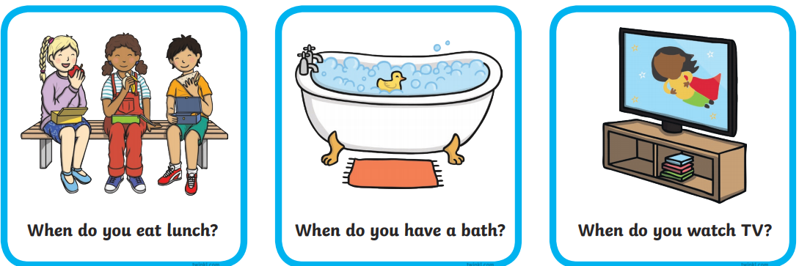
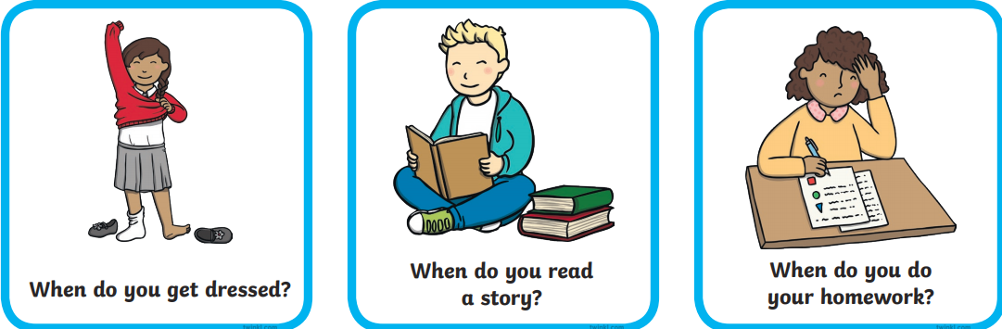
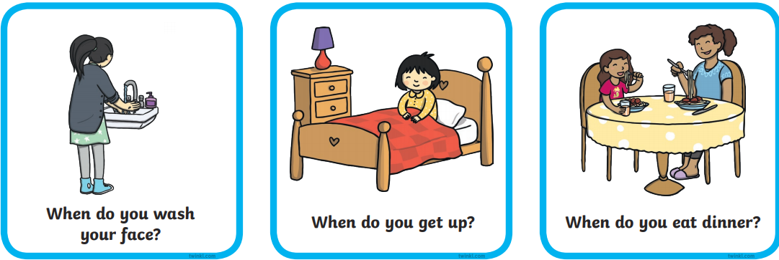
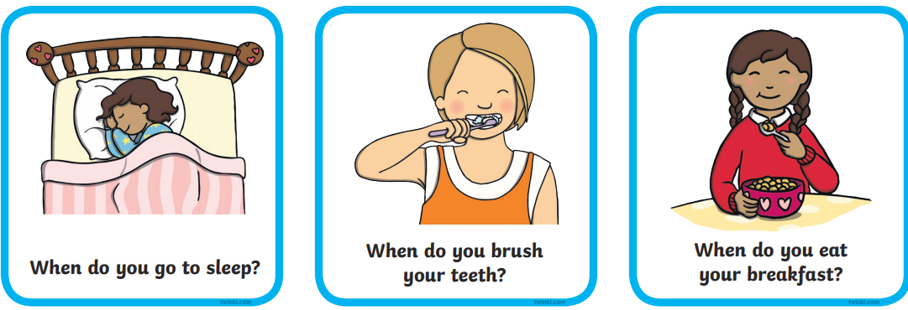
Tuesday
What time of day is it?
My day.
When might you do these activities? Match the activities to the time of day? Talk about your answers with your grown-up.

Slide 13
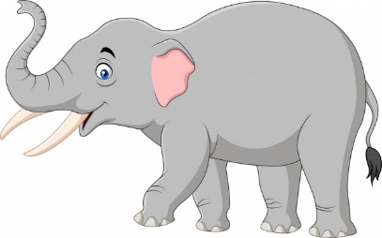
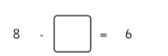
Wednesday
Here are 4 questions based on what we have already learnt.
Write numbers 1 – 4 on a piece of paper and have a go at working out the answers.
1. What is one less than 15?
2. Imagine seeing 2 elephants at the zoo.
How many legs would you see?
3. What number comes next?
6, 8, 10, 12, 14, ____
4. What is the missing number?

Slide 14
Wednesday
Answers. Mark your own work ☺
1. What is one less than 15? 14
2. Imagine seeing 2 elephants at the zoo.
How many legs would you see?
8 (4 + 4)
3. What number comes next?
6, 8, 10, 12, 14, 16
4. What is the missing number?
2

Slide 15
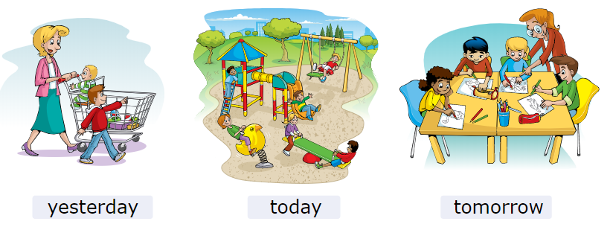
Wednesday
Today we are going to complete sections 4 and 5:
Yesterday, today and tomorrow.
Describing the days.
We are going to be using the correct vocabulary to describe the days of the week.
Look on the next slide for an extra activity.

Slide 16
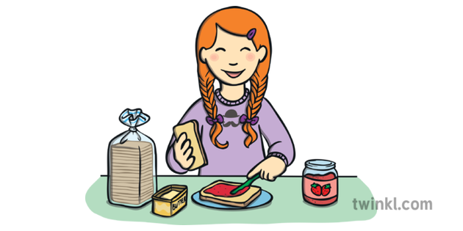
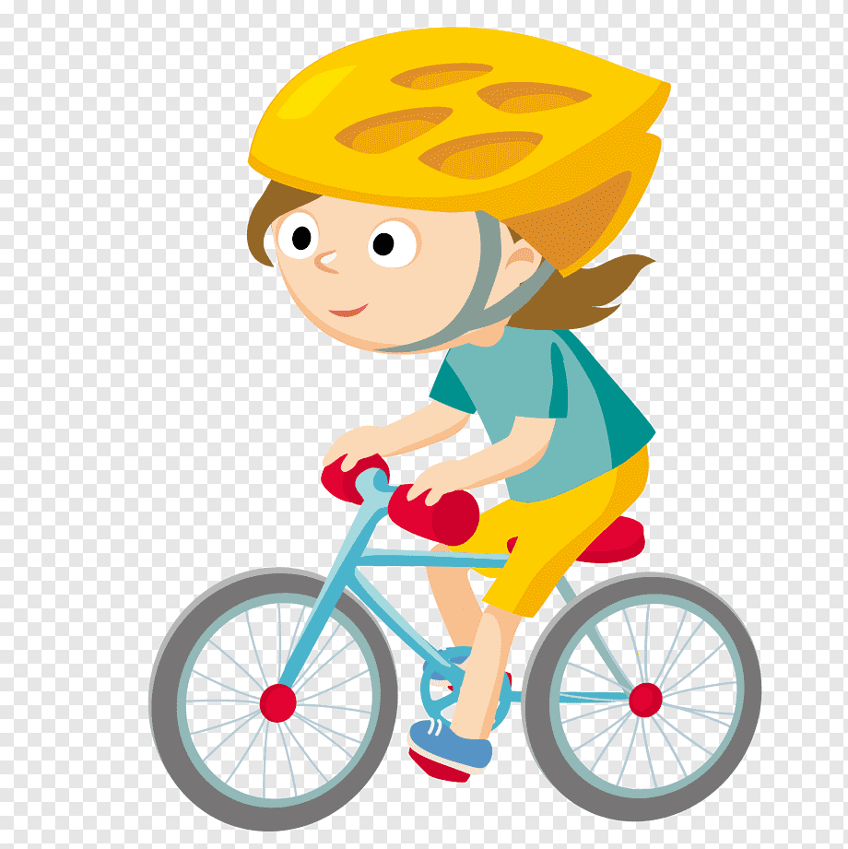
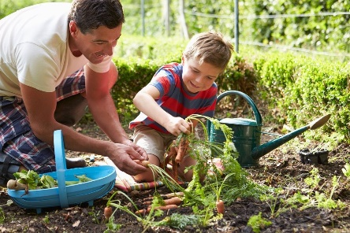
Wednesday
Yesterday, today and tomorrow.
Describing the days.
Think about today, yesterday and tomorrow. Draw a picture and write a sentence to show what you did or what you are going to do.
yesterday | today | tomorrow
I helped my Dad in the garden.
I made my own sandwich.
I am going to ride my bike.

Slide 17
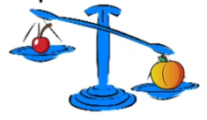
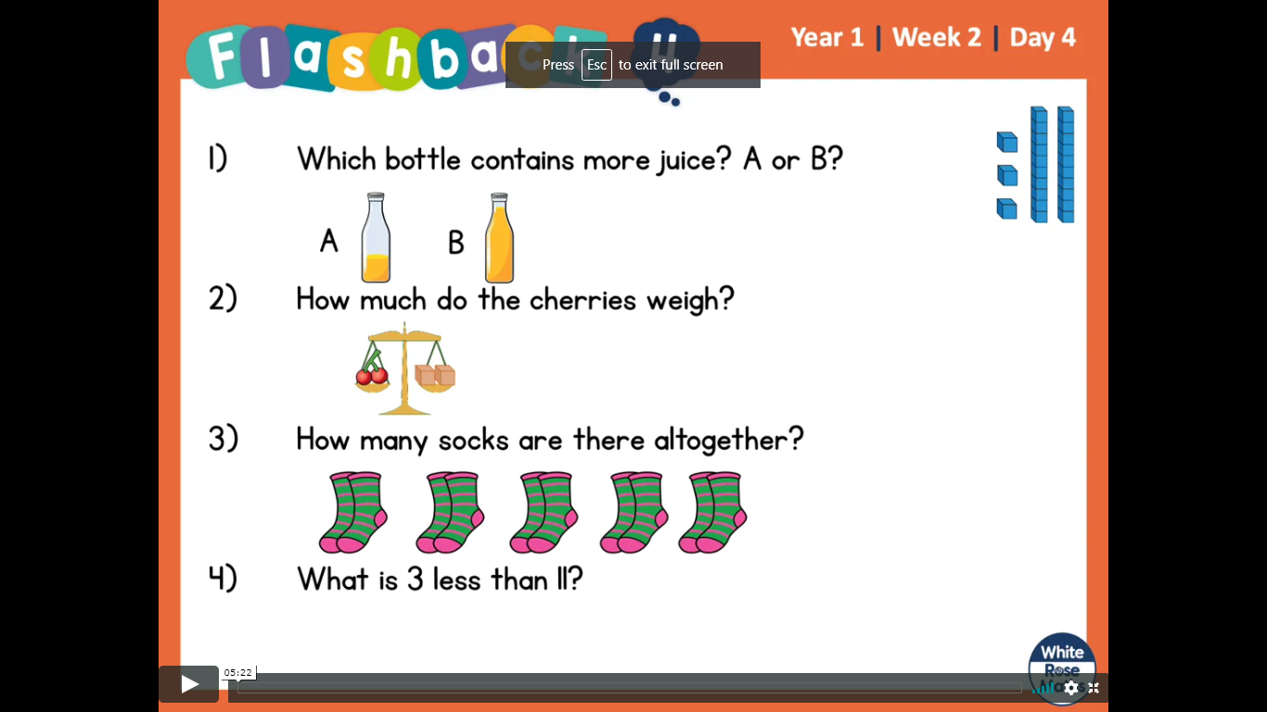
Thursday
Here are 4 questions based on what we have already learnt.
Write numbers 1 – 4 on a piece of paper and have a go at working out the answers.
Complete the sentence.
The _______ is heavier than the _______.
2. How many socks are there altogether?
3. What is 3 less than 15?
4. Write the number 9 as a word.

Slide 18
Thursday
Answers. Mark your own work ☺
Complete the sentence.
The peach is heavier than the cherry.
2. How many socks are there altogether? 14
3. What is 3 less than 15? 12
4. Write the number 9 as a word. nine

Slide 19
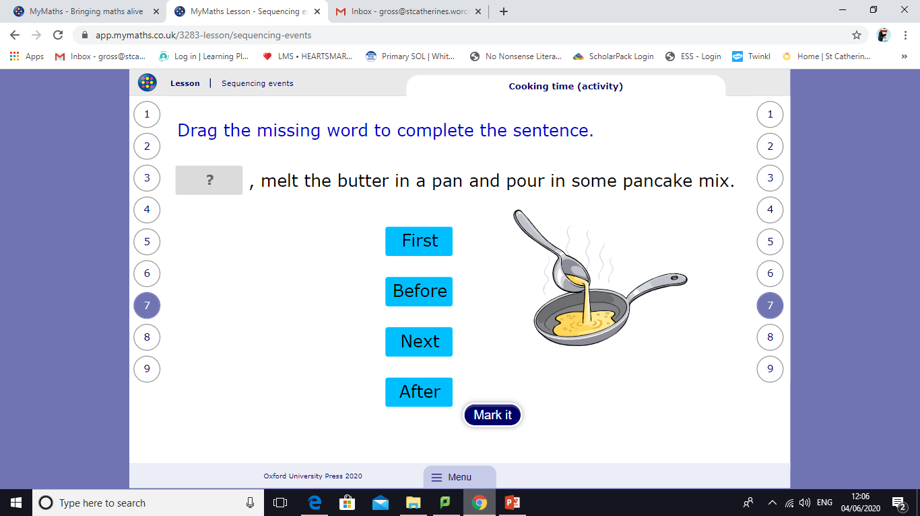
Thursday
Today we are going to complete sections 6, 7, 8 and 9:
Putting things in order.
Cooking time.
Your turn.
Washing up.
We are going to use words to describe the sequence of events.
Look on the next slide for an extra activity.

Slide 20
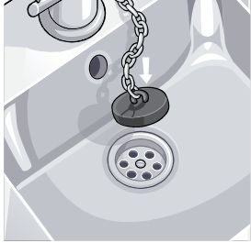
Thursday
Putting things in order.
Cooking time.
Your turn.
Washing up.
Some things have to be done in order. For example, making pancakes and washing up. Can you think of some other activities that have to be done in order? Make a list on a piece of paper.
I’ve made a list of my ideas on the next slide.
Making pancakes.
Washing up.

Slide 21
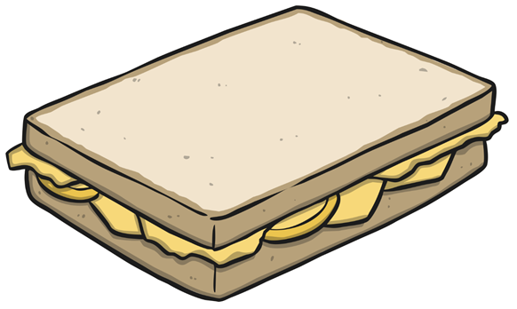
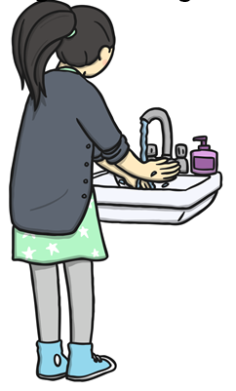
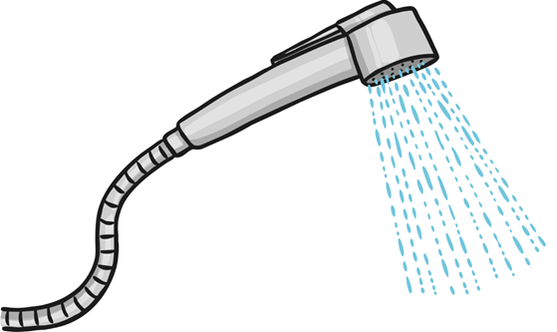
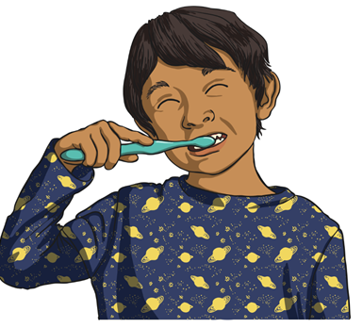
Making a sandwich.
Washing your hands.
Having a bath or shower.
Brushing your teeth.
Imagine doing these things in the wrong order, or backwards! What would happen?

Slide 22
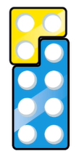
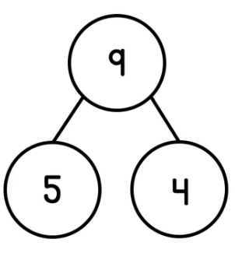
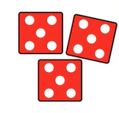
Friday
Here are 4 questions based on what we have already learnt.
Write numbers 1 – 4 on a piece of paper and have a go at working out the answers.
Which number bond to 10 is being represented?
2. What is 6 plus 4?
3. Write a number sentence to match the part
whole model?
4. What number is being shown?

Slide 23
Friday
Answers. Mark your own work ☺
Which number bond to 10 is being represented?
7 + 3 = 10 or 3 + 7 = 10
2. What is 6 plus 4? 10
3. Write a number sentence to match the part
whole model?
5 + 4 = 9 9 = 5 + 4 9 – 5 = 4 9 – 4 = 5
4 + 5 = 9 9 = 4 + 5
4. What number is being shown? 15

Slide 24
Friday
Today we are going to complete the homework, which will recap on the learning from the past weeks on ‘Sequencing events’ .
Once you’ve logged in click on ‘Start homework’.

Slide 25
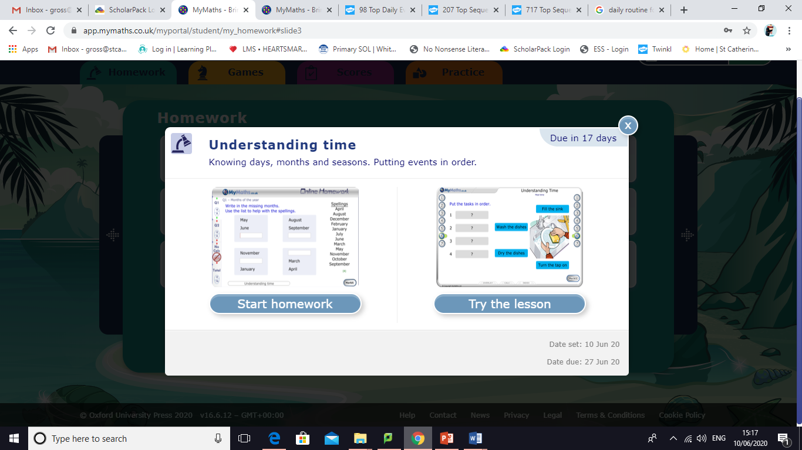
Week 2
Once you have logged in click on ‘Understanding time’.
Please note you will find this lesson on the last page.
Last page
Then click on ‘Try the lesson’.
Please follow the instructions on this Powerpoint presentation to see which parts of the lesson you need to complete each day ☺

Slide 26
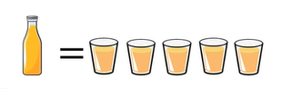
Monday
Here are 4 questions based on what we have already learnt.
Write numbers 1 – 4 on a piece of paper and have a go at working out the answers.
If one bottle of juice fills 5 cups.
How many cups do 3 bottles fill?
2. Which number comes next?
25, 30, 35, ____
3. Find the total of 10 and 8.
4. Draw a picture to show 2 + 2 + 2 = 6

Slide 27
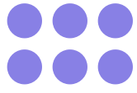
Monday
Here are 4 questions based on what we have already learnt.
Write numbers 1 – 4 on a piece of paper and have a go at working out the answers.
If one bottle of juice fills 5 cups.
How many cups do 3 bottles fill? 15 cups
2. Which number comes next?
25, 30, 35, 40
3. Find the total of 10 and 8. 18 (10 + 8)
4. Draw a picture to show 2 + 2 + 2 = 6

Slide 28
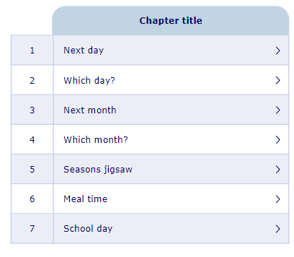
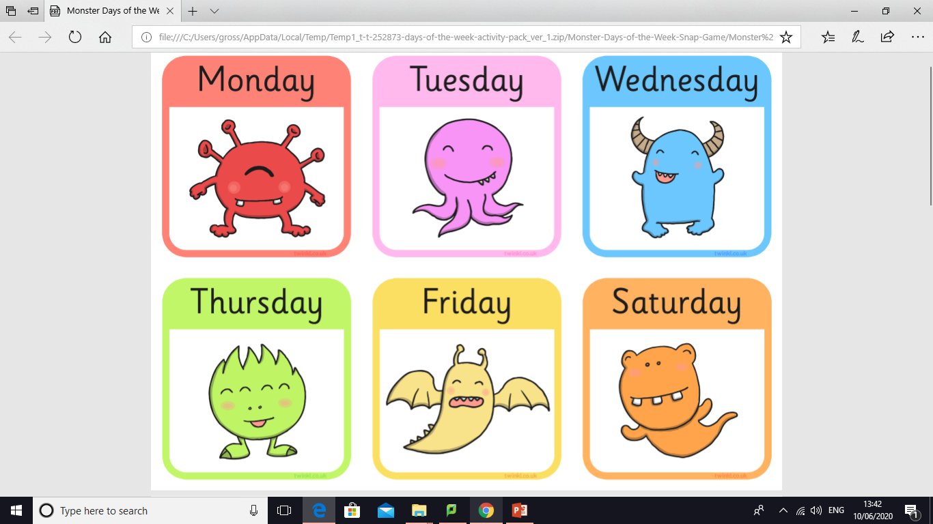
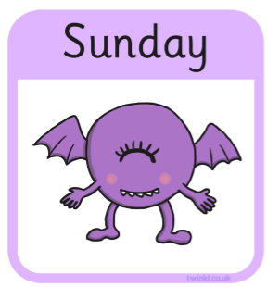
Monday
Today we are going to complete the questions in sections 1 and 2:
Next day.
Which day?
How well do you know the days of the week?
Look on the next slide for an extra activity.

Slide 29
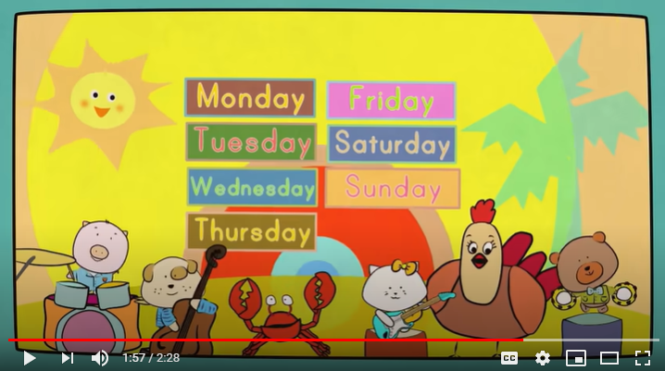
Monday
Next day.
Which day?
Join in with this fun ‘Days of the week’ song.
https://www.youtube.com/watch?v=mXMofxtDPUQ&vl=en
Can you put the days of the week into the correct order?

Slide 30
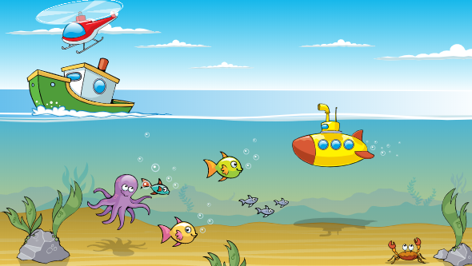
Tuesday
Here are 4 questions based on what we have already learnt.
Write numbers 1 – 4 on a piece of paper and have a go at working out the answers.
The helicopter is _________ the
boat.
2. What is 11 + 3 ?
3. 19 + ? = 20
4. Record three number bonds to 10.

Slide 31
Tuesday
Answers. Mark your own work ☺
The helicopter is above the
boat.
2. What is 11 + 3 ? 14
3. 19 + ? = 20 19 + 1 = 20
4. Record three number bonds to 10.
5 + 5 6 + 4 7 + 3 8 + 2 9 + 1 10 + 0

Slide 32
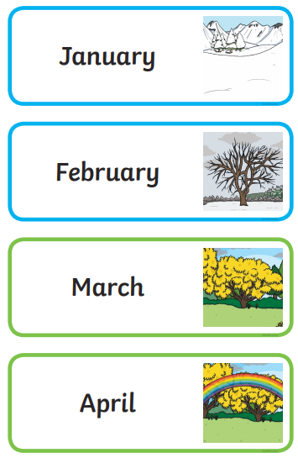
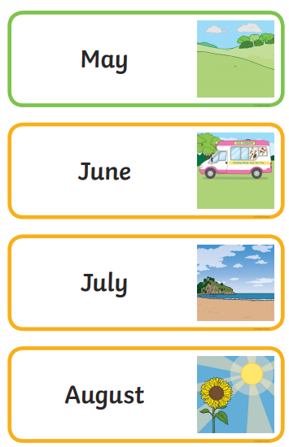
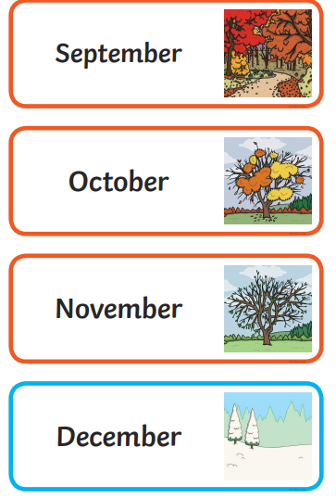
Tuesday
Today we are going to complete the questions in sections 3 and 4:
Next month.
Which month?
How well do you know the months of the year?
Look on the next slide for an extra activity.

Slide 33
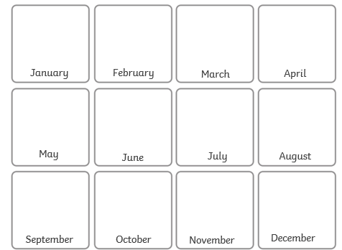

Tuesday
Next month.
Which month?
Can you create your own birthday calendar? Write down the twelve months of the year. Write your name in your birthday month. Ask members of your family when their birthdays are and write their names in too ☺
Mrs Hulagu
Miss Wheeler
Miss
Townsend
Mrs Dicken
Mrs Ross
Mrs Shelley
Miss Conway
Mrs Jones

Slide 34
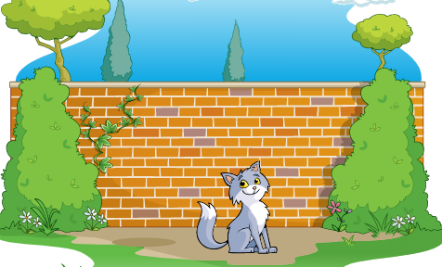
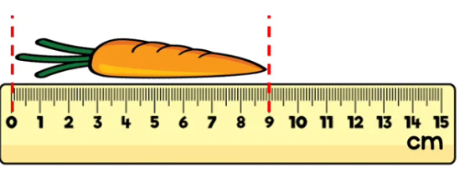
Wednesday
Here are 4 questions based on what we have already learnt.
Write numbers 1 – 4 on a piece of paper and have a go at working out the answers.
The cat is ____________ the
wall.
2. What is 15 + 5 ?
3. How long is the carrot?
4. Write the number 4 as a word.

Slide 35
Wednesday
Answers. Mark your own work ☺
The cat is in front of the
wall.
2. What is 15 + 5 ? 20
3. How long is the carrot?
9cm
4. Write the number 4 as a word. four

Slide 36
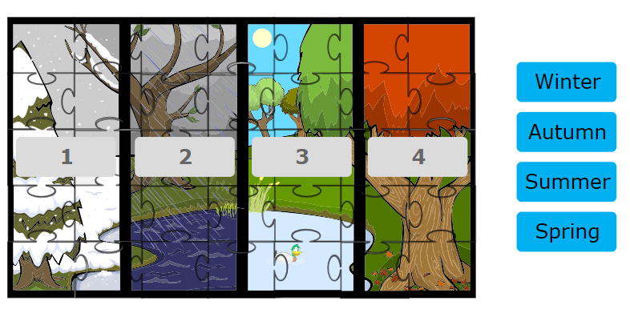
Wednesday
Today we are going to complete the questions in section 5:
Seasons jigsaw
Look on the next slide for an extra activity.

Slide 37

Wednesday
Seasons

Slide 38

Thursday
Here are 4 questions based on what we have already learnt.
Write numbers 1 – 4 on a piece of paper and have a go at working out the answers.
What do you notice about the cake and the
doughnut?
2. How many tens are there in 24?
3. Write a number between 15 and 20.
4. What is 1 more than 29?

Slide 39
Thursday
Answers. Mark your own work ☺
What do you notice about the cake and the
doughnut?
They weigh the same.
2. How many tens are there in 24?
2 tens.
3. Write all the numbers between 15 and 20.
16, 17, 18, 19
4. What is 1 more than 29? 30

Slide 40

Thursday
Today we are going to complete the questions in sections 6 and 7:
Meal time
School day
Look on the next slide for an extra activity.

Slide 41

Thursday
Meal time
School day
Can you create a daily diary. Draw pictures and write down some of the things you do throughout the day.
I brushed my teeth..
I got out of bed.
I ate my breakfast.
I worked out with Joe Wicks.
I had a shower.
I did my school work.
I put my clean clothes away.
I played football.

Slide 42

Friday
Here are 4 questions based on what we have already learnt.
Write numbers 1 – 4 on a piece of paper and have a go at working out the answers.
1. 18 is greater than 15. True or false?
2. What is 10 more than 12 ?
3. Write a number sentence to show the total of cookies.
4. Write the number 0 as a word.

Slide 43
Friday
Answers. Mark your own work ☺
1. 18 is greater than 15. True or false? True. 18 > 15
2. What is 10 more than 12 ? 22
3. Write a number sentence to show the total of cookies.
4 + 4 + 4 + 4 = 16
4. Write the number 0 as a word. zero

Slide 44
Friday
Today we are going to complete the homework, which will recap on the learning from the past weeks on ‘Understanding time’ .
Once you’ve logged in click on ‘Start homework’.

Slide 45
If you have had a go at some or all of the tasks…
Well done!
We are really proud of you.

