Slide 1
Year 1
Reading and Writing
Weeks 10 and 11
29/6/20 – 10/7/20

Slide 2
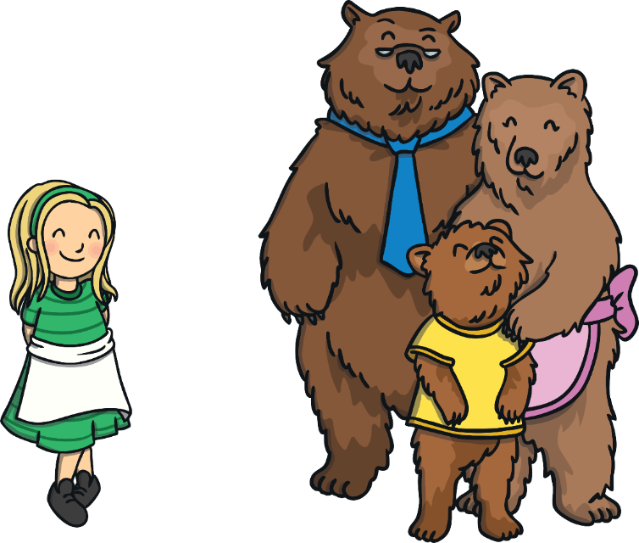
Hello Year 1!
We hope you enjoyed writing and performing your own noises poem last week ☺
This PowerPoint includes ten sessions for you to complete over the next two weeks.
Our learning is going to be based on Goldilocks and the Three Bears. This is a very well-known story, so you might have heard it before! ☺

Slide 3
Lesson 1
Reading for pleasure.
Read the story ‘Goldilocks and the Three Bears’ with your grown-up. You will find the story saved as a separate document in the Reading and Writing folder on the website.
Afterwards, see if you can retell the story.
Discuss the meaning of any new words you come across. ☺

Slide 4
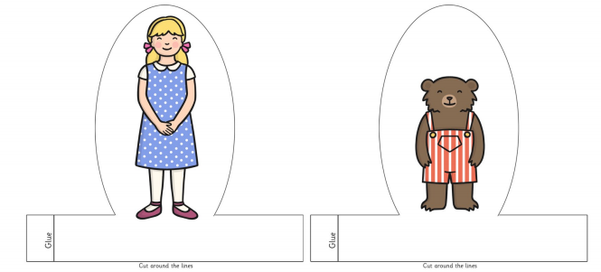
Lesson 1 – Reading for pleasure.
Have a go at making your own puppet for each of the characters from the story. You will find some printable finger puppets in the Reading and Writing folder on the website. Alternatively, you can get creative and make your own however you like!
Use your puppets to act out and retell the story. ☺

Slide 5
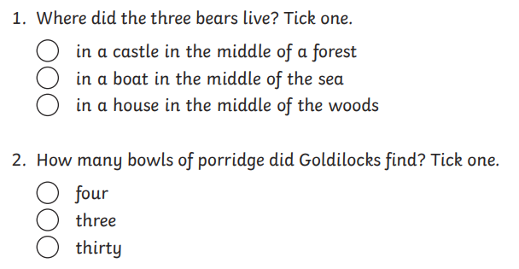
Lesson 2 – Reading comprehension.
Re-read the story. Then complete the reading comprehension questions. ☺

Slide 6
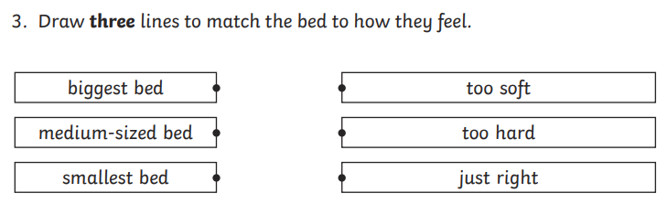

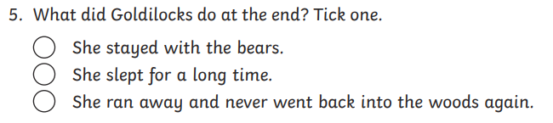
Lesson 2 – Reading comprehension.

Slide 7

Answers
Lesson 2 – Reading comprehension.

Slide 8
Answers
Lesson 2 – Reading comprehension.
tired

Slide 9

Lesson 3 – Role on the wall.
Print out a picture of Goldilocks or draw one yourself. Sort the following words and phrases so that the words that describe what she looks like are on the outside and words that describe her actions are on the inside.
blonde hair
broke the chair
slept in the bed
short
entered the house
ate porridge
hairband
green dress

Slide 10
Answers
Lesson 3 – Role on the wall.
green dress
short
broke the chair
entered the house
ate porridge
slept in the bed
blonde hair
hairband

Slide 11
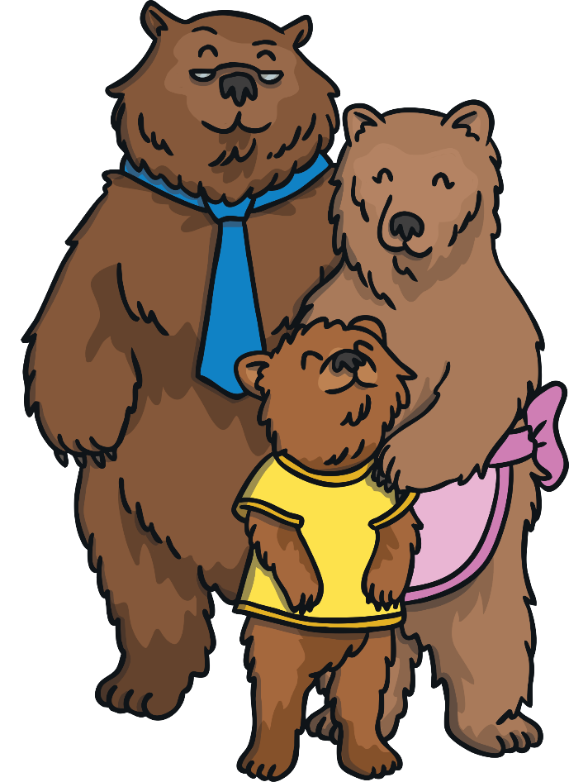
Lesson 4 – Make a poster.
We are very cross! A little girl has eaten our porridge, lay on our beds and has even broken Baby Bear’s chair! Can you help us find her?

Slide 12
Lesson 4 – Make a poster.
The bears need our help to find Goldilocks! Make a ‘Wanted’ poster to find her. We need to make sure we include lots of information so that people will recognise Goldilocks if they see her! Remember to include the following:
What does she look like?
What is she wanted for?
Where was she last seen?
You could even include a reward for the person who finds her!
Use your role on the wall activity to help you!

Slide 13


Lesson 4 – Make a poster.
Here is Miss Townsend’s example.
There is a template on the website you can print or you can make your own. ☺
Eating the bears’ porridge
Lying in the bears’ beds
Breaking Baby Bear’s chair
Goldilocks is a little girl wearing a green dress and a headband. She has blonde hair.
Last seen running away in the woods.
£500

Slide 14

Lesson 5 – Speech bubbles
Well done! Your poster helped us to find Goldilocks!
Goldilocks made some bad choices in the story. How can she put it right?
Should Goldilocks run off again? Or should Goldilocks say something to the bears? What should she say?

Slide 15
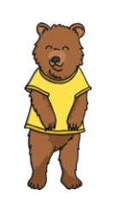
I shouldn’t have eaten your porridge.
Lesson 5 – Speech bubbles
It’s okay Goldilocks.
I will fix Baby Bear’s chair.
Let’s be friends!
I’m so sorry!
Draw a picture of Goldilocks and Baby Bear with a speech bubble. What should she say? What might Baby Bear say to her? Here are some examples.

Slide 16

Lesson 6 – Generate ideas.
Later this week we are going to write our own version of Goldilocks and the Three Bears. Today we are going to come up with our own story ideas. When Goldilocks went into the bears’ house, she made some bad choices. What else could might Goldilocks have done inside the house?
Draw a picture and write down your ideas.

Slide 17
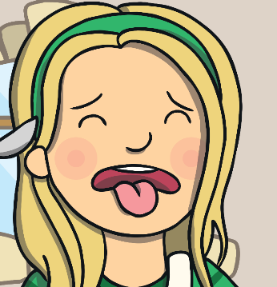
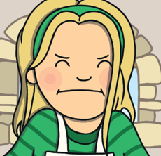


Lesson 6 – Generate ideas.
Example:
Then, she ate Mummy Bear’s cookie but it was too crumbly.
Finally, she ate Baby Bear’s cookie and it was just right!
Goldilocks ate Daddy Bear’s cookie but it was too crunchy.

Slide 18
Lesson 7 – Story map
Today we are going to draw a story map to help us write our story tomorrow.
We need to start with Goldilocks entering the house. Then add 1 or 2 of your own ideas. Finally Goldilocks is found in Baby Bear’s bed. There is an example on the next slide. ☺

Slide 19
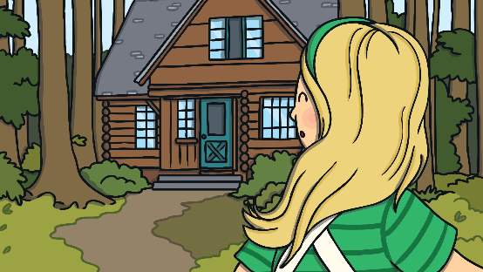


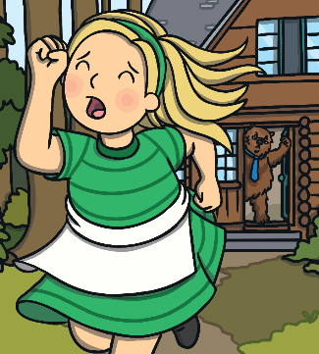
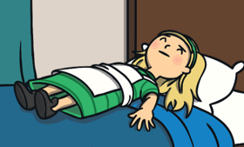
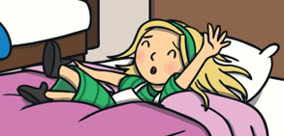
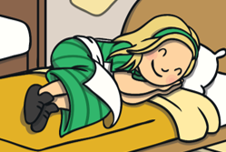

Slide 20
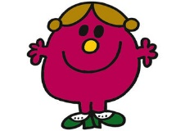
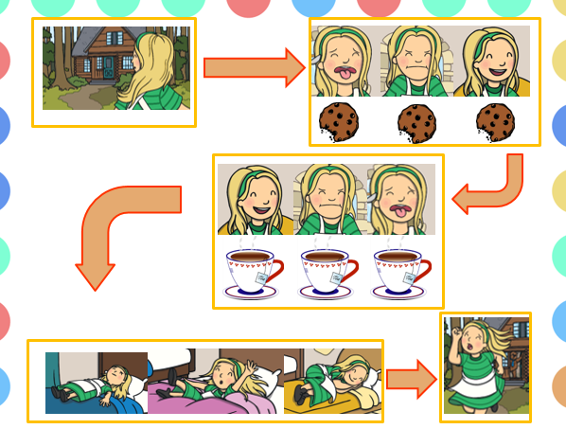
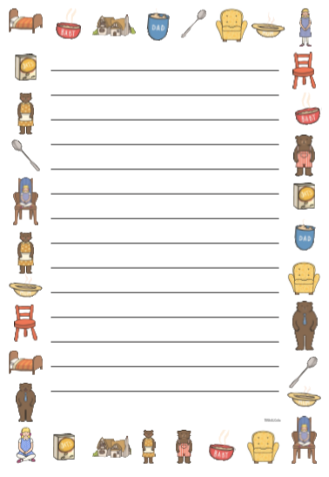
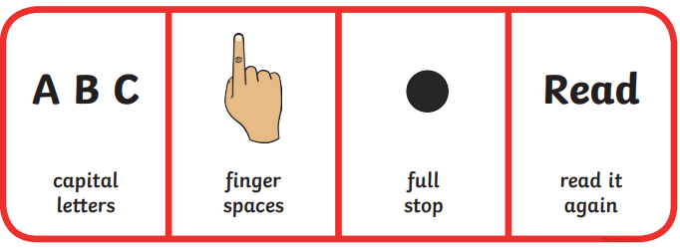
Lessons 8 and 9 – Writing your story.
We are going to spend the next two lessons writing our version of ‘Goldilocks and the Three Bears’.
Little Miss Helpful is back! She has written a helpful list of things to remember when writing your story ☺
Use your story plan to help you organise your writing. Write about one picture at a time.
Say your sentences out loud before you write them.
Remember a good sentence needs these:
We have saved this writing frame into the folder if you would like to write your story on it ☺

Slide 21

Lesson 10 – Edit and perform story.
Well done for writing your story!
Today we are going to check our writing.
Sometimes we find our sentences don’t make sense or we may have forgotten a capital letter – this is perfectly ok! When this happens we go back and make changes. This is called editing.
Do you remember Mr Rush? He’s always in a hurry! He has edited his sentence in blue pen. Take a look at what he has done.
Once upon a time there woz was a girl called Goldilocks. She had golden, curly hair.
Have a go at editing your story ☺

Slide 22


Lesson 10 – Edit and perform story.
You should be really proud of yourself for writing your own story!
Take some time to read it to your family.
You could even ask an adult to take a video of you reading your story! You could then send it to your family and friends ☺

Slide 23
If you have had a go at some or all of the tasks…
Well done!
We are really proud of you.
Have a lovely weekend with your family.

