Slide 1
Year 1
Reading and Writing
Week 1 and Week 2
20/4/20 – 1/5/20

Slide 2

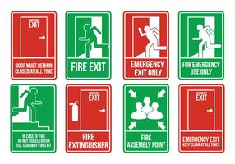
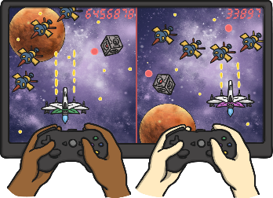

Hello Year 1!
Over the next two weeks we are going to be learning about instructions.
This PowerPoint includes ten sessions for you to complete over the next two weeks.
Instructions are written for someone who needs to know how to do something.
Here are some examples…
How to play a game.
How to make a craft.
Safety procedures.
Recipes.

Slide 3
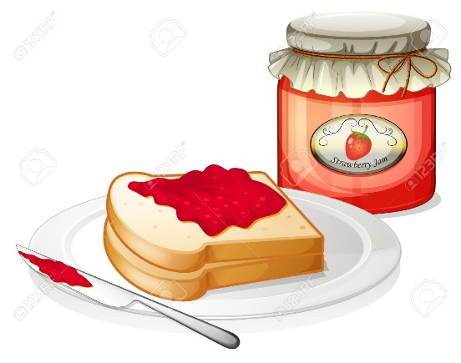
Lesson 1 – Reading and following instructions.
Read and re-read the instructions ‘How to Make a Jam Sandwich’ on the next few slides. With your adult talk about…
Are the instructions easy to follow?
What makes them easy to follow?
Have a go at acting out the instructions. Or, if you are able to, have a go at following the instructions and make your own jam sandwich with your adult ☺
Don’t forget to wash your hands.

Slide 4
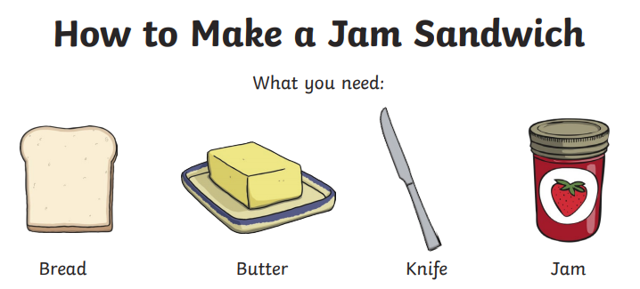
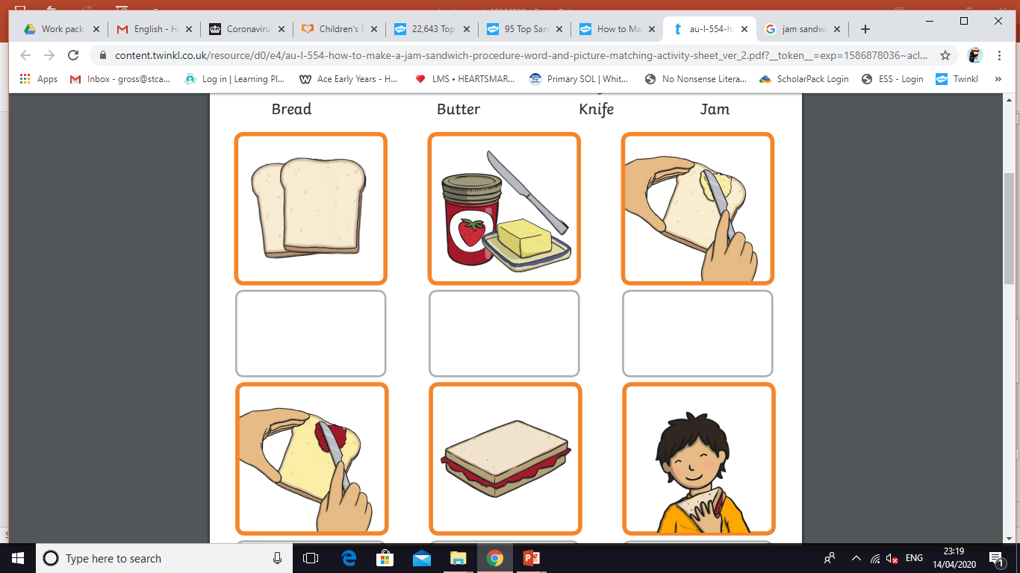
Lesson 1
Wash your hands and
get two slices of bread.
2. Get some jam, some butter
and a knife.

Slide 5

Lesson 1
3. Spread the butter onto one
slice of bread.
4. Spread the jam onto the
other slice of bread.
5. Place one slice of bread on
top of the other, to make
a sandwich.

Slide 6
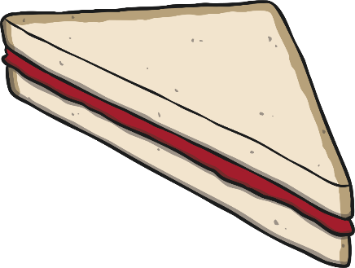
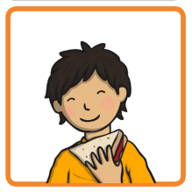
Lesson 1
6. Cut the sandwich in half
with the knife.
7. Eat your sandwich.

Slide 7
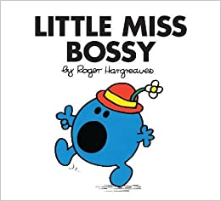
Lesson 2 – Bossy verbs.
Bossy verbs are words that tell you what to do.
For example: Turn off the light. Shut the window.
We use bossy verbs at the beginning of a sentence to change it into a command (telling someone what to do).
Look back through the instructions on ‘How to Make a Jam Sandwich’. How many bossy verbs can you find?
Answers are on the next slide ☺

Slide 8
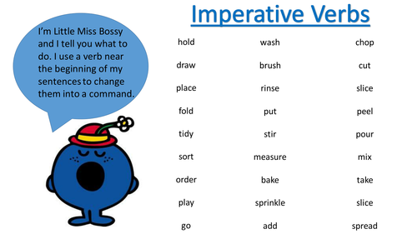
Lesson 2
Hopefully you found the following bossy verbs:
wash get spread place cut eat
Pretend to be Mr or Little Miss Bossy! Pick a bossy verb from below and instruct your adult to do something (just pretend by acting it out). For example: ‘Wash your hands’. ‘Pick the apples from the tree’. Take it in turns ☺
Can you think of any others?
brush pick put
wash fold pour
stir sprinkle spread

Slide 9
Lesson 3 – Bossy verbs.
Read the commands below. Which bossy verb is missing?
_________ the milk into the glass.
_________ the butter onto the bread.
_________ off the lights off please.
_________ the sandwich in half.
Can you write down two of your own commands?
Turn Spread Cut Pour

Slide 10
Lesson 4 – Ordering instructions.
It is important for instructions to be written and followed in the right order.
Some instructions use numbers to help you follow the commands. Some use ‘time connectives’. These are words or phrases that tell you WHEN to do something. Here are some examples.
First Then
After that Next
Last Finally

Slide 11
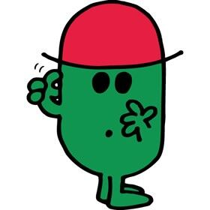
Lesson 4
Mr Muddle has muddled the instructions for ‘How to Make a Jam Sandwich’. Can you help him put them in the right order?
Look out for those time connectives. They may help you ☺
Finally eat your sandwich.
Next cut your sandwich in half with a knife.
Then spread the butter onto one slice of bread and spread the jam onto the other slice of bread.
First wash your hands and get two slices of bread.
After that place one slice of bread on top of the other, to make a sandwich.
Next get some jam, butter and a knife.

Slide 12

Lesson 5 – Writing instructions.
Let’s have a go at writing the instructions for ‘How to Make a Jam Sandwich’. Use the pictures to help you with your ideas. Remember to say your sentence before you write it.
Challenge: Try using a time connective too.
For example…
Bossy verb
1. First wash your hands and get two slices of bread.
Time connective
Please find the pictures on the next slide.
If your child is finding sentence writing difficult, please don’t worry! We would encourage you to simplify the task by asking your child to record simple commands. For example:
Get the bread. Spread the butter. Cut it.
This is great too ☺

Slide 13
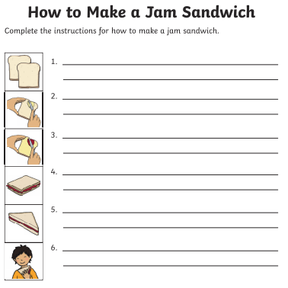
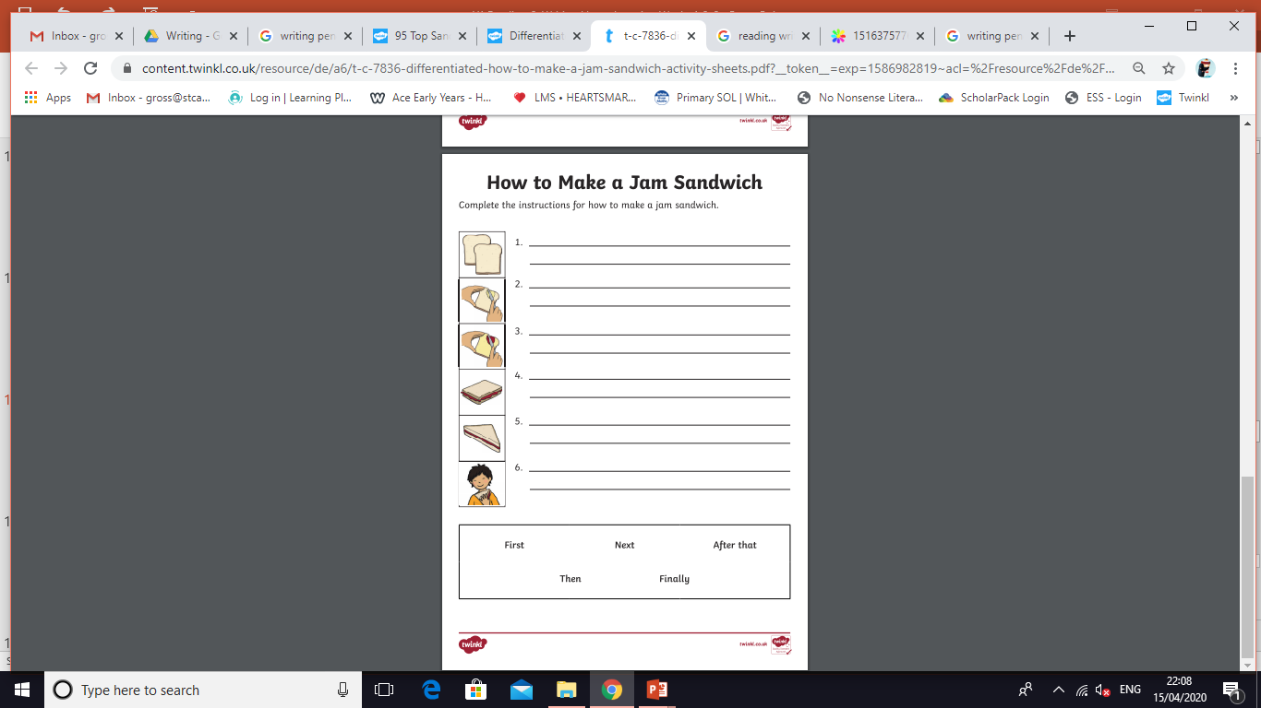
Lesson 5
We have uploaded a printable version of this writing frame onto the school website if you should wish to use it.

Slide 14

Lesson 6 – Improving sentences.
Mr Rush had a go at writing the instructions too, but accidentally missed some important things!
Help Mr Rush improve his sentences. Each sentence has two mistakes. Can you find them?
Look carefully at the capital letters, full stops, finger spaces and spellings!

Slide 15
Lesson 6
Each sentence has two mistakes.
Can you find them?
1. first wash your hands and get th bread.
2. Spread the butter onto one slice off bread
3. then spread the jam onto the other slice of Bread.
4. put the pieces ofbread together.

Slide 16
Lesson 6
Did you spot the mistakes? Here are the answers:
1. first wash your hands and get th bread.
2. Spread the butter onto one slice off bread
3. then spread the jam onto the other slice of Bread.
4. put the pieces ofbread together.
Now take a look at your piece of instruction writing. Is there anything you could improve on?

Slide 17
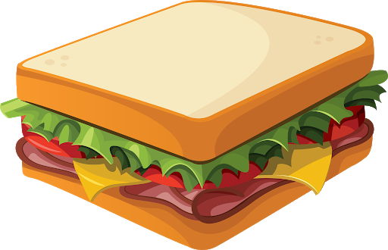
Lesson 7 – Labelling.
Jam sandwiches may not be for you! What do you normally have on a sandwich (roll, wrap, baguette etc)?
Draw, colour and label a sandwich that you normally eat at home.
This is Mrs Ross’s favourite sandwich ☺
White bread
Lettuce
Butter
Ham
Cheese
Tomatoes

Slide 18


Lesson 8 – Make a sandwich.
If possible have a go at making your sandwich with an adult. If this is not possible you could act it out.
In lesson 10 we will be having a go at writing instructions for making our chosen sandwich. If possible ask your adult to take pictures of you making your sandwich, or even a video. You could draw a few pictures of what you would do if you were to make your sandwich. These will help you with your writing in lesson 10. ☺
Can you make a list of the equipment and ingredients you need to make your sandwich?

Slide 19
Lesson 9 – Bossy verbs.
We now know that bossy verbs are words that tell you what to do. Read the bossy verbs below. Choose the ones that you did when you made/acted making your sandwich.
Make a list of these on a piece of paper.
spread cut slice
mix grate place
roll chop scoop
eat wash sprinkle

Slide 20
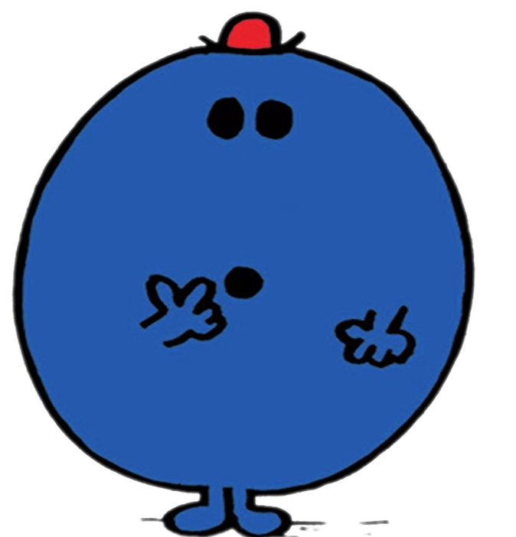
Lesson 10 – Writing instructions.
Think about the sandwich you made or pretended to make in lesson 8. If you took or drew pictures have a look at them to remind yourself of what you did. Talk it through with your adult.
Mr Forgetful is hungry, but he has forgotten how to make a sandwich! Can you help him by writing down the instructions for how to make your sandwich?
Please find some helpful hints on the next page ☺

Slide 21

Lesson 10
This is Little Miss Helpful. She has made a list of things that may help you write your instructions.
Say your sentence before you write it.
Start each sentence with a bossy verb. Use the
list you made in lesson 9.
Use a capital letter at the beginning of your sentence and a full stop at the end.
Reread your sentence to check it makes sense.
Please simplify the task if you need to. Simple commands are great too. For example…
Get the ham. Cut it. Eat it. ☺
Challenge: Try using a time connective.
Next spread the butter onto the bread.

Slide 22
If you have had a go at some or all of the tasks…
Well done!
We are really proud of you.
Have a lovely weekend.

