Slide 1
Year 1
Reading and Writing
Week 12
13/7/20 – 17/7/20

Slide 2

Hello Year 1!
We hope you enjoyed writing your own version of Goldilocks and the Three Bears ☺
This PowerPoint includes five sessions for you to complete over the next week.
This week we are going to be reflecting on our time in Year 1 and thinking about our move to Year 2. ☺

Slide 3
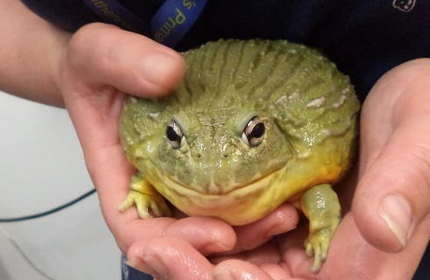
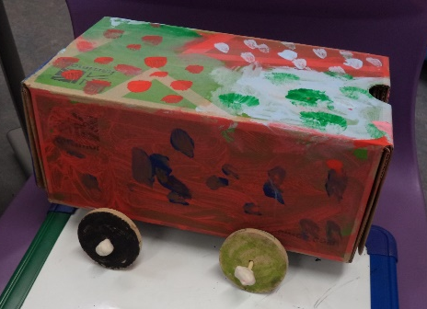
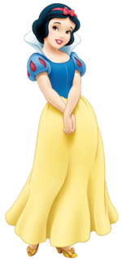
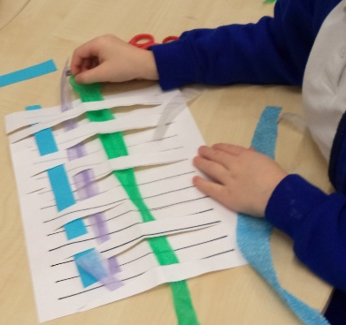

Lesson 1
Reflecting on our time in Year 1.
Some of our Year 1 memories!
bull frog visit
making vehicles in DT
pantomime
weaving
class assembly

Slide 4
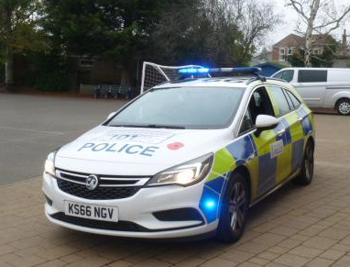
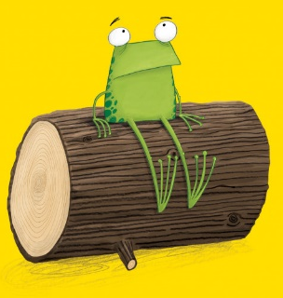
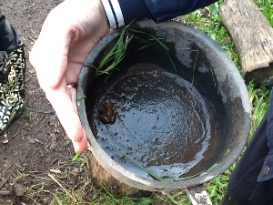
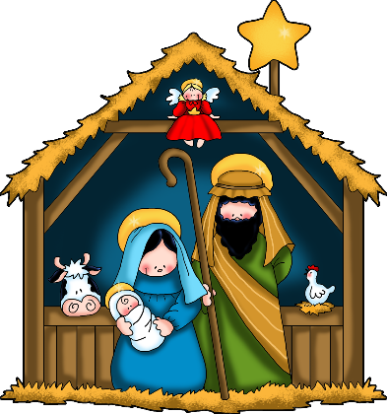
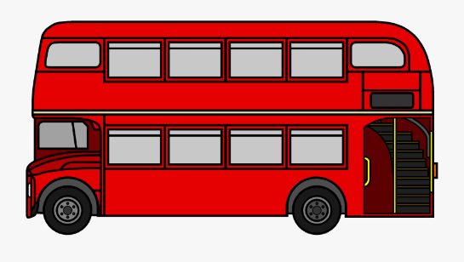
police visit
Oi Frog performance
frog hunting in forest school
Christmas play
naughty bus

Slide 5
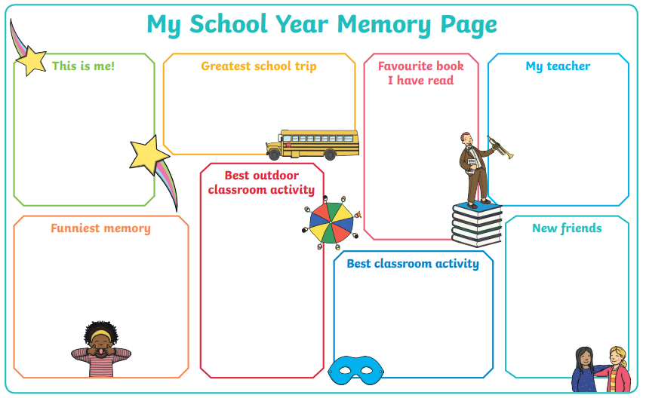
Lesson 1 – Reflecting.
Let’s reflect on our time in Year 1. Who were you friends with? What was your favourite moment? Record your ideas on this sheet which is saved in the Reading & Writing folder, or make your own. ☺

Slide 6
Lesson 2
All About Me!
Make a booklet all about you! You could give this to your new teacher in September to help them get to know you. ☺
Some things you could include are:
A picture of your family
A picture of your friends
Things you enjoy most about school
Things you sometimes need help with
Your favourite things (colour, animal, hobby etc.)
What you would like to be when you grow up
There is a template you can use on the website or you can make your own.

Slide 7
Lesson 3
Question writing.
You might have some questions you’d like to ask your new teacher. Practice question writing in a note to your new teacher. You could give this to them in September. ☺
Don’t forget to use a question mark instead of a full stop!
E.g.
What is your favourite colour?
Do you have any pets?
What are your hobbies?
What is your favourite story?
If you could be a superhero, who would you be and why?

Slide 8
Lesson 4
Goals for Year 2.
Think of 3 things you would like to improve on when you are in Year 2. For example:
I will make HeartSmart choices on the playground.
I will remember to start every sentence with a capital letter.
I will be brave and put my hand up more in class.

Slide 9




Lesson 5
Spreading your wings!
This year has been so special,
We’ve watched you learn and grow.
But now the time has come for you,
To spread your wings and go.
So hold your head up proudly,
We know that you’ll go far.
You’ll be a beautiful butterfly,
For just being who you are!

Slide 10
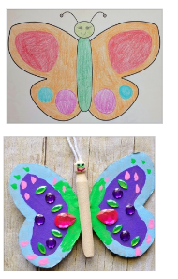
We would like you to decorate a butterfly to take with you to your new class. Your butterfly will remind you throughout Year 2 how wonderful you are for just being you!
You might just want to colour it or you could stick things to it as well. Write your name on the back and bring it to school in September. ☺
A template has been saved on the website for you to use or you can draw your own.

Slide 11
If you have had a go at some or all of the tasks…
Well done!
We are really proud of you.
Have a lovely break with your family.

