Slide 1
Year 1
Reading and Writing
Week 5
18/5/20 – 22/5/20

Slide 2
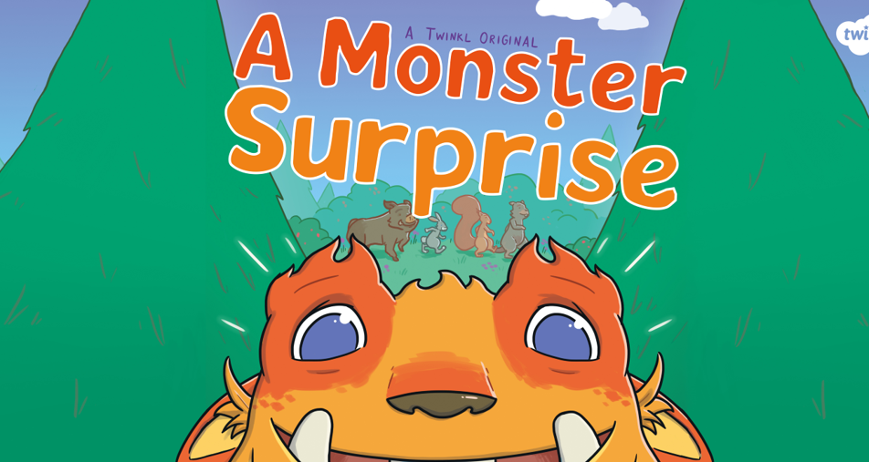
Hello Year 1!
We hope you had fun reading ‘Treasures in the Garden’ last week ☺
This PowerPoint includes five sessions for you to complete over the next week.
Our learning is going to be based on the story
‘A Monster Surprise’

Slide 3
Lesson 1
Reading for pleasure and reading for meaning.
Share the story ‘A Monster Surprise’ with your grown-up.
You may want to read some of the story yourself or your grown-up could read it to you.
You may come across some new words in this story. Discuss their meanings with your adult. Here are some examples:
Culprit – A person who is responsible for a crime.
Villain – A character who does mean things on purpose.
The story is saved as a separate document which you will find in the
Year 1 Reading and Writing folder on our school website ☺

Slide 4
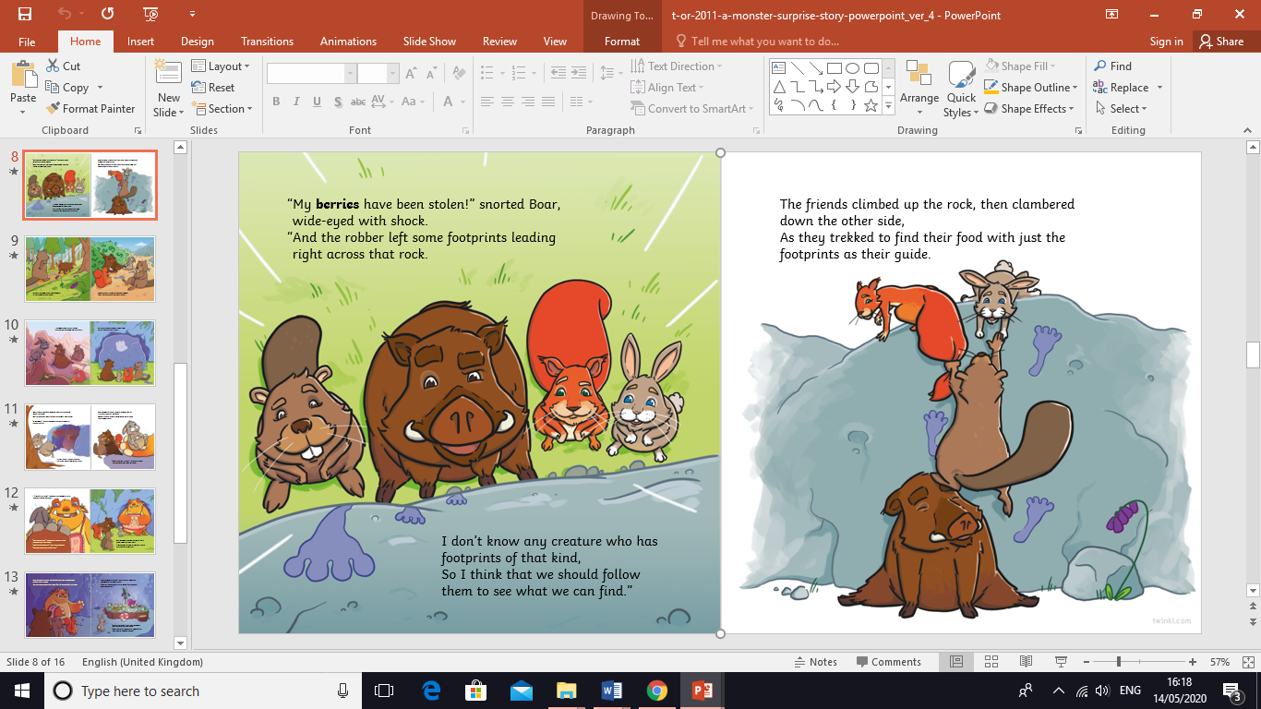


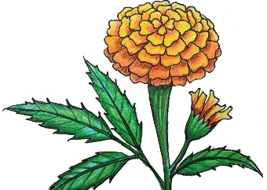

Lesson 1
Reading for pleasure and reading for meaning.
We hope you enjoyed reading the story. We love a story with a happy ending ☺
During the story the animals discovered their food was missing. Can you match the animal to their food? You may want to look back at the story for help.
Rabbit
Squirrel
Beaver
Boar
acorns
berries
marigolds
branches

Slide 5
Lesson 1
Reading for pleasure and reading for meaning.
Did you manage to match them up? Here are the answers.
Rabbit
Squirrel
Beaver
Boar
acorns
berries
marigolds
branches

Slide 6
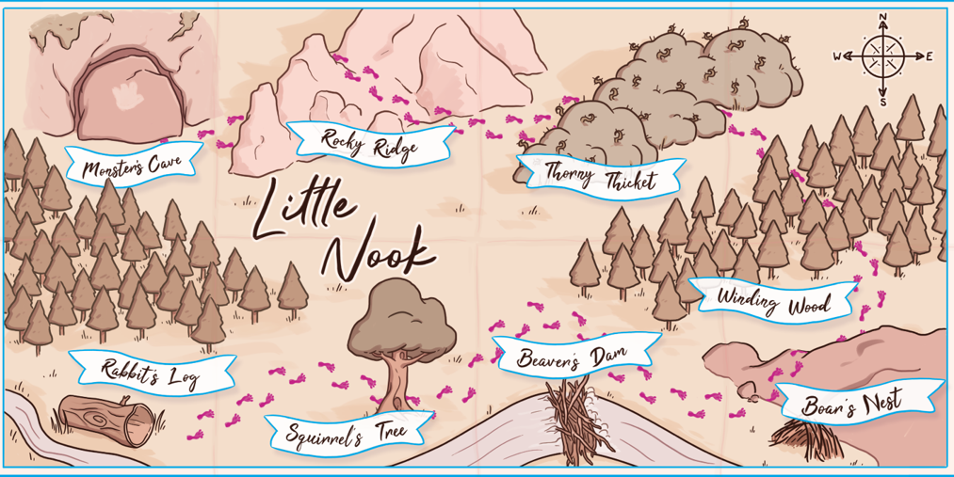
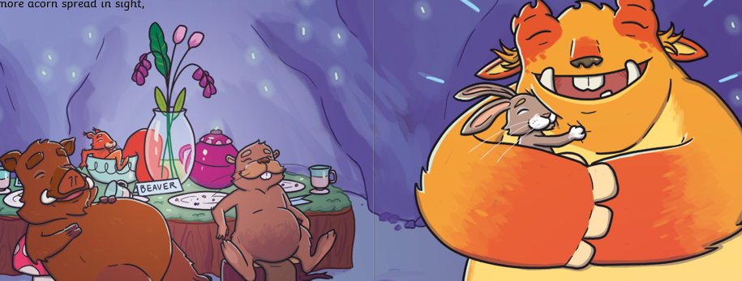
Lesson 2 – Using ’and’ to join words.
We would like you to start this lesson by retelling (verbally) the story ‘A Monster Surprise’. Use the story map below to help you.

Slide 7
Lesson 2 – Using ‘and’ to join words.
Information for parents: When we are speaking and writing, we join our words and ideas together using conjunctions. Conjunctions are words used to join words, phrases and clauses. One of the most common ones is ‘and’.
What useful little word do you think we could use to join the words in these answers?
Who is coming to the party?
Squirrel. Beaver.
What are they going to eat?
Acorns. Branches.

Slide 8
Lesson 2 – Using ‘and’ to join words.
We can use the word and to join the words together.
Who is coming to the party?
Squirrel and Beaver.
What are they going to eat?
Acorns and branches.
Use and to answer this question. Write your answer on a piece of paper.
What would you like to eat at a party?
_______________ and _______________.

Slide 9
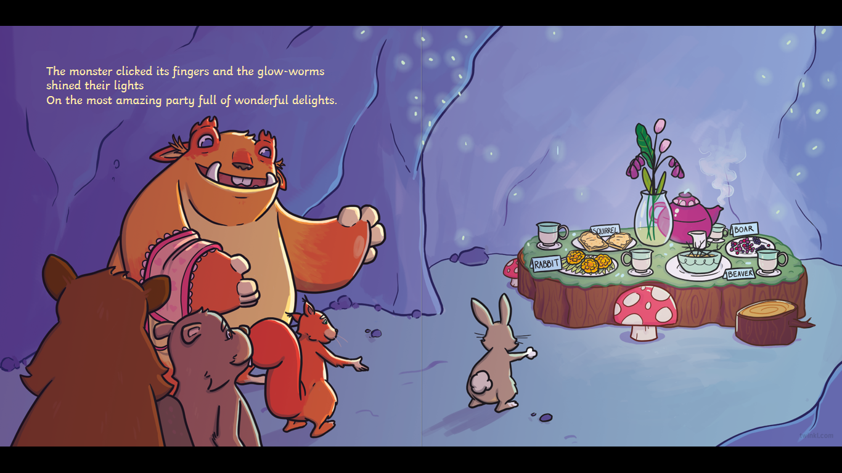
Lesson 3 – Joining sentences.
We can also use and to join two sentences or parts of sentences together.
Rabbit went to the party. He had fun.
Rabbit went to the party and he had fun.
This word no longer needs to start with capital letter.

Slide 10
Lesson 3 – Joining sentences.
Can you use and to join these sentences?
Copy the sentences onto a piece of paper using and to join them. If you find this too tricky talk about the sentences with your adult.
The monster had a party. Everyone loved it.
Squirrel sat at the table. She ate the party food.
Rabbit thanked the monster. She gave him a hug.
Remember the next word after ‘and’ does not need to start with a capital letter.

Slide 11
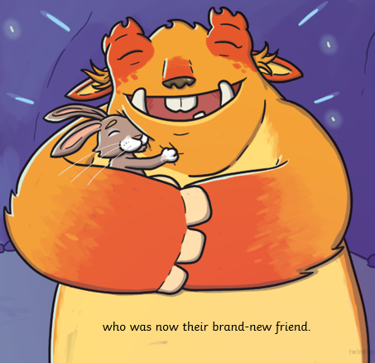
Lesson 3 – Joining sentences.
Did you remember that the next word after ‘and’ does not need a capital letter?
The monster had a party and everyone loved it.
Squirrel sat at the table and she ate the party food.
Rabbit thanked the monster and she gave him a hug.

Slide 12
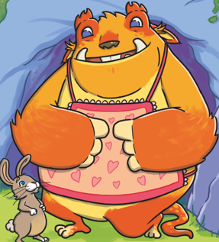
Lesson 4 – Joining sentences with and.
Read the sentences below. Which sentences would go together if you joined them with and?
They played pass the parcel.
He had lots of fun.
The table was full of food.
Squirrel won.
Rabbit went to the party.
It was very yummy.

Slide 13
Lesson 4 – Joining sentences with and.
Did you get it right?
They played pass the parcel.
He had lots of fun.
The table was full of food.
Squirrel won.
Rabbit went to the party.
It was very yummy.
They played pass the parcel and Squirrel won.
The table was full of food and it was very yummy.
Rabbit went to the party and he had lots of fun.

Slide 14
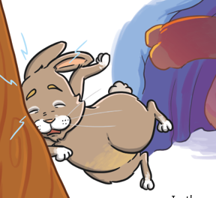

Lesson 4 – Joining sentences with and.
How would you finish these sentences?
The Rabbit got scared and…
The Rabbit hugged the monster and…

Slide 15
Lesson 4 – Joining sentences with and.
You may have thought of something like this…
The Rabbit got scared and he ran into the tree.
The Rabbit hugged the monster and they became friends.

Slide 16

Lesson 5 –Writing sentences with ‘and’.
Now we can use and to join words and sentences ☺
Today we are going to have a go at writing some of our own sentences.
Even though we are in lockdown, we can still have small celebrations in our houses with our families. You or someone in your family may have had a Birthday whilst at home. How did you make it special? How would you make it special if it was someone's Birthday in your house?
Write some sentences about what you have done or would do.
Please find some helpful tips on the next slide ☺

Slide 17
Lesson 5 – Writing sentences with and.
Below is a word bank to help you with your ideas and spelling ☺
birthday | balloons | cake | sandwiches
games | presents | fun | sweets
sing | dance | dress up | laugh
family | brother | sister | card
Challenge: If you feel your child is ready for the challenge, encourage them to use ‘and’ to join words and sentences. For example…
On my Dad’s birthday we played music and I danced around the living room.
I would eat lots of cake and sweets.
Grown-ups: Please simplify this task if you need to. Simple sentences are great too. For example…
I made a cake.
I would dress up.

Slide 18
If you have had a go at some or all of the tasks…
Well done!
We are really proud of you.
Have a lovely half term with your family.

