Slide 1
Year 1
Reading and Writing
Week 6 and 7
1/6/20 – 12/6/20

Slide 2

Hello Year 1!
We hope you had fun reading ‘A Monster Surprise’ before half term ☺
This PowerPoint includes ten sessions for you to complete over the next two weeks.
Our learning is going to be based on the story
‘The Very Hungry Caterpillar’ by Eric Carle.

Slide 3

Lesson 1
Reading for pleasure and reading for meaning.
Read the story ‘The Very Hungry Caterpillar’ to your grown-up.
This is a very well-known story. We are sure you will have heard it before!
The story is saved as a separate document which you will find in the
Year 1 Reading and Writing folder on our school website ☺

Slide 4
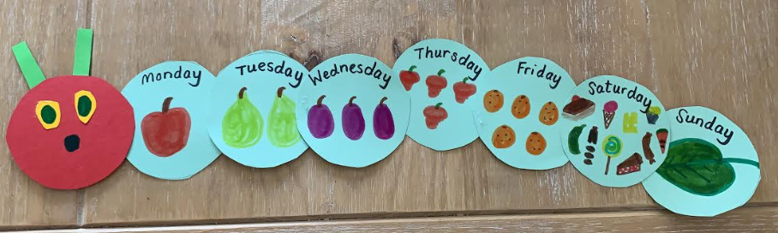
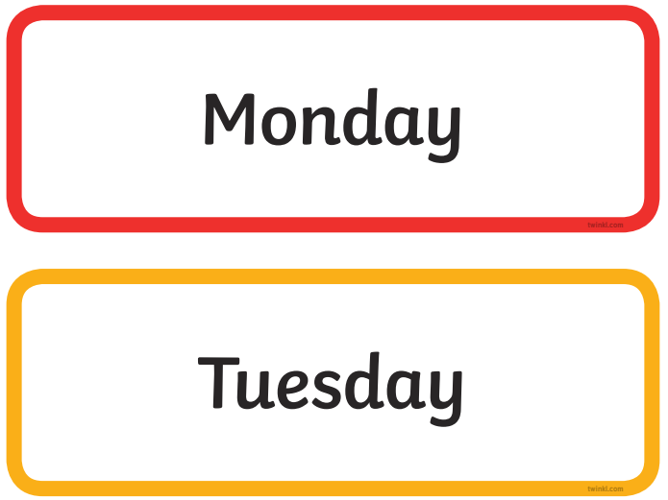
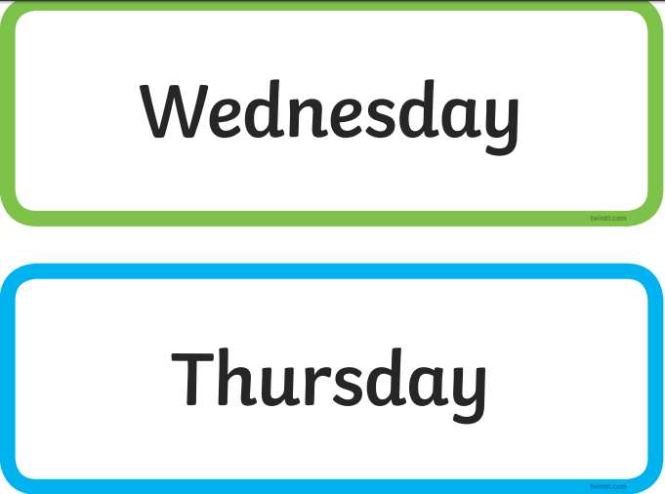
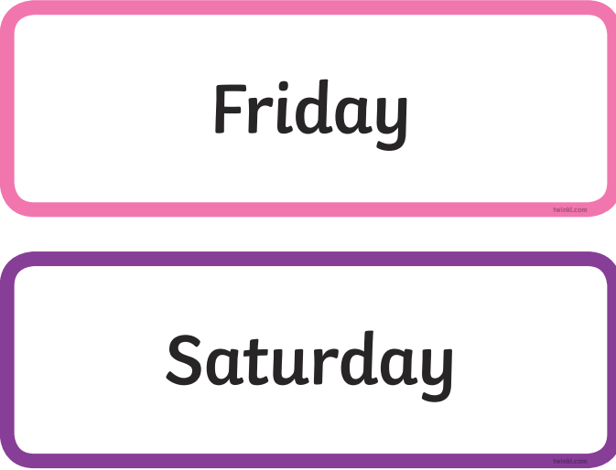
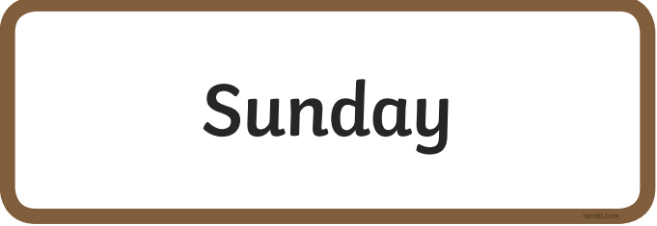
Lesson 1
Reading for pleasure and reading for meaning.
Have a go at making your own hungry caterpillar paper craft. This is Mrs Ross’s caterpillar. Can you remember what he ate each day? Look back at the story to help you.
You will need:
A pencil
Something circular to draw around (Mrs Ross used a plastic cup)
Paper
Colouring pens or pencils
Scissors
Glue
This is a good opportunity to practice writing the days of the week. Remember each day needs a capital letter at the beginning ☺

Slide 5
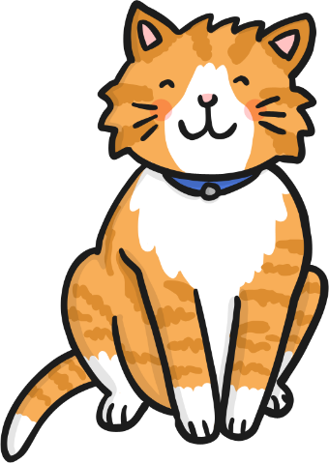
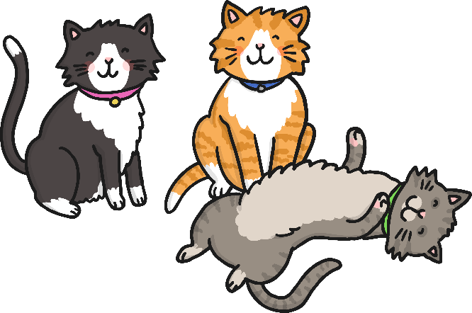
Lesson 2 – Singular and plural.
What does singular and plural mean?
one cat
three cats
Singular refers to only one person, place or thing.
Plural refers to more than one person, place or thing.

Slide 6
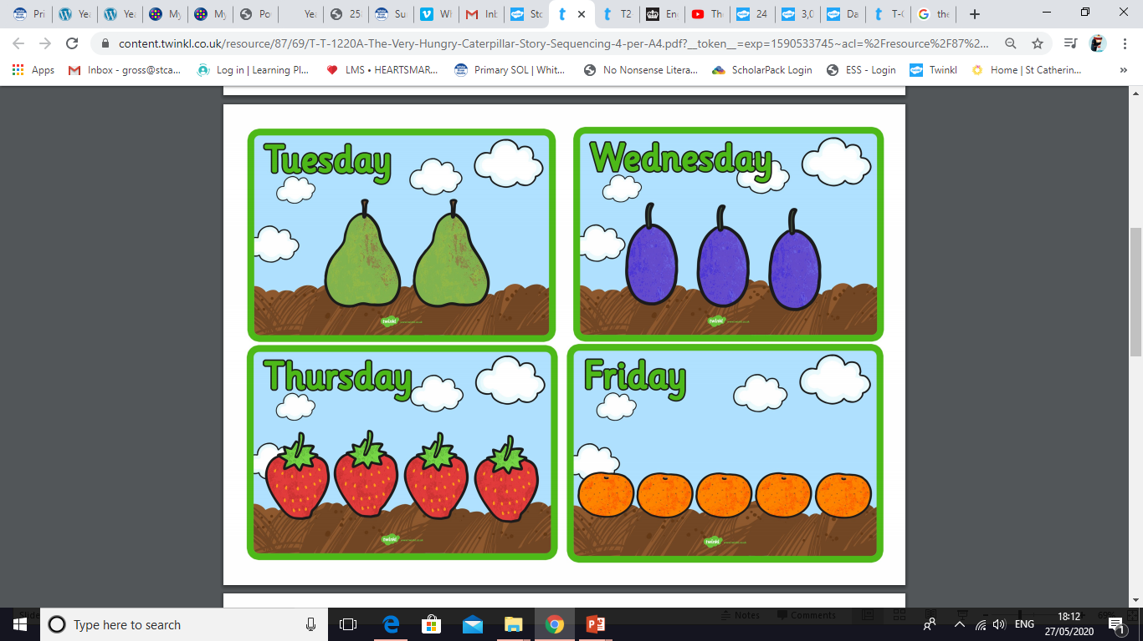
Lesson 2 – Singular and plural.
Singular = 1
Plural = more than 1
One pear
Two pears
One plum
Three plums
One orange
Five oranges
One lollipop
Lots of lollipops
Here are some other examples of singular and plural words.

Slide 7

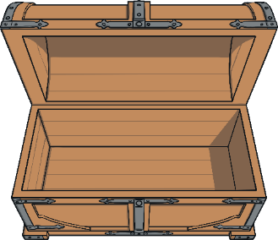

Lesson 2 – Singular and plural.
Can you sort the words on the coins into plural and singular? You could write the words into two columns on a piece of paper.
plural
singular
ship
cakes
houses
brushes
mouse
apple
plums
pickle
leaf
plates

Slide 8
Lesson 2 – Singular and plural.
Here are the answers ☺
plural
singular
cakes
houses
pickle
ship
brushes
plums
leaf
mouse
plates
apple
How many more words can you think of to go in the plural treasure chest?

Slide 9
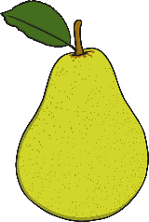
Lesson 3 – Changing words from singular to plural.
For most words we just add ‘s’ to the end of it to change it into a plural.
one pear
three pears
Have a look at how these singular words are changed into a plural.
desk
desks
month
months
book
books
train
trains
pen
pens
dog
dogs

Slide 10
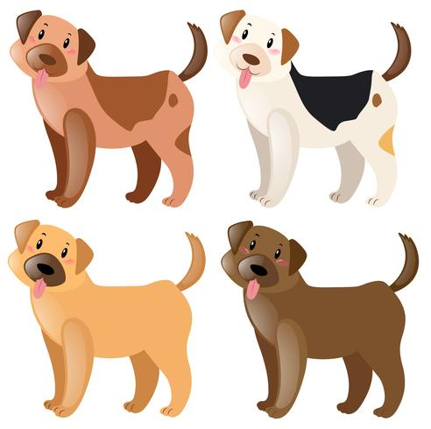



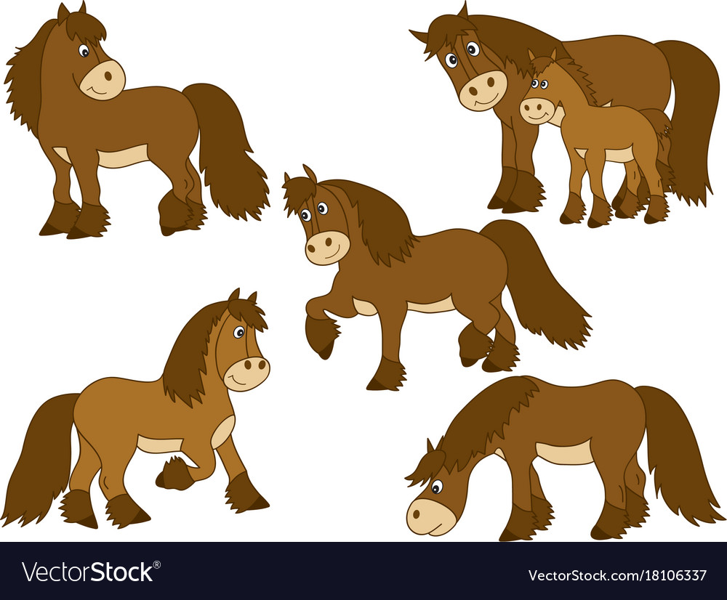

Lesson 3 – Changing words from singular to plural.
Can you change these singular words into a plural?
Write the plural on a piece of paper. You could draw a picture too ☺
book
car
dog
horse
flower
boy and girl

Slide 11

Lesson 3 – Changing words from singular to plural.
Answers. Did you spell the plurals correctly?
dogs
books
cars
horses
flowers
boys and girls

Slide 12
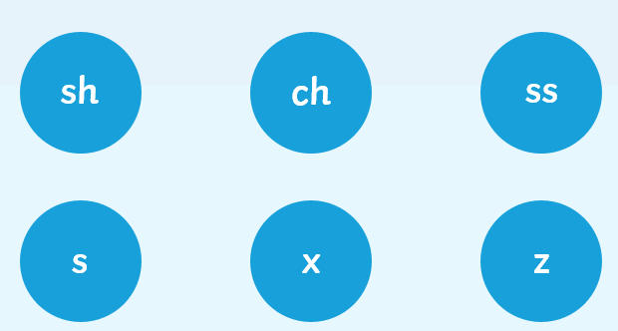
Lesson 4 – Changing words from singular to plural.
Not all words are changed into plurals by adding ‘s’. If a word ends in one of these sounds…
…then add ‘es’.
Take a look on the next page for some examples.

Slide 13

Lesson 4 – Changing words from singular to plural.
To change these words in to plurals, we add ‘es’.
one brush
two brushes
box
boxes
dish
dishes
glass
glasses
church
churches

Slide 14
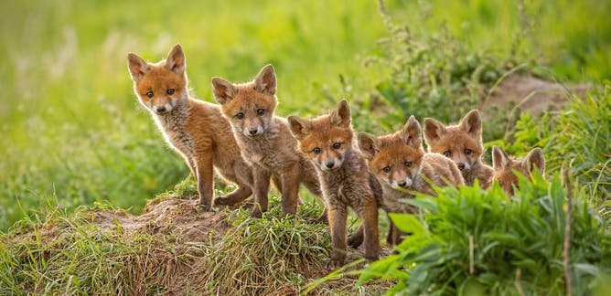
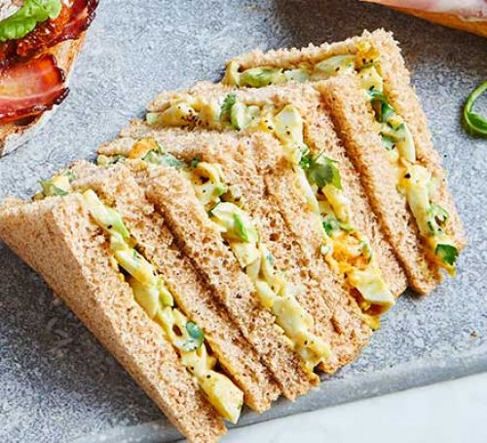


Lesson 4 – Changing words from singular to plural.
Remember the rule!
If a word ends in one of these sounds we add ‘es’ to make it plural.
Which is the correct spelling for these plurals?
foxes foxs
sandwichs sandwiches
brushs brushes
glasses glasss

Slide 15
Lesson 4 – Changing words from singular to plural.
Remember the rule!
If a word ends in one of these sounds we add ‘es’ to make it plural.
Which is the correct spelling for these plurals? Answers.
foxes foxs
sandwichs sandwiches
brushs brushes
glasses glasss

Slide 16
Lesson 4 – Changing words from singular to plural.
Can you spot these plurals in the wordsearch?
b | u | s | h | e | s | c | t
f | g | h | j | k | o | h | r
c | a | t | s | a | c | u | e
y | u | i | o | p | k | r | e
c | r | i | s | p | s | c | s
d | f | w | q | l | x | h | z
i | t | f | l | e | o | e | v
f | o | x | e | s | m | s | b
trees
cats
socks
crisps
apples
foxes
bushes
churches

Slide 17
Lesson 4 – Changing words from singular to plural.
Answers. Did you find them all?
b | u | s | h | e | s | c | t
f | g | h | j | k | o | h | r
c | a | t | s | a | c | u | e
y | u | i | o | p | k | r | e
c | r | i | s | p | s | c | s
d | f | w | q | l | x | h | z
i | t | f | l | e | o | e | v
f | o | x | e | s | m | s | b
trees
cats
socks
crisps
apples
foxes
bushes
churches

Slide 18


Lesson 5 – Correcting the spelling.
The hungry caterpillar has forgotten to change the words in his sentences to plurals! Can you write his sentences correctly, using plural words?
On Thursday I ate four radish.
On Tuesday I ate two peach.
On Wednesday I ate three grape.
On Friday I ate five sandwich.
On Saturday I ate lots of sweet.
Can you write your own sentence using a singular word for a friend to correct?

Slide 19

Lesson 5 – Correcting the spelling.
Here are the answers. Check your sentences to see if you spelt the plurals correctly ☺
On Thursday I ate four radishes.
On Tuesday I ate two peaches.
On Wednesday I ate three grapes.
On Friday I ate five sandwiches.
On Saturday I ate lots of sweets.
Can you write your own sentence using a singular word for a friend to correct?

Slide 20


Lesson 6 – Creating your own storybook.
Over the next few lessons we are going to create our own version of ‘The Very Hungry Caterpillar’.
To create your book you will need 4 pieces of plain A4 paper.
Put them together in a pile and fold in half to create a book ☺
You may want to staple the middle, but a grown-up would have to do this for you.

Slide 21
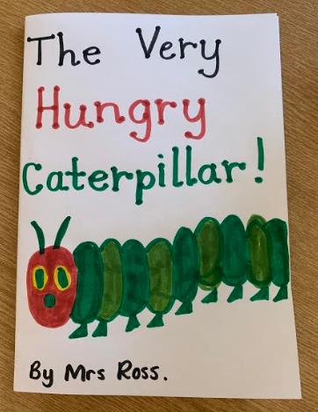
Lesson 6 – Creating your own storybook.
Today we would like you to design your front cover.
Make it as bright and as colourful as you want.
This is Mrs Ross’s…
You need to include the title ‘The Very Hungry Caterpillar’
Draw a picture of what the story is about.
Include your name. You are the author of this story ☺

Slide 22
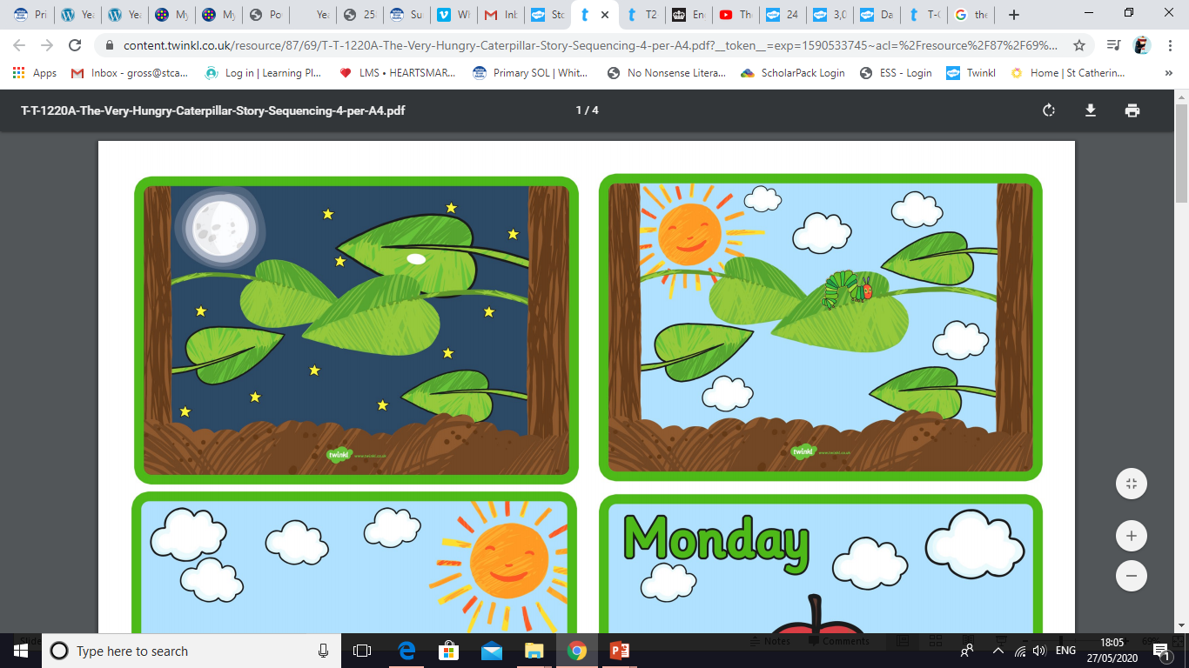
Lesson 7 – Writing the start of our story.
Today we are going to write the first two pages of our story.
We are going to keep this part similar to ‘The Very Hungry Caterpillar’. You can use these pictures to help you.
Use the first two pages of your book to draw pictures similar to these, then write a sentence underneath. Take a look at the next slide to see what Mrs Ross has done.

Slide 23
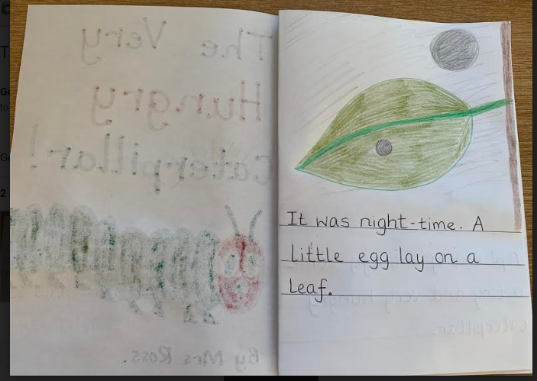
Lesson 7 – Writing the start of our story.
Helpful hint!
Pencil crayons work best as they don’t soak through to the other side ☺
Page 1
You don’t need to use the exact same words as the book. Look at the picture and put it into your own words ☺ You can always look back at the story to help you with your ideas.

Slide 24
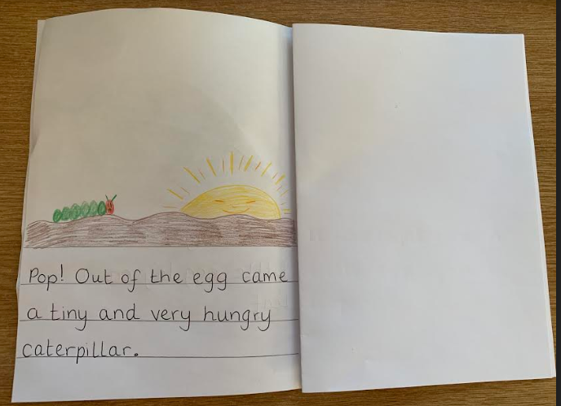
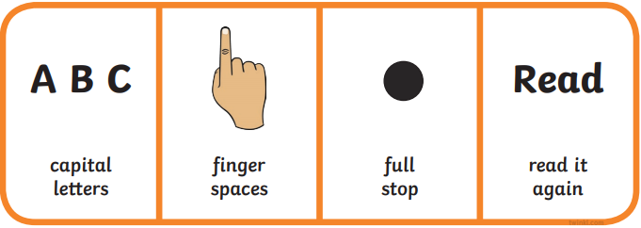
Lesson 7 – Writing the start of our story.
Page 2
Remember what a good sentence needs:

Slide 25
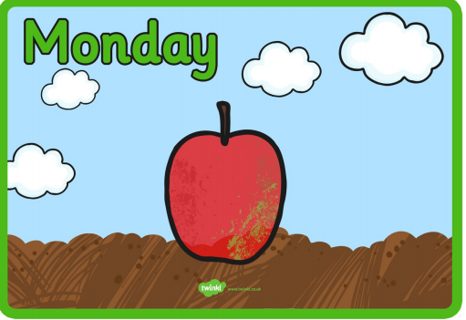
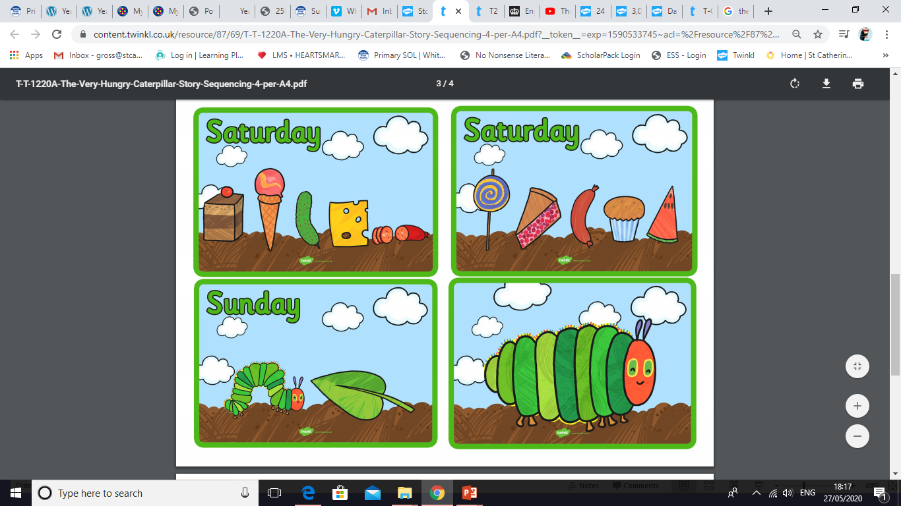
Lessons 8 and 9 – Continuing with the story and adding our own ideas.
The next part of the story goes on to tell us what the caterpillar eats on each day of the week.
This is where we would like you to think of your own ideas. Choose your own foods to include in your story. What might the caterpillar eat? This task will take two lessons. It does not need to be done in one go. Take breaks and do it in smaller bits if you prefer ☺ Take a look on the next slide to see what Mrs Ross has done.

Slide 26
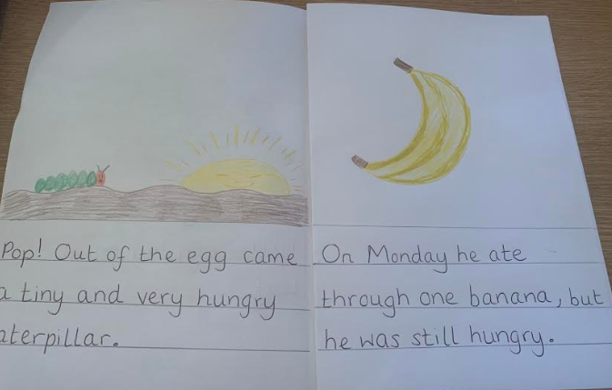
Lessons 8 and 9 – Continuing with the story and adding our own ideas.
Page 3
The next few pages follow the same writing pattern.
On ________ he ate through __________,
but he was still hungry.
If your child is finding this difficult, ask them to write a simple phrase on each page, for example, One banana. Two peaches. etc…

Slide 27
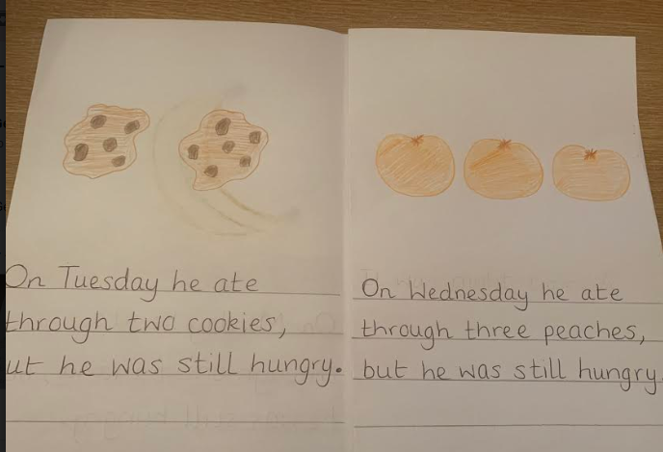
Lessons 8 and 9 – Continuing with the story and adding our own ideas.
Page 4 and 5
Remember! We add ‘s’ to most words when turning them into a plural (more than one), but if a word ends in
‘ch’, ‘sh’, ‘ss’, ‘s’ ‘x’ or ‘zz’ we add ‘es’.
cookie – cookies
peach - peaches

Slide 28
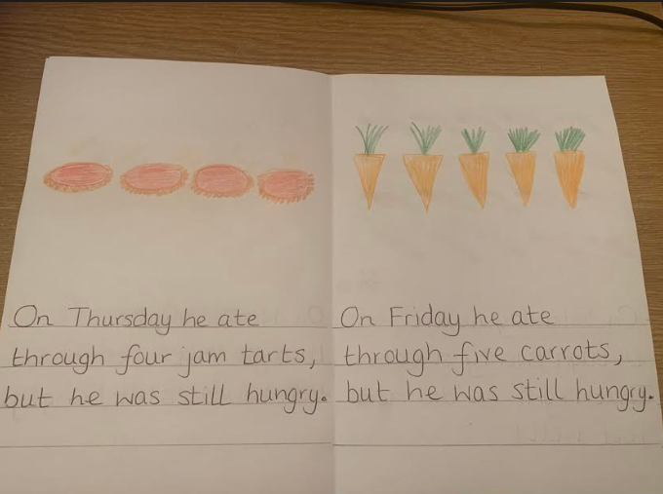
Lessons 8 and 9 – Continuing with the story and adding our own ideas.
Page 6 and 7
Which foods will you choose in your story?

Slide 29
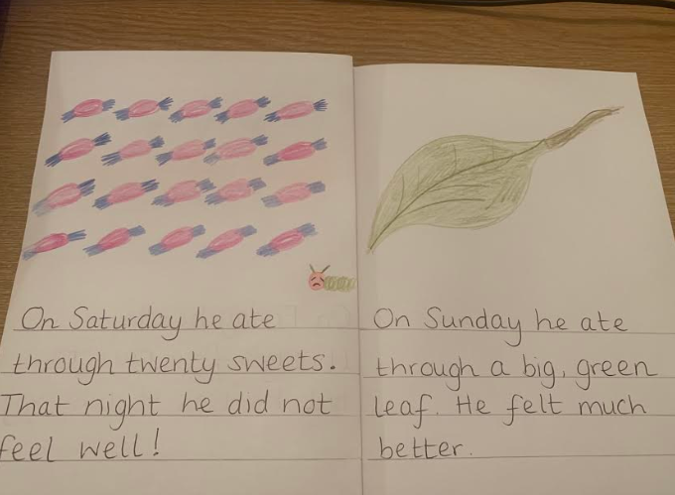
Lessons 8 and 9 – Continuing with the story and adding our own ideas.
Pages 8 and 9
Grown-ups, you can simplify the writing by supporting your child with simple phrases and sentences, for example,
Lots of sweets. He ate a leaf.

Slide 30
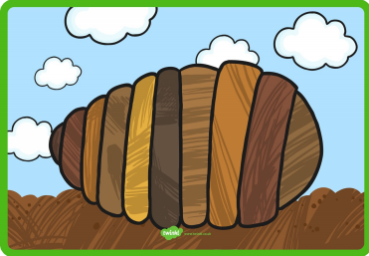
Lesson 10 – Finishing our story.
Today we are going to write the end of our story.
We are going to keep this similar to ‘The Very Hungry Caterpillar’. We can use these pictures to help us.
Use the next two pages of your book to draw pictures similar to these, then write a sentence underneath. Take a look at the next slide to see what Mrs Ross has done.

Slide 31
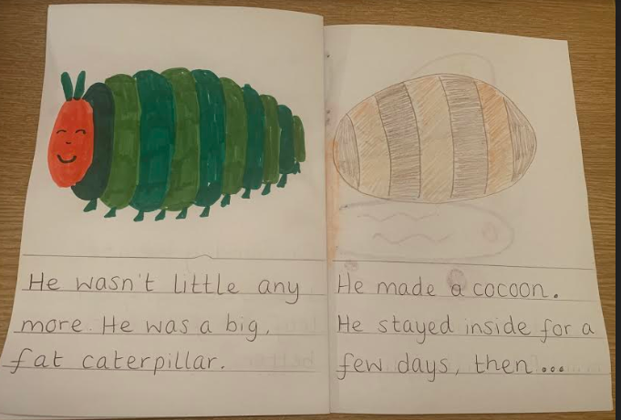
Lesson 10 – Finishing our story
Pages 10 and 11
You don’t have to write this much. You could write…
He was a fat caterpillar. He made a cocoon.

Slide 32
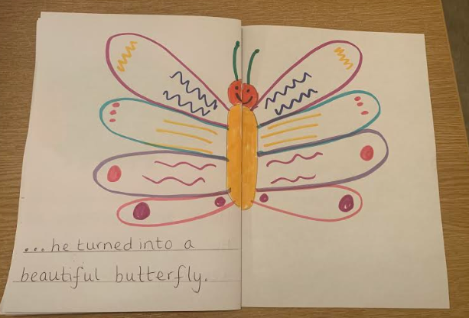
Lesson 10 – Finishing our story
Page 12
The last page! Enjoy drawing a beautiful (symmetrical) butterfly.
If you have completed your book, very well done!! Go and share your story book with someone in your family. You should be very proud.

Slide 33
If you have had a go at some or all of the tasks…
Well done!
We are really proud of you.
Have a lovely weekend with your family.

