Slide 1
Year 1
Reading and Writing
Weeks 8 and 9
15/6/20 – 26/6/20

Slide 2
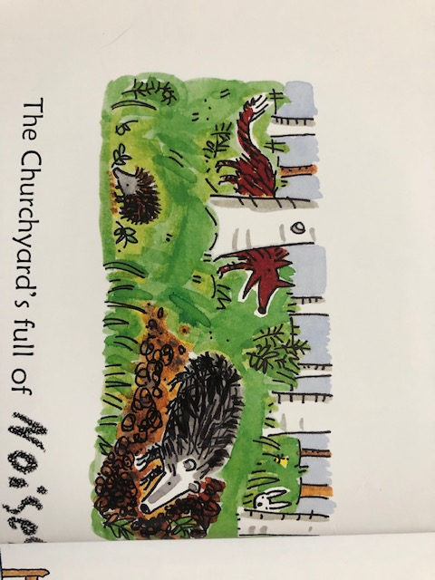
Hello Year 1!
We hope you enjoyed making your very own Hungry Caterpillar book last week ☺
This PowerPoint includes ten sessions for you to complete over the next two weeks.
Our learning is going to be based on the poem
‘Noises Off’ by Gervase Phinn.

Slide 3
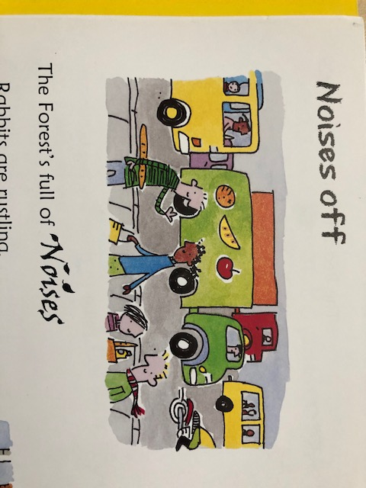
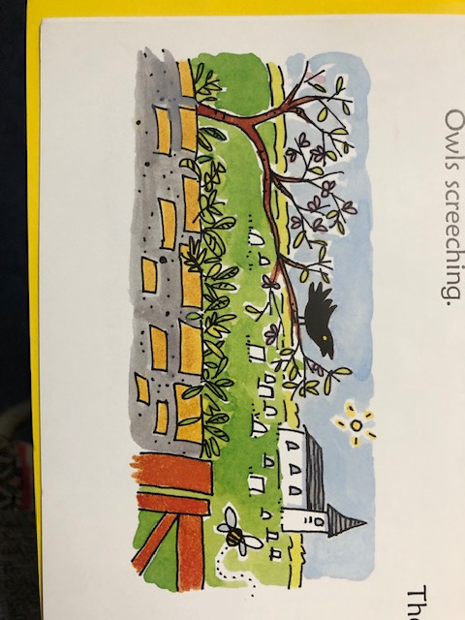
Lesson 1
Reading for pleasure and meaning.
Read the poem ‘Noises Off’ with your grown-up.
As you are reading the poem, see if you can make the noise being described. For example, to represent the bushes rustling you might rub your hands together.
Discuss the meaning of any new words you come across. ☺

Slide 4
Lesson 1 – Reading for pleasure and meaning.
The City’s full of Noises
Cars are honking,
Vans are grumbling,
Lorries juddering,
Buses rumbling,
Trams are sliding,
Trains clattering,
Motorbikes spluttering,
Shoppers chattering.

Slide 5
Lesson 1 – Reading for pleasure and meaning.
The Forest’s full of Noises
Rabbits are rustling,
Badgers burrowing,
Slow worms slithering,
Dormice scurrying,
Foxes barking,
Bats squeaking,
Hedgehogs snuffling,
Owls screeching.

Slide 6
Lesson 1 – Reading for pleasure and meaning.
The Churchyard’s full of Noises
Grass is whispering,
Branches creaking,
Blossoms fluttering,
Gate squeaking,
Bushes rustling,
Birds singing,
Bees buzzing,
Bells ringing.

Slide 7
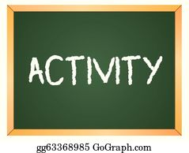


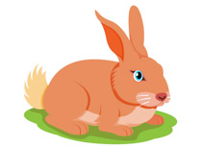

Lesson 2 – Doing words (verbs).
The poem includes many doing words (verbs). These words tell us which noise the object or animal is making. How many doing words can you spot?
Choose 4 of the doing words from the poem and make a list or draw pictures of other things that might make a similar noise.
Example:
‘Bats squeaking’
Mice
Rats
Rabbits
Guinea pigs

Slide 8
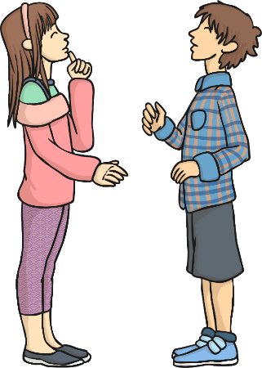
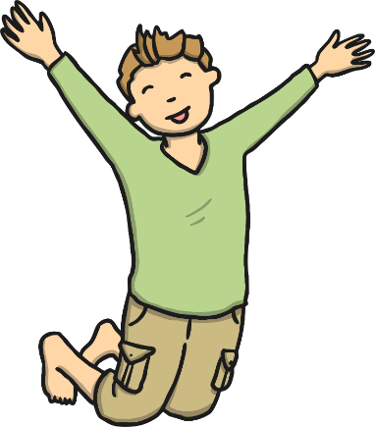
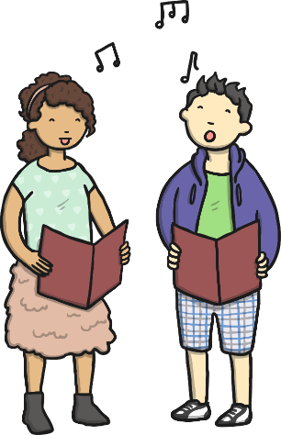
Lesson 3 – Adding ‘–ing’.
talk
talking
Read these pairs of words together:
jump
jumping
sing
singing
What is the same about the meaning of these words?
How is the second word different?
What has been added?

Slide 9
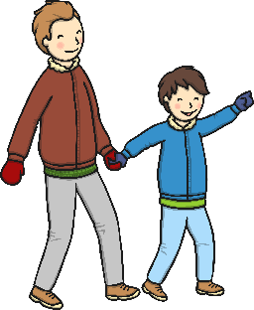
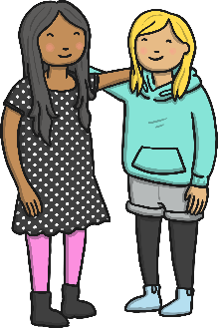



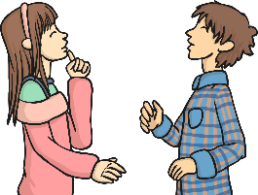
Lesson 3 – adding ing.
All of these words are things you can do.
These ‘doing’ words are called verbs. They describe an action.
Can you think of any more ‘doing’ words?
Act out the action and see if your partner can guess the word.
The second word in each pair has –ing added at the end.
How does this change the meaning of the word?
It tells us that the action is happening now.

Slide 10
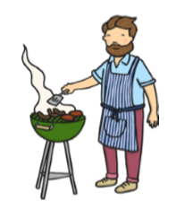
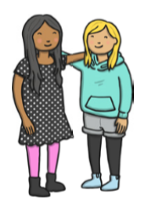



Lesson 3 – adding ing.
Can you add –ing to make a new word?
Write the new word on a piece of paper. You could draw a picture too ☺
cook
meet
fly
go
see
read

Slide 11
Lesson 3 – adding ing.
Answers. Did you spell the –ing words correctly?
cooking
meeting
flying
going
seeing
reading

Slide 12

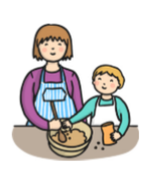

Lesson 3 – adding ing.
Can you choose the correct word to fill the gaps?
Jess is ________________ .
cry crying
Ted likes to ________________ .
help helping
The bee is ________________ .
buzz buzzing

Slide 13
ANSWERS
Lesson 3 – adding ing.
Can you choose the correct word to fill the gaps?
Jess is ________________ .
crying
cry crying
Ted likes to ________________ .
help
help helping
The bee is ________________ .
buzzing
buzz buzzing

Slide 14
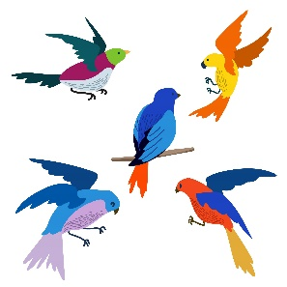
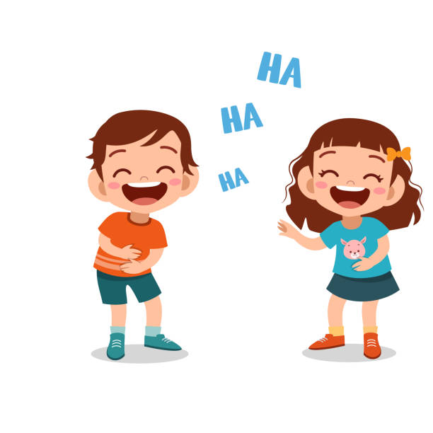

Lesson 4 – Collecting ideas.
Today we would like you go to on a Listening Walk. You could go into the garden, go for a walk in your local area, or even listen out of a window at home!
Have a look at the things around you. What are they doing? What noise are they making? You might even want to close your eyes! This can help us notice the sounds of things we can’t see.
You could make a list, draws some pictures or take photographs/ videos of the sounds you collect.
Examples:
birds tweeting
children giggling
wind howling

Slide 15



Lesson 5 – Writing a poem.
Using your ideas you collected on your listening walk, we would like you to have a go at writing your own verse for a poem.
You can use the structure of the ‘Noises Off’ poem to help you.
Remember:
capital letters
finger spaces
illustration
Can you write your own sentence using a singular word for a friend to correct?

Slide 16
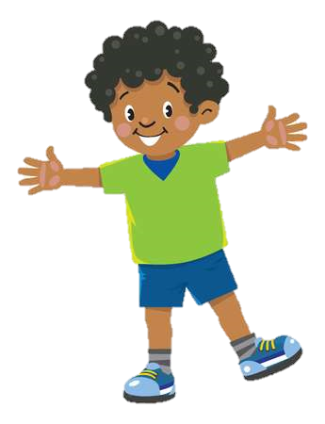
Lesson 6 – Reading for pleasure and meaning.
Here is another verse from the poem. Read it with your grown-up. Afterwards, draw a picture to go with the poem. Try to include all of the things mentioned!
The Kitchen’s full of Noises
Taps are dripping,
Cupboards banging,
Kettle boiling,
Pans clanging,
Chairs scraping,
Cups cracking,
Cutlery clinking,
Plates stacking.
Discuss the meaning of any new words you come across!

Slide 17
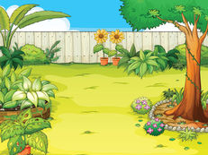
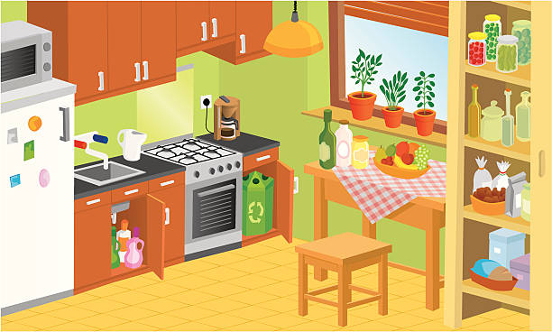
Lesson 7 – Sorting verbs.
Think back to the sounds you heard in your garden and the kitchen sounds from the poem. Sort the doing words into the setting where you would be most likely to hear the sound.
glasses clinking
birds tweeting
pans crashing
leaves rustling
mouths munching
wind blowing
toaster popping
horns honking

Slide 18
ANSWERS
Lesson 7 – Sorting verbs
garden
kitchen
birds tweeting
glasses clinking
leaves rustling
pans crashing
wind blowing
mouths munching
horns honking
toaster popping

Slide 19
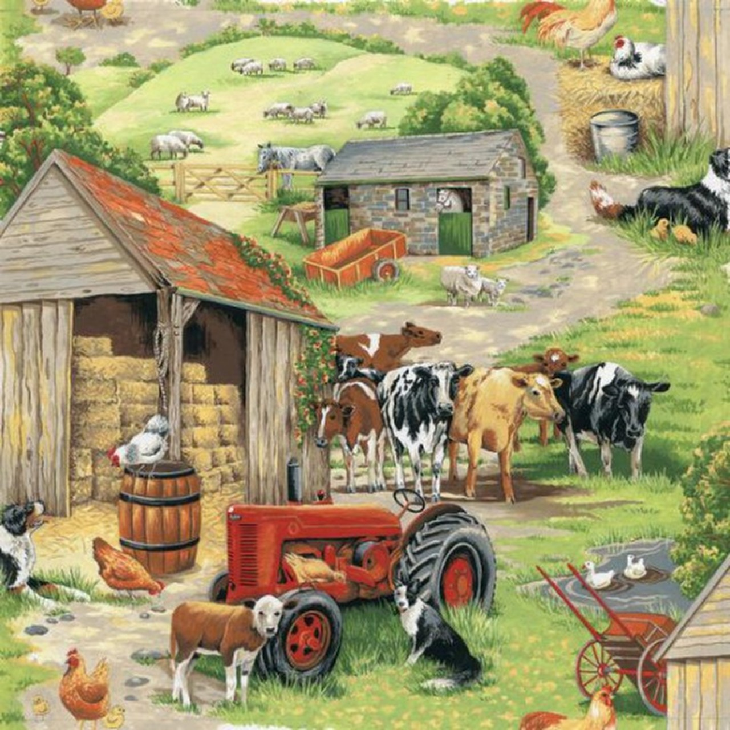
Lessons 8 – Collecting ideas.
We are going to write the next verse of our poem about a farmyard. Today we are going to gather our ideas ready for writing this verse. Make a list (with words or drawings) of all the sounds you would be able to hear at a farm, using the picture clues to help you.

Slide 20
Lesson 8 – Collecting ideas
Here are some of the ideas we came up with! You might have thought of others too ☺
chickens clucking
gate creaking
cows mooing
tractor rumbling
dogs barking

Slide 21
Lesson 9 – Writing a poem.
Using your farmyard ideas you came up with yesterday, we would like you to have a go at writing another verse for your poem.
You can use the structure of the ‘Noises Off’ poem to help you.
Remember:
capital letters
finger spaces
illustration
Can you write your own sentence using a singular word for a friend to correct?

Slide 22
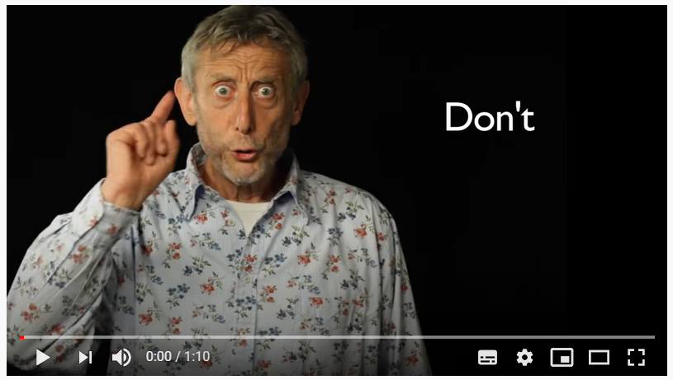
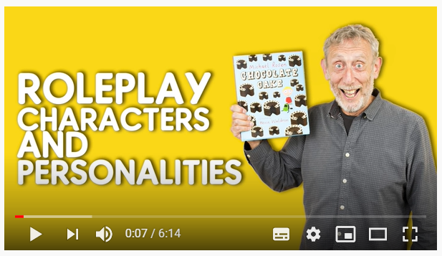
Lesson 10 – Performance.
Now that you have written two verses of your poem, it is time to perform it. First, watch Michael Rosen performing and think about what makes him so fun to watch! Then watch Michael’s top tips video ☺
1
2
https://www.youtube.com/watch?v=Oaq3gzswei0
https://www.youtube.com/watch?v=RvV23xoZRkI&t=172s

Slide 23
The most important tips for our poem performances are:
Change your volume
Emphasise certain words
Change your speed
Add sound effects
Use actions
Be enthusiastic
Be silly!
Practise saying each line clearly, until you have learnt the words. Remember to face your audience!
Show your performance to your grown ups and brothers and sisters. You could send a video of it to other family members and friends!

Slide 24
If you have had a go at some or all of the tasks…
Well done!
We are really proud of you.
Have a lovely weekend with your family.

