Slide 1
Year 1
Reading and Writing
Week 3 and Week 4
4/5/20 – 7/5/20

Slide 2
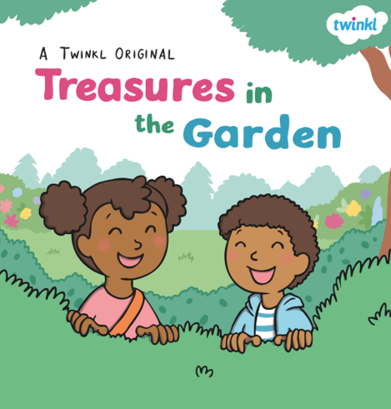
Hello Year 1!
We hope you had fun making your sandwiches last week ☺
This PowerPoint includes nine sessions for you to complete over the next two weeks.
Our learning is going to be based on the story ‘Treasures in the Garden’

Slide 3

Lesson 1
Reading for pleasure and reading for meaning.
Share the story ‘Treasures in the Garden’ with your grown-up.
You may want to read the story yourself or your grown-up could read it to you (or share the reading ☺)
This is Little Miss Curious. She is interested in everything and likes to ask questions! During reading look out for Little Miss Curious and discuss the answers to her questions with your grown-up.
The story is saved in a separate PowerPoint which you will find in the Year 1 Reading and Writing folder online ☺

Slide 4

Lesson 1
Reading for pleasure and reading for meaning.
We hope you enjoyed reading the story ☺
Jake and Holly found lots of treasures in their garden.
Can you make a list of all the things they found?
Look back at the story to help you. There are six altogether ☺

Slide 5
Lesson 2 – Sequencing a story.
Reread ‘Treasures in the Garden’ with your grown-up.
Rereading helps us build our reading confidence and reading fluency.
If you shared the reading last time, try reading more yourself this time ☺
Look on the next slide for the activity ☺

Slide 6
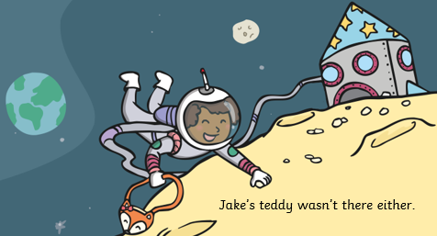
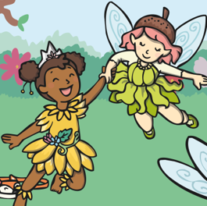
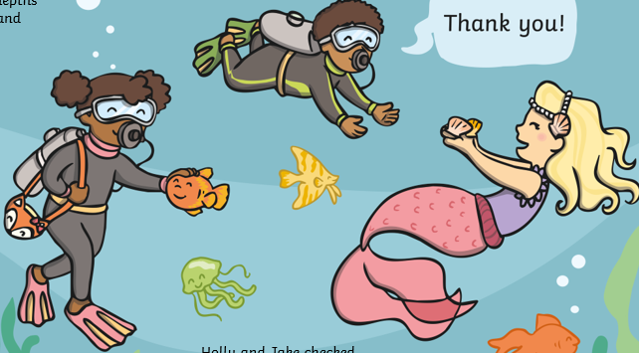
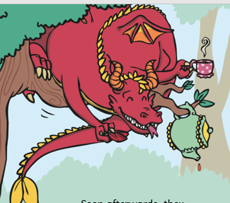
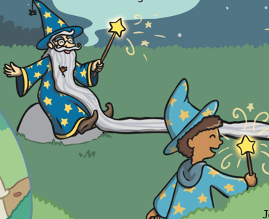
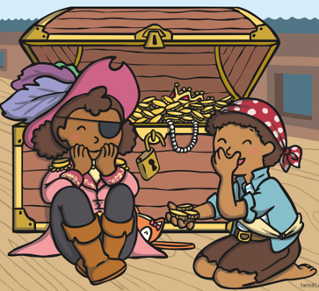
Lesson 2 - Sequencing a story.
Jake and Holly pretend to visit six different places in their garden. Can you remember where they visit first? Next?
Have a go at numbering the pictures 1-6 as they appear in the story.
They travelled into space and landed on the moon.
The deepest depths of the sea.
An enchanted forest.
A tall, green tree.
A dark, creepy wood.
A huge pirate ship.

Slide 7
Lesson 2 - Sequencing a story.
Here are the answers. Did you order the pictures correctly?
1. The deepest depths of the sea.
3. They travelled into space and landed on the moon.
2. A huge pirate ship.
4. A tall, green tree.
5. A dark, creepy wood.
6. An enchanted forest.

Slide 8
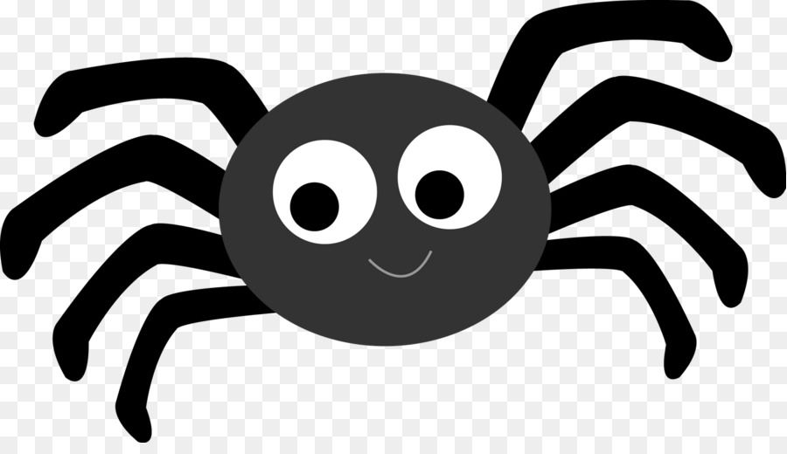
Lesson 3 – Adjectives.
An adjective is a describing word.
They provide more detail about someone or something. For example…
There was a spider in the bathroom.
There was a huge, hairy spider in the bathroom.

Slide 9
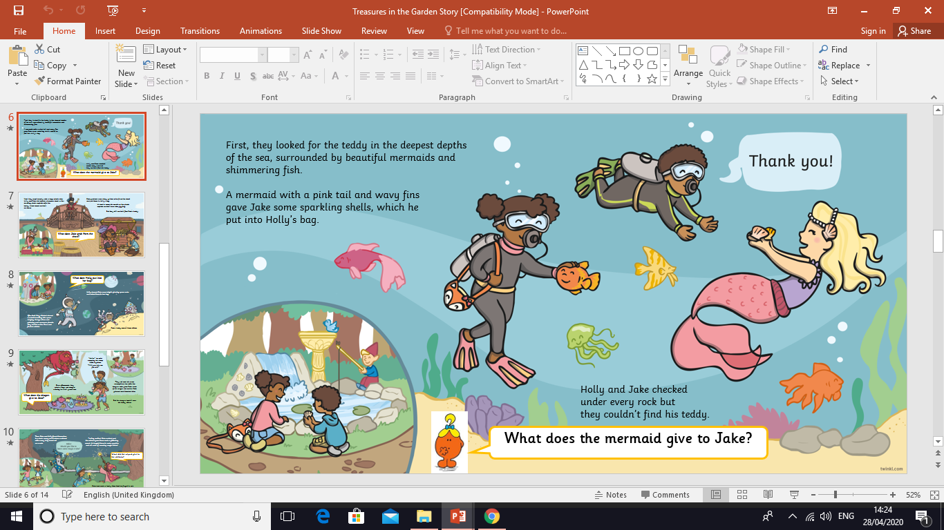
Lesson 3 – Adjectives.
There are lots of lovely adjectives in the story ‘Treasures in the Garden’. We’ve circled some for you to read.
Can you spot the three adjectives in this sentence?
Answers are on the next page ☺

Slide 10
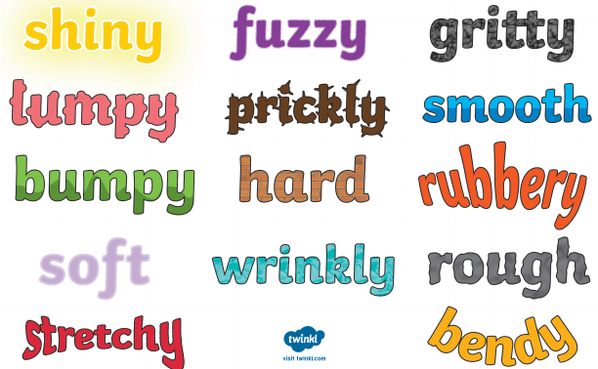
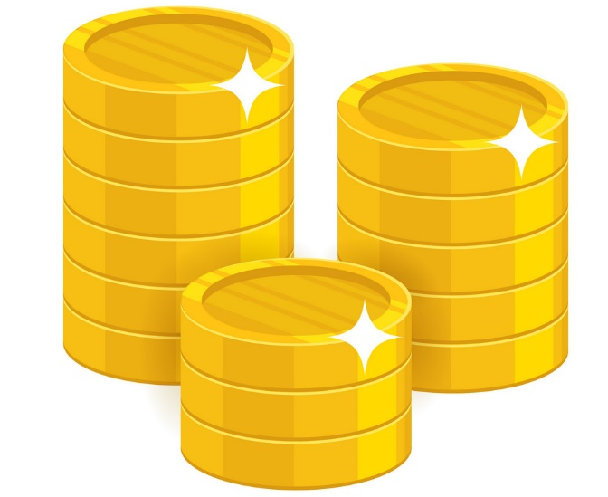
Lesson 3 – Adjectives.
Answers:
Which of these adjectives would you use to describe these coins?

Slide 11
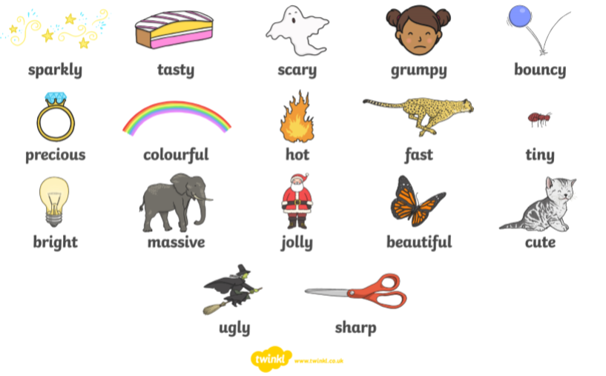
Lesson 4 – Adjectives.
The words below are all adjectives.
They could be used to describe someone or something.
?
Can you think of three things you would describe as ‘beautiful’?

Slide 12
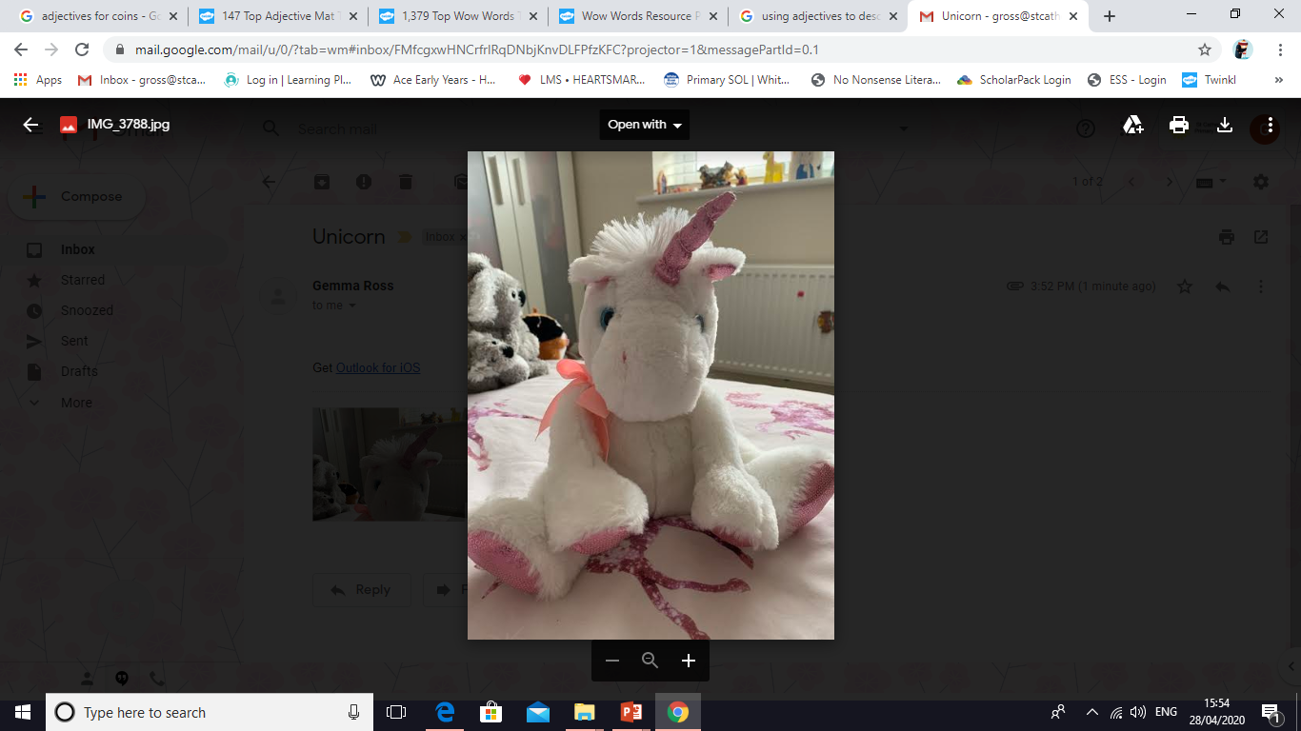
Lesson 4 – Adjectives.
Choose something in your house to describe. This could be a toy or an item of clothing. Draw a picture of it and write as many adjectives as you can around the outside. You could use the adjectives on the previous slide to help you.
This is Mrs Ross’s unicorn teddy ☺
sparkly
fluffy
pink
glittery
cute
white
soft
smooth
round
cuddly
What does it look like? How does it feel? Does it make a noise? Does it smell of anything?
special

Slide 13

Lesson 5 – Writing sentences.
Let’s have a go at using these adjectives to write sentences about
our chosen object. Remember to say your sentence before you write it.
For example…
My unicorn is called Candyfloss. She has a glittery horn. She has a soft, fluffy body. Her eyes are sparkly. I like to cuddle her in bed.
Grown-ups: Please simplify the task if you need to. Simple sentences are great too. For example…
It is pink.
It is soft.
Challenge: Try extending your sentences with ‘and’. For example…
Woody is a cowboy. He has a yellow shirt and a red neckerchief.

Slide 14
Lesson 6 – Reading a description.
Carefully read the passage below. Have a go at drawing what is described. Look out for the adjectives. These will help you add detail to your picture.
I am at the bottom of the deep, blue sea.
I can see a friendly mermaid with a pink, shimmering tail and long, wavy hair. She is holding two sparkly shells. There are colourful fish swimming around. I can see seaweed swaying in the water and a few rocks scattered on the seabed.

Slide 15
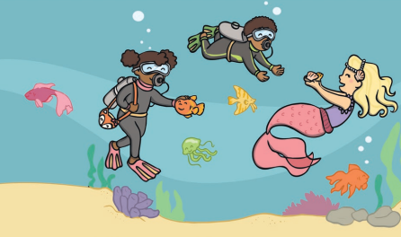
Lesson 6 – Reading a description.
Did you recognise the place that was described on the last slide?
It was the deep, blue ocean from the story. ☺

Slide 16
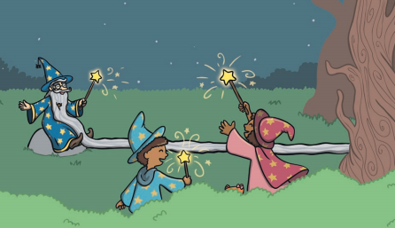
Lesson 7 – Choosing adjectives.
In the story Jake and Holly visit the wizard in the forest. Which adjectives would you use in the sentences below?
Copy the sentences onto paper and add your own adjectives.
I am holding a _____________ wand.
I can see a ___________ forest.
The wizard is wearing a _________ hat.

Slide 17
Lesson 7 – Choosing adjectives.
Here are some examples:
I am holding a sparkly wand.
I can see a gloomy forest.
The wizard is wearing a pointy hat.

Slide 18
Lesson 8 – Writing sentences.
Let’s have a go at writing sentences about one of the places in the story. Imagine you are Jake or Holly and you have just arrived.
On the next two slides you will find two places to choose from. Pick just one of these to write about.
Each page provides some helpful words and ideas for writing. ☺
Grown-ups: Please simplify this task if you need to. Simple sentences are great too. For example…
I can see a pirate.
I can see the sea.
Challenge: If you feel your child is ready for a challenge, encourage them to use adjectives in their sentences. For example…
The fairies have glittery wings.

Slide 19
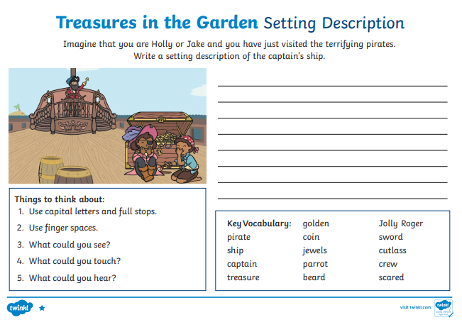
Lesson 8 – Writing sentences.

Slide 20
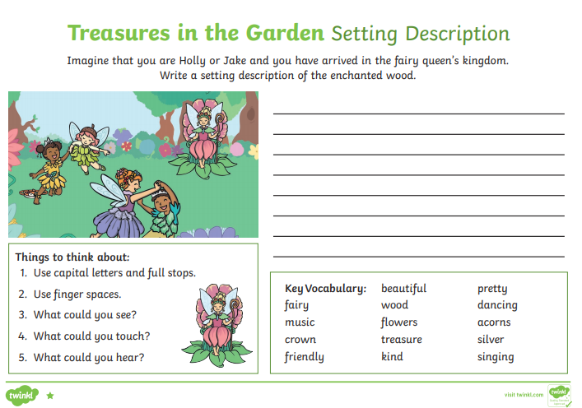
Lesson 8 – Writing sentences.

Slide 21
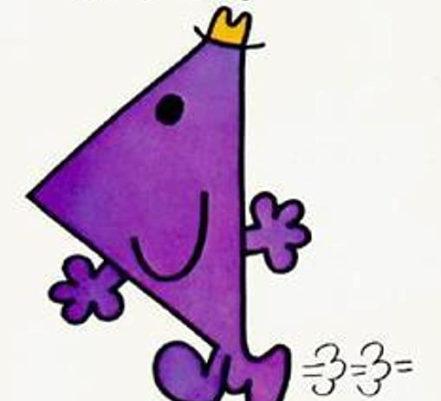
Lesson 9 – Improving sentences.
Do you remember Mr Rush? He had a go at writing sentences too, but accidentally missed some important things!
Help Mr Rush improve his sentences. Each sentence has two mistakes. Can you find them?
Look carefully at the capital letters, full stops, finger spaces and spellings!

Slide 22
Lesson 9
Each sentence has two mistakes.
Can you find them?
The fairies ar dancing around the beautiful flowers
the fairy queen has silver wings anda colourful headband.
i can hear wonderful music playin in the background.
Thay gave me a twinkling crown

Slide 23
Lesson 9
Did you spot the mistakes? Here are the answers:
The fairies are dancing around the beautiful flowers.
The fairy queen has silver wings and a colourful headband.
I can hear wonderful music playing in the background.
They gave me a twinkling crown.
Now take a look at your piece of writing. Is there anything you could improve on?

Slide 24
If you have had a go at some or all of the tasks…
Well done!
We are really proud of you.
Have a lovely weekend with your family.

