Slide 1
PE
When we are in school we would normally have a weekly PE session. Since you have been at home, we know lots of you are beginning the day with the Joe Wicks workout, as well as doing some other form of daily exercise. This is great and helps keep our bodies and minds healthy!
From now on, we will plan to include one PE session a week in our work packs. We will be using the REAL PE resource to support this.

Slide 2
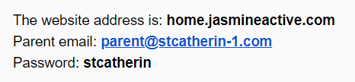
REAL PE
To access the PE lesson, you will need to log in to the website below.

Slide 3
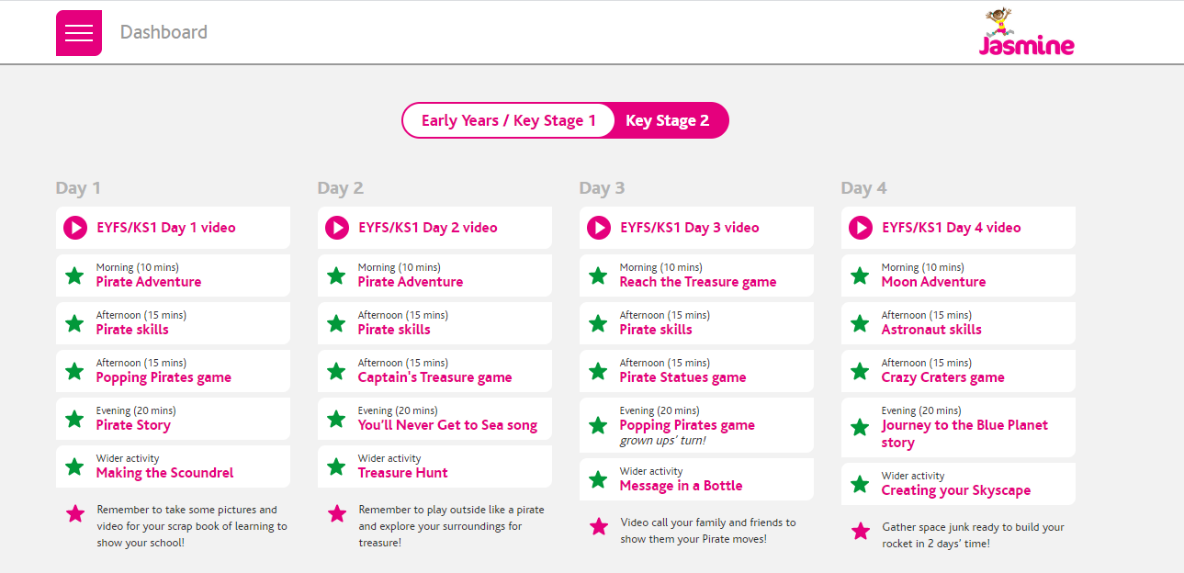
Once you are logged in, you will see this screen.
Make sure you are following Key Stage 1

Slide 4
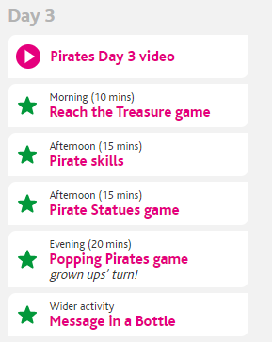
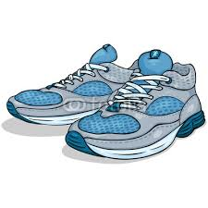
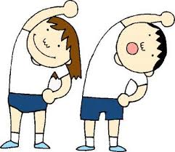
PE session for wc 18.5.20
Start by watching the video clip. This will set the scene for today’s activities.
Remember to wear appropriate clothing and footwear, just like we would in school!

Slide 5
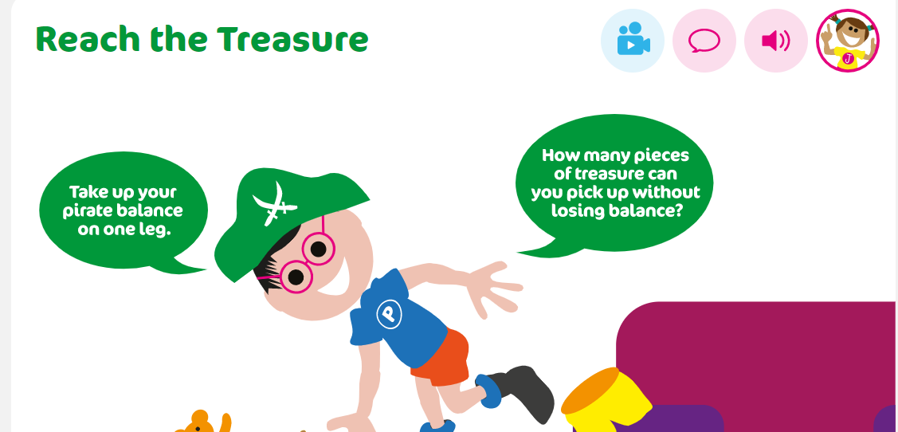
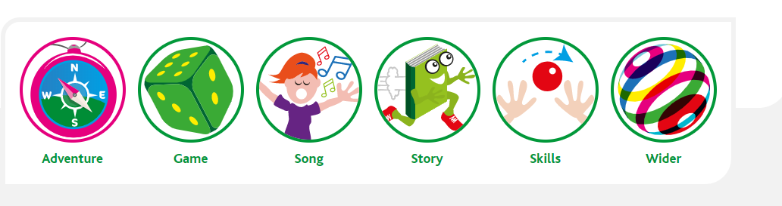
Dashboard Screen
After the video, click on ‘Reach the Treasure game’ to get started!
These icons will appear at the bottom of the page. You can use them to navigate through the lesson.
Or you can return to the ‘dashboard’ screen and click on the next section here.

Slide 6
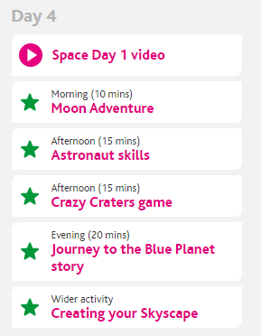
PE session for wc 1.6.20
Start by watching the video clip. This will set the scene for today’s activities.
Remember to wear appropriate clothing and footwear, just like we would in school!

Slide 7
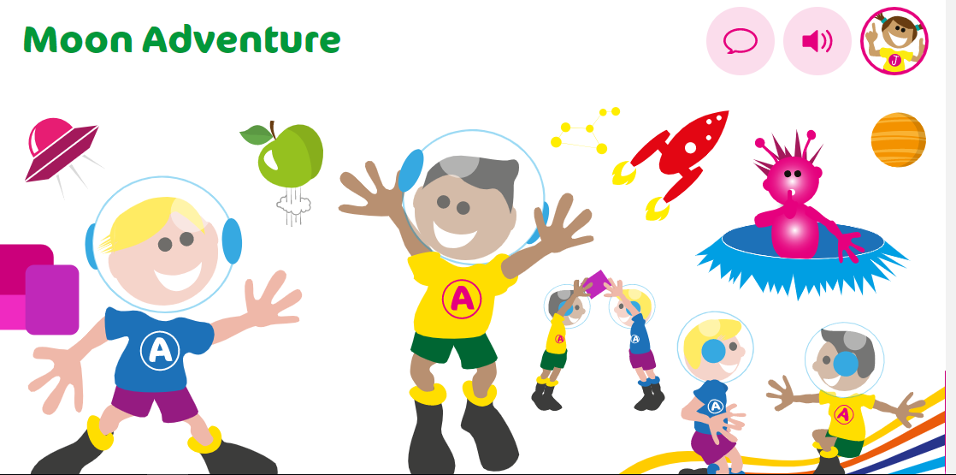
Dashboard Screen
After the video, click on the Moon adventure to get started!
These icons will appear at the bottom of the page. You can use them to navigate through the lesson.
Or you can return to the ‘dashboard’ screen and click on the next section here.

